Slide 1
The European AI-on-Demand Platform for AI Researchers
Iraklis Klampanos
NCSR “Demokritos”
(on behalf of the AI4Europe team)
25 July 2024
ESSAI & ACAI 2024
Athens, Greece

Slide 2
The European AI-on-Demand Platform for Research

Slide 3
Overview
History and ecosystem
Objectives & priorities
Tools and services
Exploring existing and future tools
Discussion and feedback

Slide 4



The European AI-on-Demand Platform
An unbiased, open and cooperative platform from and for the European AI research community
Services ranging from data access, services and tools to cooperation with other researchers.
2022
2024

Slide 5
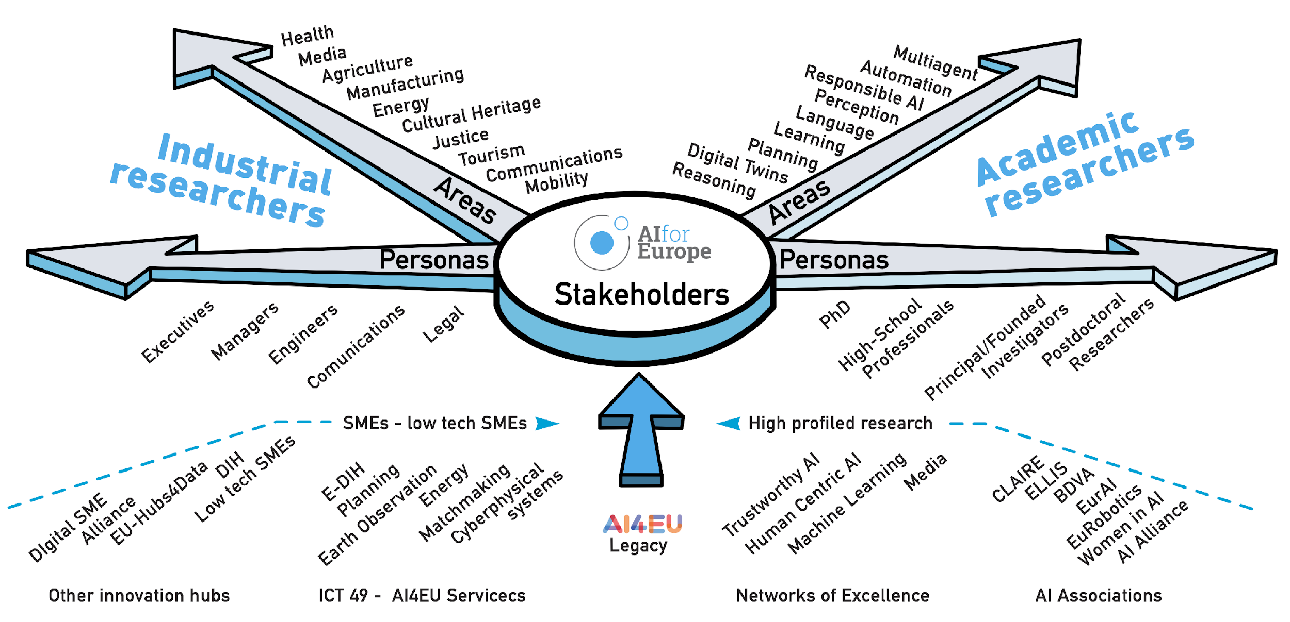
Target Users

Slide 6
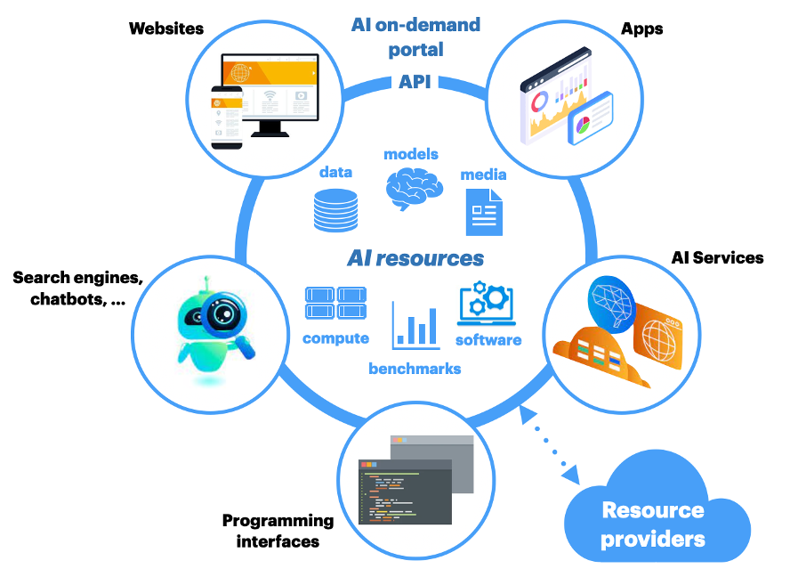

Slide 7
Open Science
FAIR: Findable, Accessible, Interoperable and Reusable
Findable:
Methods, models, datasets, etc. catalogued with appropriate metadata
Accessible:
Direct path to accessing resources
In academic research, typically freely accessible
Interoperable:
Assets should be usable across applications and infrastructures
Reusable/reproducible:
Self assessment, data provenance/lineage, benchmarking
Higher-level abstractions - Workflows, Python notebooks, etc.

Slide 8
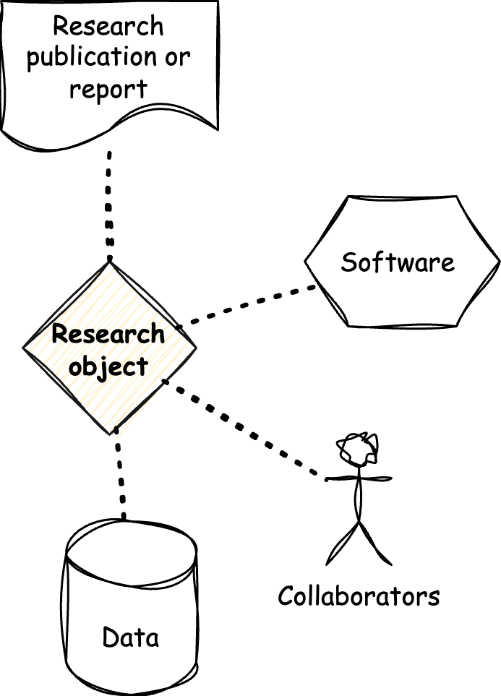
Research objects
Digital representation of all the components of a research project
  Data, software, workflows, protocols, publications, etc.
Designed to make research more transparent, reproducible, and reusable
  Easier for others to understand how the research was conducted and to replicate the results
Research objects can be shared and cited, just like traditional publications
  Attribution and reuse of ROs

Slide 9






(A few) European and global initiatives for Open Science

Slide 10
Traditional data-driven science Vs. AI
Traditional sciences computational research, e.g. material sciences, geosciences, etc.
Hardware well understood and established - e.g. HPC
Research institutes and University-driven
Links with industry more stable and predictable
  not always obvious or motivated by the market
Open Science has long been in the agenda
AI research is very fast paced
Optimised for specific types of HW
Parts of it quickly moves to or originates in industry
Links with market typically more obvious
Open Science is more fragmented

Slide 11
Exploration

Slide 12
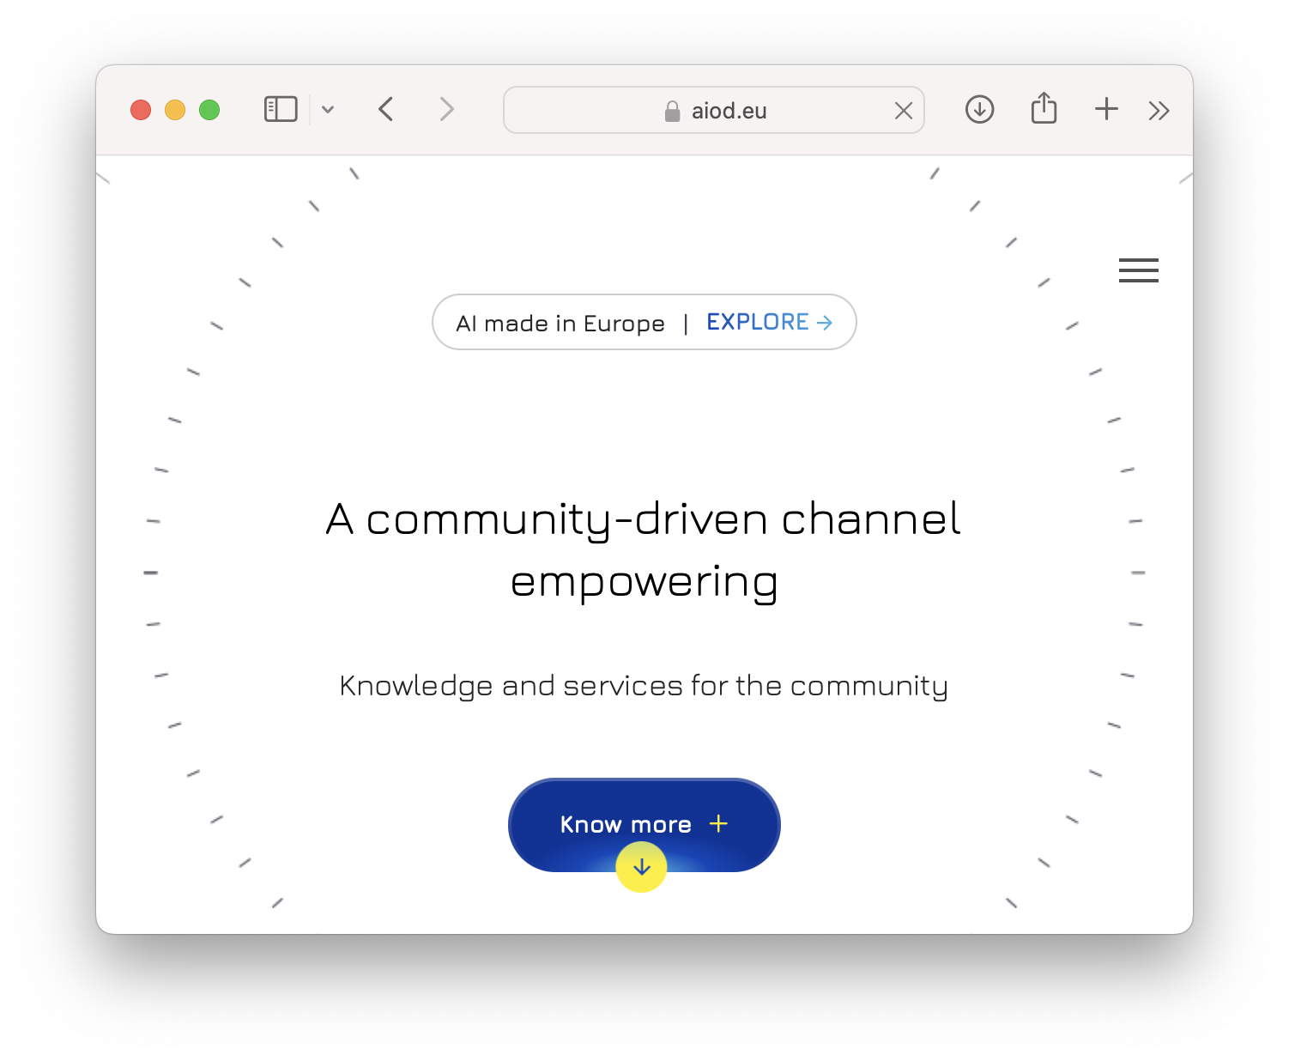
The AIoD Portal for Research

Slide 13
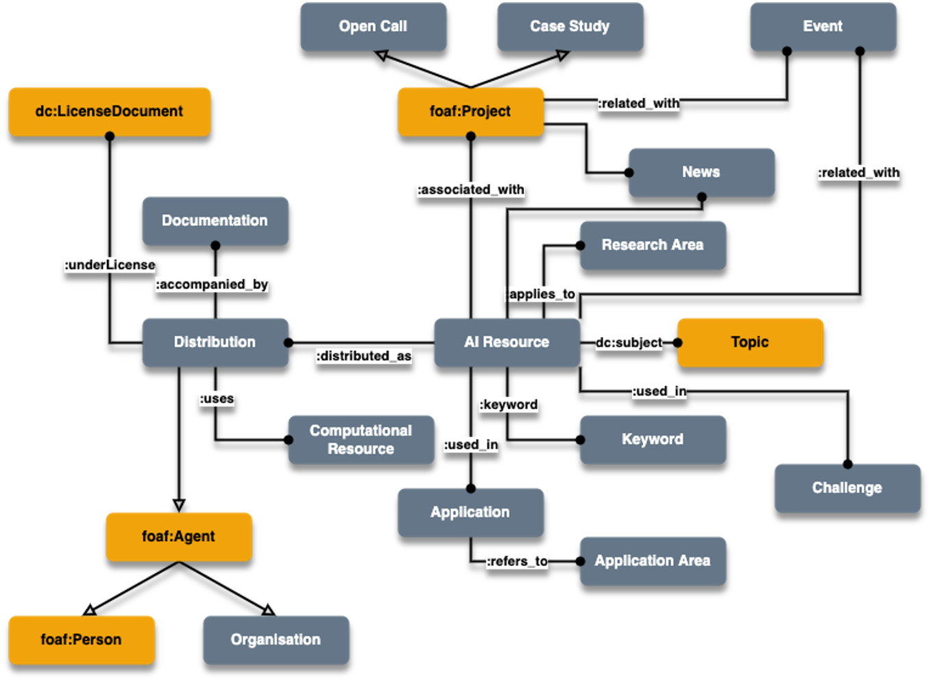
The AI Conceptual Model

Slide 14
Open AI Metadata Catalogue
API based component.
Comprehensive Resource Management
  Listing, updating, and retrieving resources like datasets, ML models, and publications.
  Supports onboarding of new resources and updating existing ones.
Over 500K+ resources available for AI projects.
Integrated with top platforms like Hugging Face and Zenodo.
Advanced search capabilities enabling quick access to necessary resources.
Available at: https://aiod.i3a.es/docs

Slide 15
RAIL
Create and run experiments that make use of assets that are available at the AIoD platform.
Experiments are meant to be reproducible and reusable from other users.
Integrating with REANA, a workflow execution system based on the Common Workflow Language (CWL) specification, by CERN.
Accessible both from web interface and Python SDK.

Slide 16
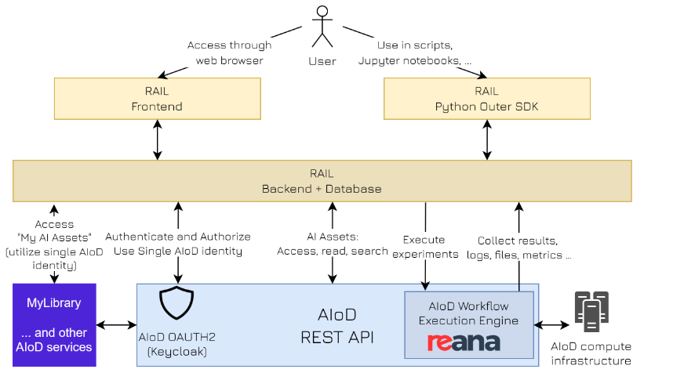
RAIL

Slide 17
ReProv
Data provenance for reproducibility
Following https://www.w3.org/TR/prov-o/ standard for provenance
CWL workflows are currently supported.
Provide direct reference into AIoD assets.
Ensures traceability of AI Assets throughout the development process.
Accessible through API or Python SDK.

Slide 18
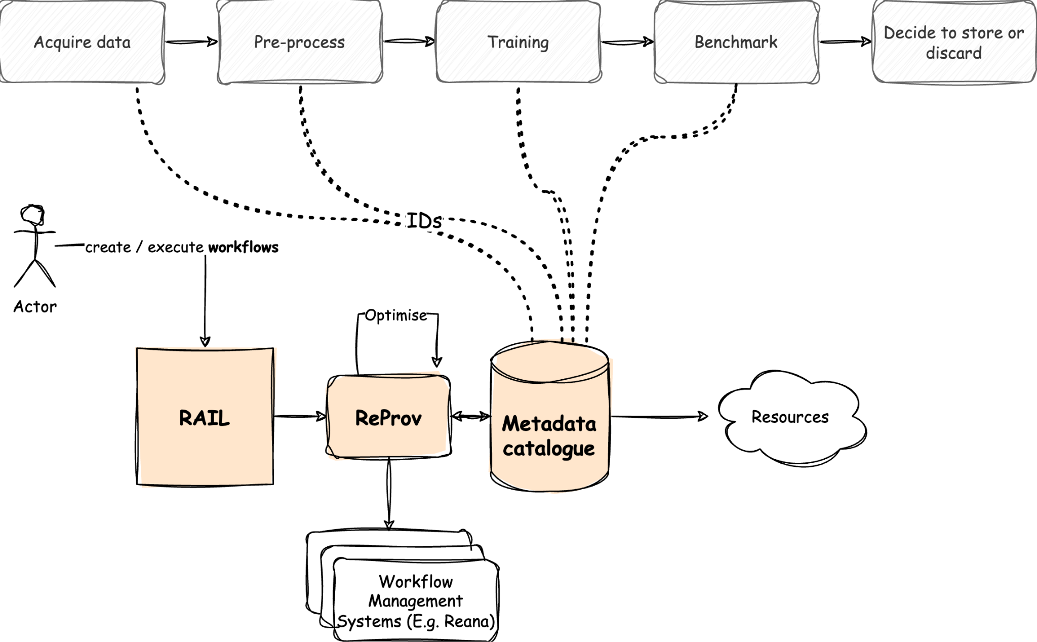
ReProv Overview

Slide 19
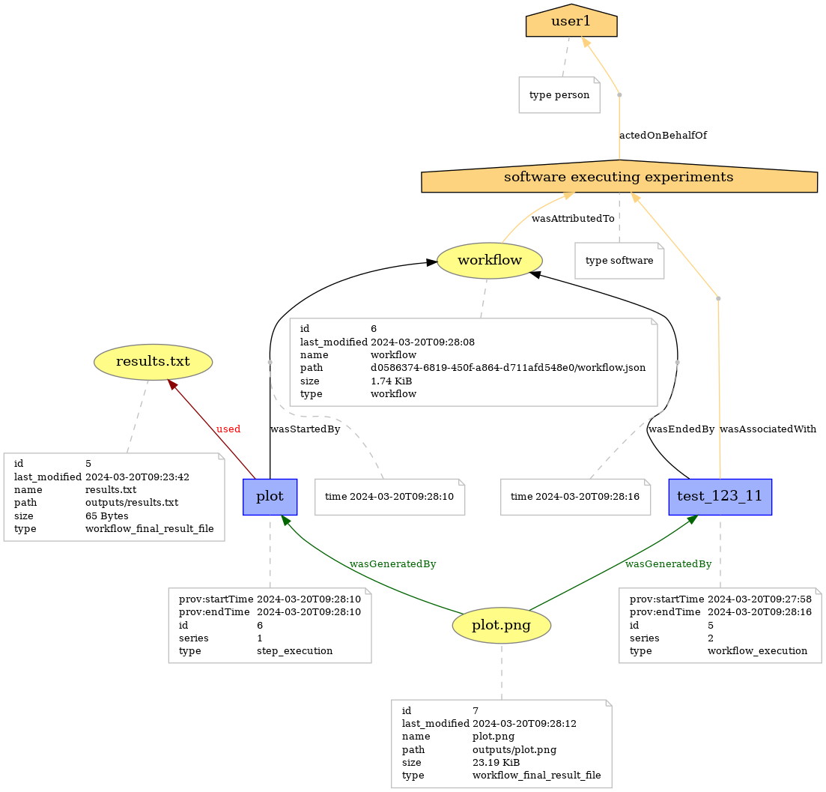
ReProv

Slide 20
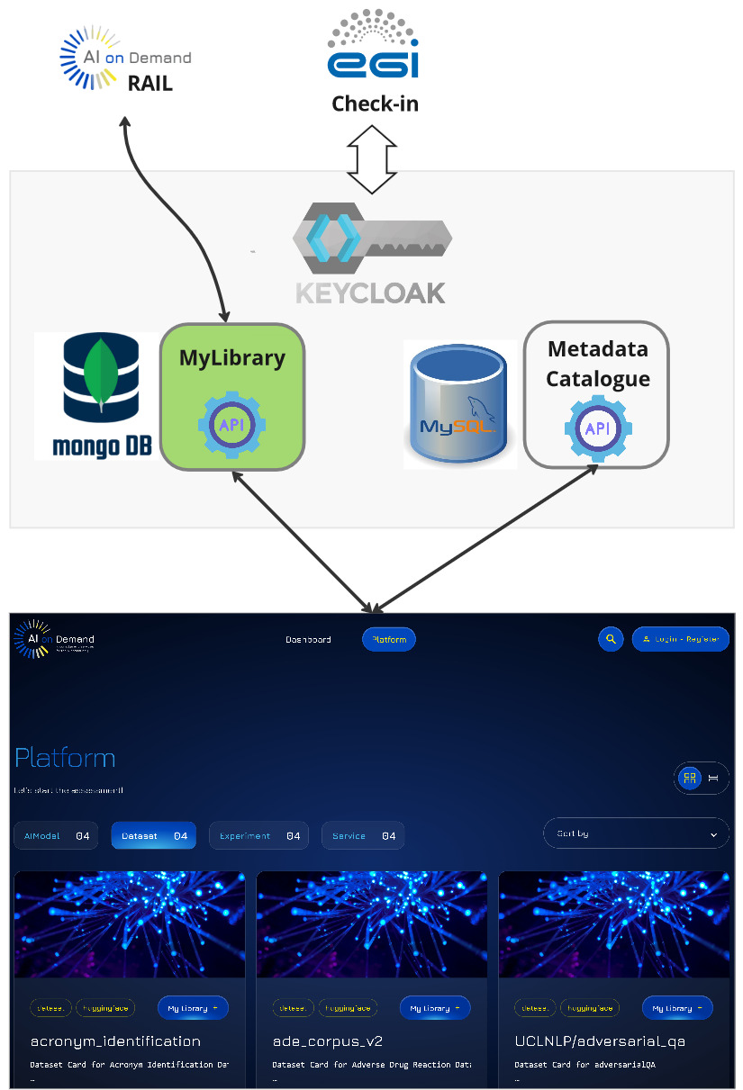
MyLibrary
Website that allows users to explore AIoD AI assets from Metadata Catalogue DB (public and private access)
Select and add to a Personal Library (private access)
Personal Library can be shared with other services like RAIL and ReProv

Slide 21
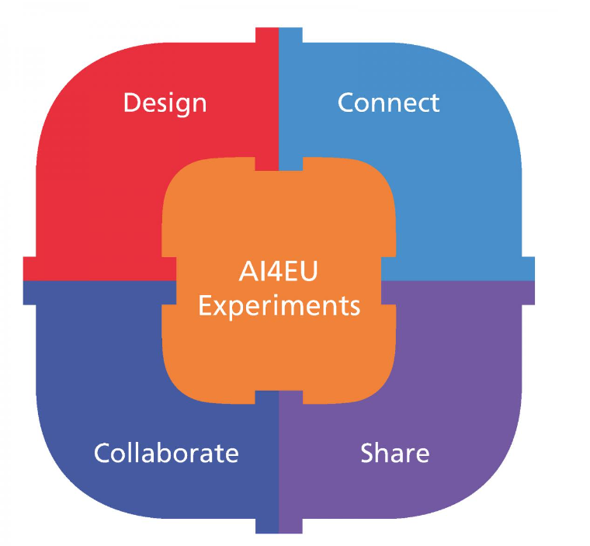
AI Builder
Design AI pipelines using a visual editor, connect the building blocks, share your solution and collaborate with other developers.
Collaborate
  Create groups for working together on building AI pipelines
  AIoD platform facilitates knowledge transfer.
Share your solutions
  Once your solution is ready, we recommend on-boarding it as a containerized microservices (Docker container).
Build hybrid AI-solutions
  When building your pipeline, you can choose from the re-usable, existing building blocks
  Hybrid solutions combine different AI technologies, for example classic Machine Learning with symbolic AI, reasoning or constraint programming.

Slide 22
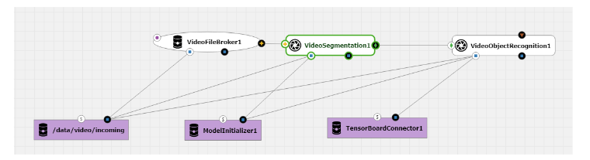
AI Builder Example
The figure demonstrates the process of designing a video pipeline on the design canvas of the visual editor.
The main building blocks of the solution are two models:
  video segmentation
  video object recognition
A video file broker manages the data input.
Pipeline is further enhanced by auxiliary infrastructure nodes depicted on a purple background:
  persistent volume provider on the left,
  model initializer
  tensor board connector, a tool for analyzing a model.

Slide 23
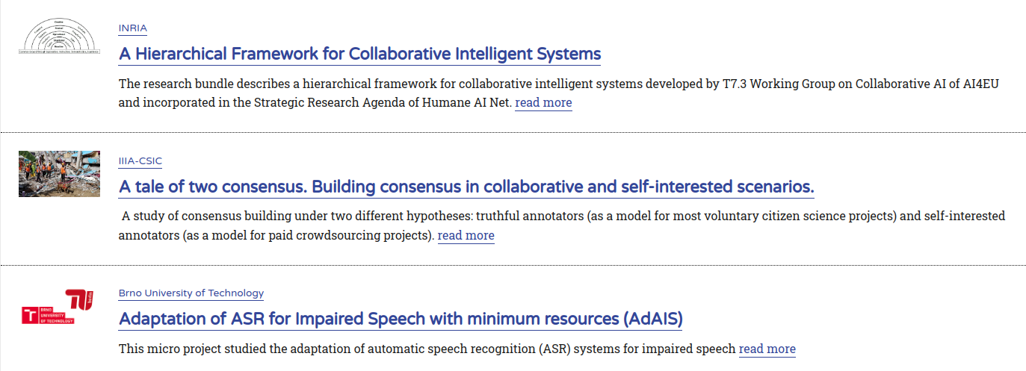
Research Bundles
Web page where you can collect and publish the outputs of a small research project in a compact way.
Collects in a single place all the assets for you project:
  code
  datasets
  tutorials
  examples
Supports external links to assets published elsewhere, like Github or Zenodo.
Available at https://www.ai4europe.eu/research/research-bundles/

Slide 24
Resources
AIoD website: https://aiod.eu
GitHub: https://github.com/aiondemand

Slide 25
Discussion & Feedback

Slide 26
Open Discussion

Slide 27

AIoD Usability and Accessibility Feedback
After exploring the AIOD website and services, please fill in the following questionnaire:
https://forms.gle/Ew6yzGUUp27DZC187

Slide 28


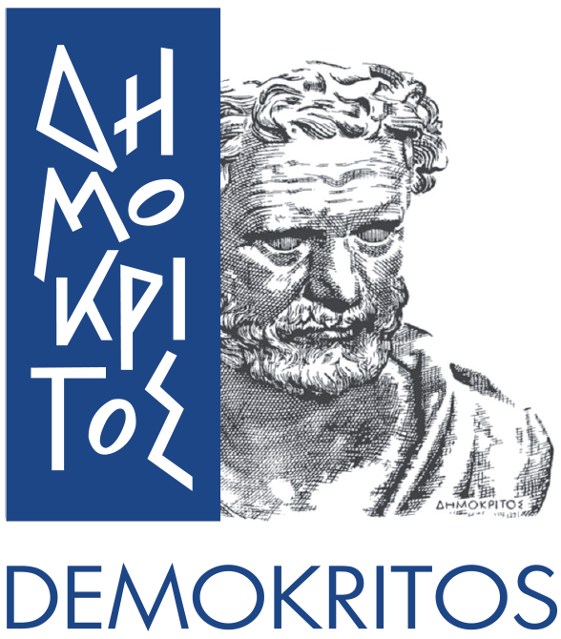





















Consortium

