Slide 1
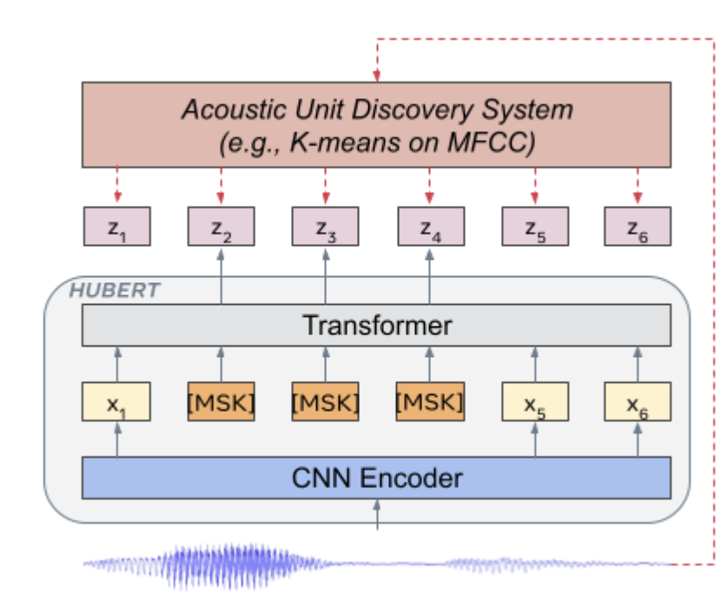
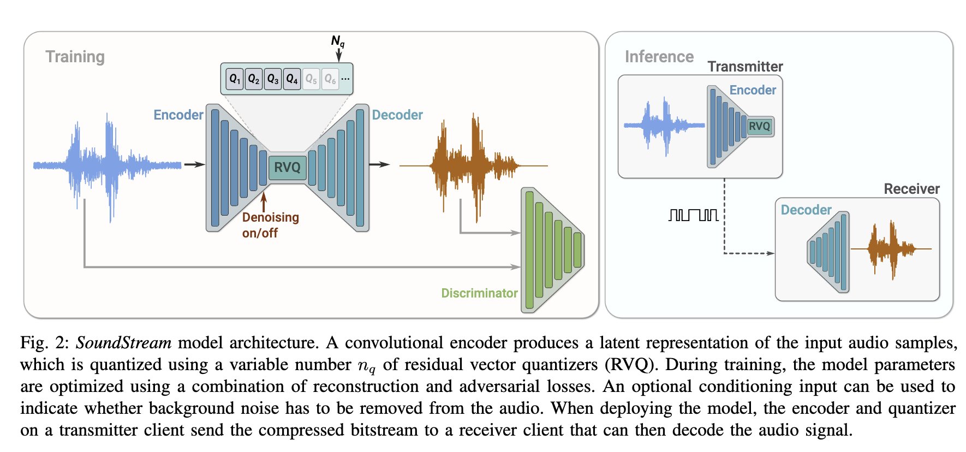
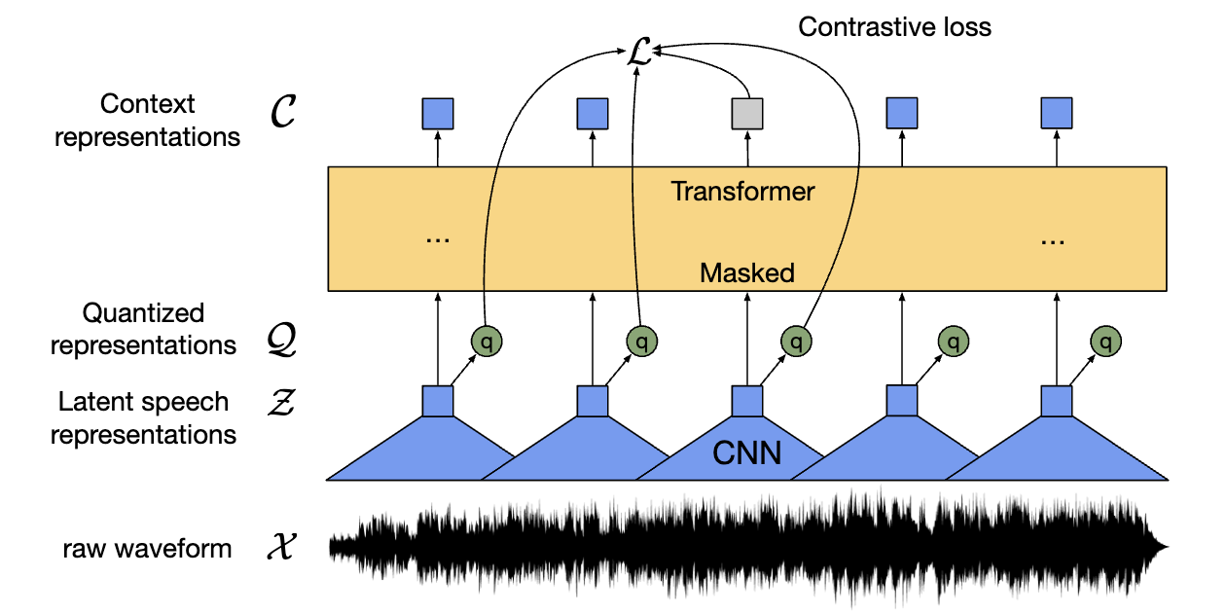
Advancements in self-supervised learning for speech technologies
ESSAI & ACAI 2024
18 July 2024
Themos Stafylakis
Assoc. Prof. at Athens Univ. of Economics and Business, Dpt. of Informatics
Head of Machine Learning at Omilia - Conversational Intelligence
Affiliated with “Archimedes”/Athena R.C. and Brno Univ. of Technology

Slide 2
Contents
Introduction to self-supervised speech modeling
Popular self-supervised models in speech and their taxonomy
The SUPERB challenge
From continuous representations to discrete speech units
Textless NLP and the Zero Resource Speech challenge
Speech continuation with discrete units
Text-to-Speech with discrete units
Synthetic speech detection

Slide 3
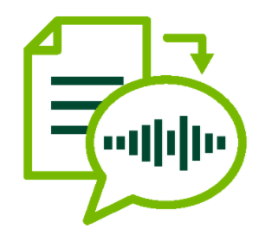

Introduction
The two most common speech applications
Automatic Speech Recognition (Speech-to-Text) Speech Synthesis (Text-to-Speech)
But there are a lot more….

Slide 4
Introduction
Other speech applications
Speech enhancement
Keyword Spotting (e.g. wake-word detection in Siri)
Synthetic speech detection (or speech-deepfake detection)
Speaker related:
  Recognition, Verification, Diarization, Separation, Target Speaker Extraction, Voice Conversion
  In fact, wake-word detection is a combination of Speaker Verification and Keyword Spotting.
Emotion recognition
Extraction of semantics
  Spoken language understanding directly from speech (e.g. intent recognition, slot filling)
  End-to-end speech-to-speech translation
Note: Audiovisual settings in virtually all the above

Slide 5
Introduction
Traditional ASR training and development pipeline
Say we want to train a ASR model (e.g. in Greek).
Let’s focus of the acoustic model, i.e. assume a language model can be created using text corpora.
We need to:
collect a massive training set (e.g. 100h) with multiple speakers (ideally >500),
annotate the training set (ground-truth transcript),
decide:
  the approach and loss (CTC, RNN-T, Enc-Dec),
  the architecture (convolutional, recurrent, transformer),
  the recognition units (phonemes, characters, subword units),
initialize from scratch a neural network,
start training…

Slide 6
Introduction
Traditional TTS training and development pipeline
Say we want to train a TTS model (e.g. in Greek).
We need to:
find a voice talent (someone with a nice voice),
create a corpus to collect about 24h recordings,
process the training set (e.g. for sanity check),
decide:
  the approach and loss (Enc-Dec, recurrent or non-recurrent),
  the architecture (convolutional, recurrent, transformer),
  the input units (phonemes, characters, subword units),
initialize from scratch a neural network,
start training…

Slide 7
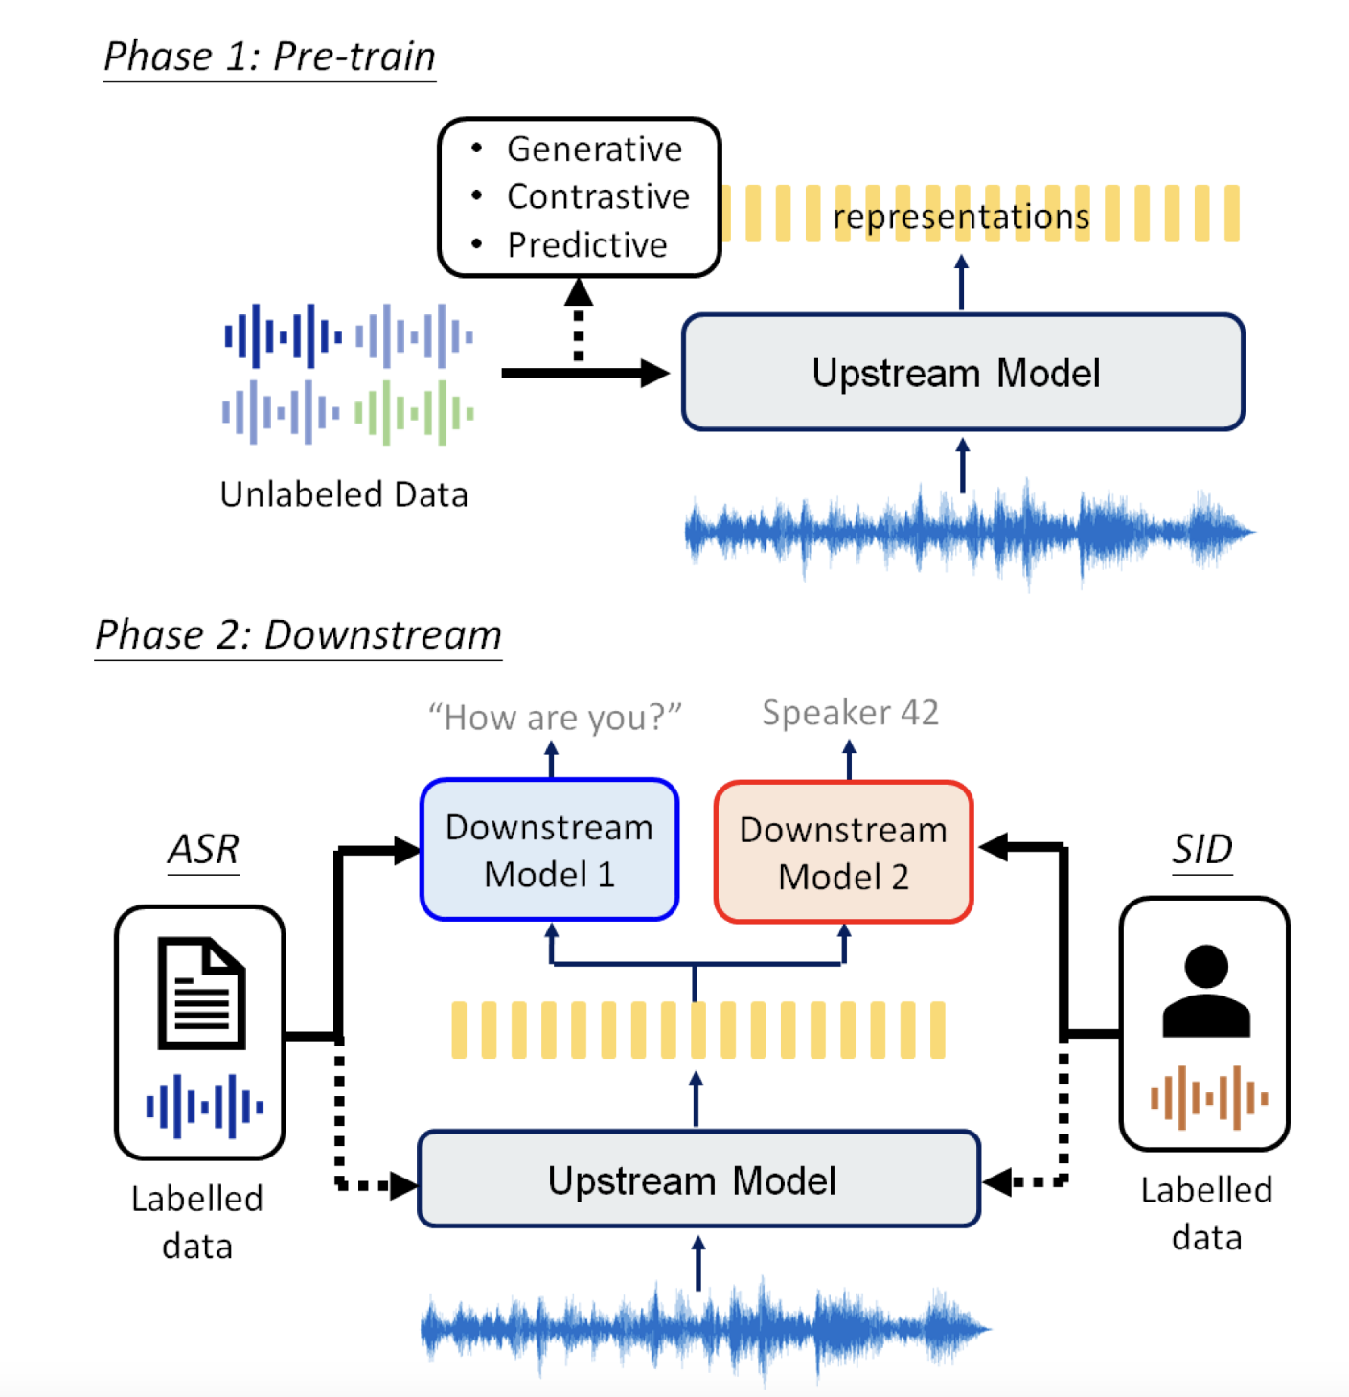
SSL models in speech applications
Mohamed, Abdelrahman, et al. "Self-supervised speech representation learning: A review." IEEE Journal of Selected Topics in Signal Processing 16.6 (2022): 1179-1210.

Slide 8
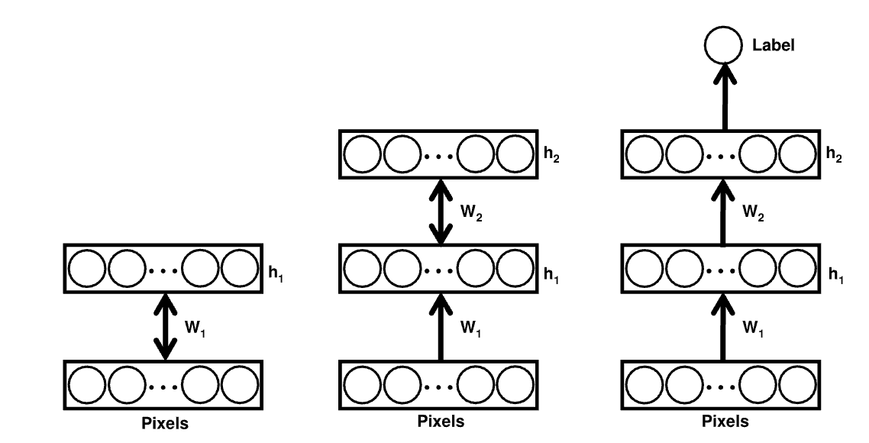
Deep learning and un-/self-supervised pretraining
Unsupervised pretraining is not something new in deep learning.
The first period of Deep Learning (2006-2012) was largely about unsupervised pretraining.
Examples:
  G. Hinton et al. Stacked Restricted Boltzmann Machines and Deep Belief Networks.
  Y. Bengio et al. Stacked denoising autoencoders.
However, they didn’t use this term SSL, while the training algorithm and losses were quite different than SSL ones.
Fig. Greedily pretraining two hidden layers of NReLUs as RBMs.
Nair, Vinod, and Geoffrey E. Hinton. "Rectified linear units improve restricted boltzmann machines." Proceedings of the 27th international conference on machine learning (ICML-10). 2010.

Slide 9

SSL in speech applications
Self-supervised pretraining
Pretrain a SSL architecture using lots of data
Define a self-supervised loss that requires no supervision (pretext task)
  e.g. no transcripts, no speaker or emotion labels, etc.
Self-supervision: the system learns to predict part of its input from other parts of its input.
Numerous such pretrained models can be found in HuggingFace, together with code to fine-tune them.
https://huggingface.co/docs/transformers/index

Slide 10
SSL in speech applications
Self-supervised finetuning
Fine-tune the SSL architecture on the downstream task using labeled data
  Add a classification head, and/or a CTC-loss, and/or a temporal pooling layer for speaker, emotion and in general utterance-level classification
Parameter-efficient fine-tuning (adapters):
  Freeze the parameters of the pretrained transformer, add a few parameters per layer and train only these.
https://huggingface.co/docs/transformers/index

Slide 11
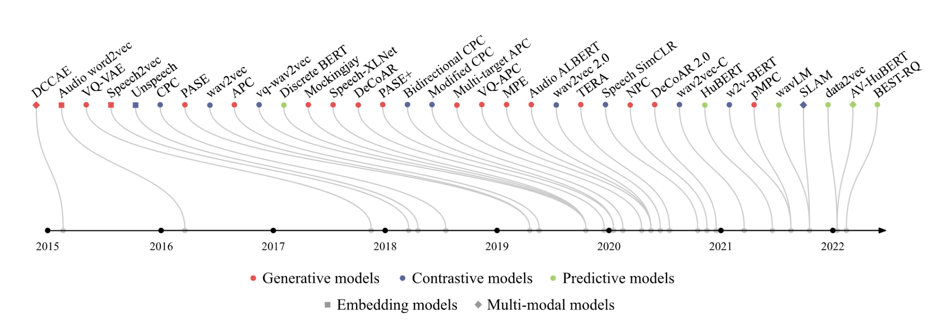
SSL speech models
Mohamed, Abdelrahman, et al. "Self-supervised speech representation learning: A review." IEEE Journal of Selected Topics in Signal Processing 16.6 (2022): 1179-1210.

Slide 12
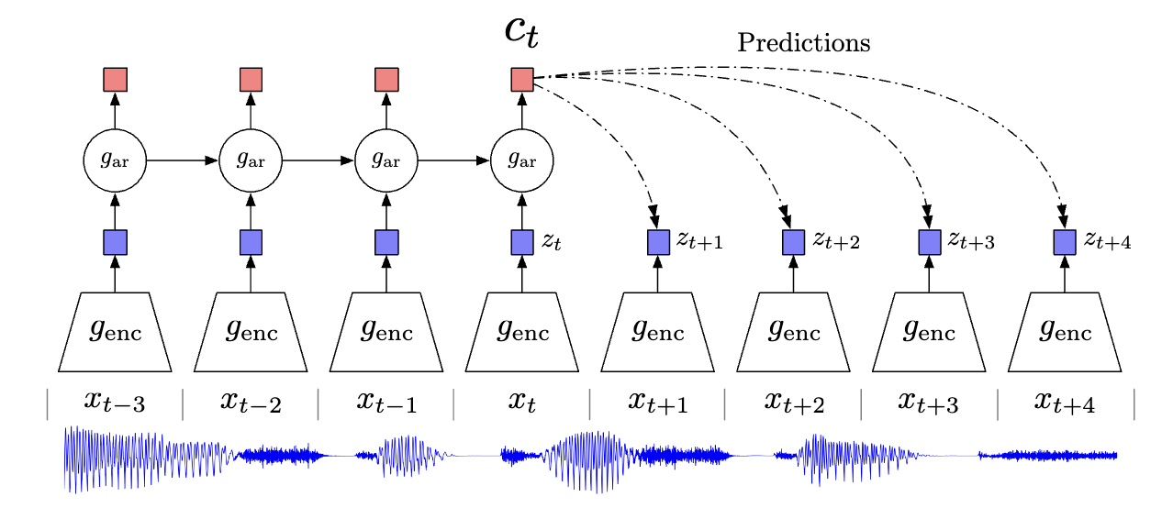
Contrastive self-supervised speech models
Contrastive Predictive Coding (CPC)
Aaron van den Oord, Yazhe Li, and Oriol Vinyals. Representation learning with contrastive predictive coding. In NeurIPS, 2018.

Slide 13
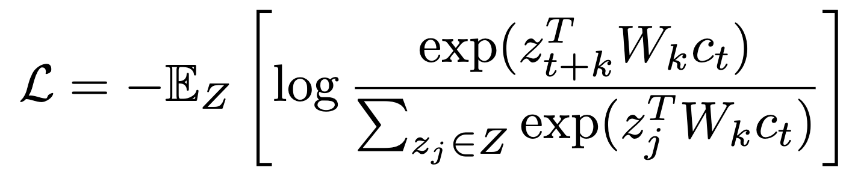
Contrastive self-supervised speech models
Contrastive Predictive Coding (CPC)
Convolutional Encoder
  Input: 1-D input @16KHz xt
  Output: 256-D frames @100Hz zt
Autoregressive model
  GRU with 256-D hidden size
  Produces context latent representations ct
Loss
  Noise Contrastive Estimation:
  k-step prediction (k=1,...,12)
  Z: K negative samples plus the positive
  Negative samples drawn from the same utterance
Aaron van den Oord, Yazhe Li, and Oriol Vinyals. Representation learning with contrastive predictive coding. In NeurIPS, 2018.

Slide 14
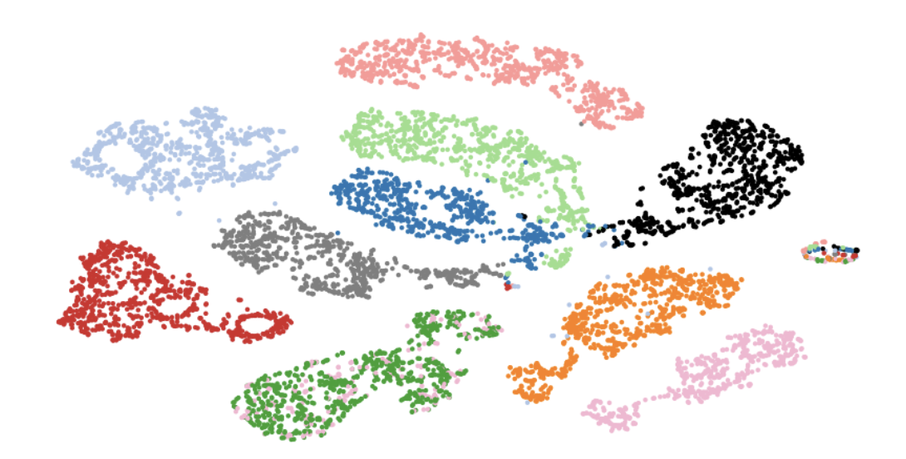
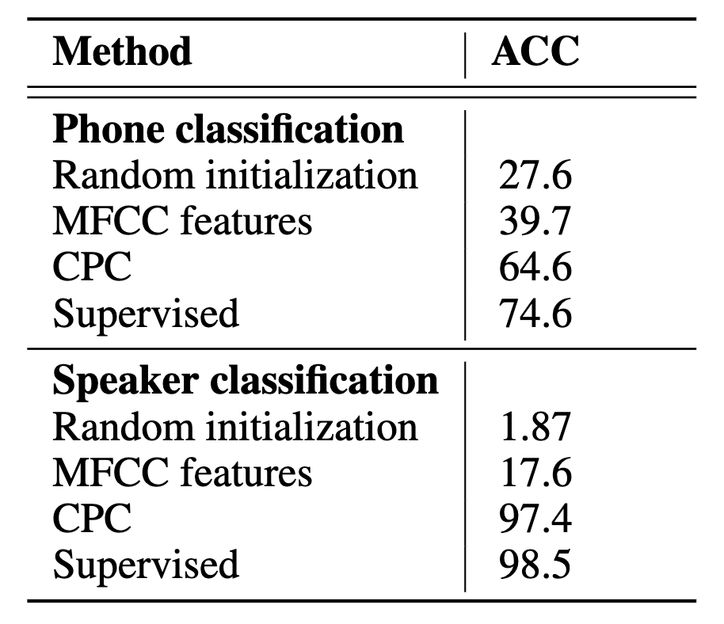
Contrastive self-supervised speech models
Contrastive Predictive Coding (CPC)
Fig. t-SNE visualization of audio (speech) representations for a subset of 10 speakers (out of 251). Every color represents a different speaker.
Table: LibriSpeech phone (1 out of 41) and speaker classification results (1 out of 251).
Aaron van den Oord, Yazhe Li, and Oriol Vinyals. Representation learning with contrastive predictive coding. In NeurIPS, 2018.

Slide 15
Contrastive self-supervised speech models
Wav2Vec 2.0
A CNN processes the waveform to learn latent speech representations (X → Z)
  50 per second
NLP’s units are discrete (subword units) while speech is a continuous signal
Quantization is learnt (Z → Q)
  Via Gumbel-Softmax
The Zs are fed to the transformer to produce contextualized representations (Z → C)
Masking is applied to 10 consecutive time steps
A contrastive loss is used to estimate Q from C on the masked time-steps.
Baevski, Alexei, et al. "wav2vec 2.0: A framework for self-supervised learning of speech representations." NeurIPS, 2020

Slide 16
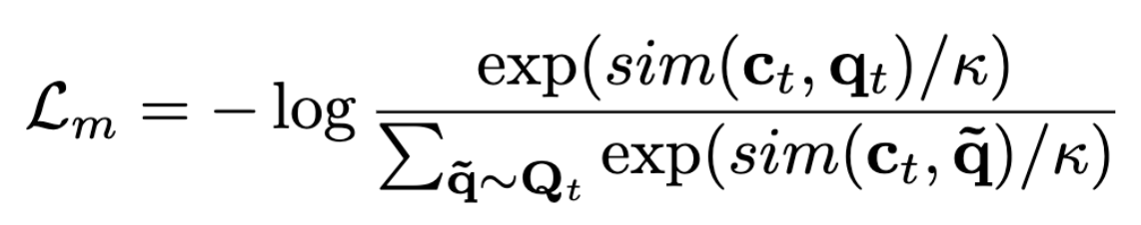
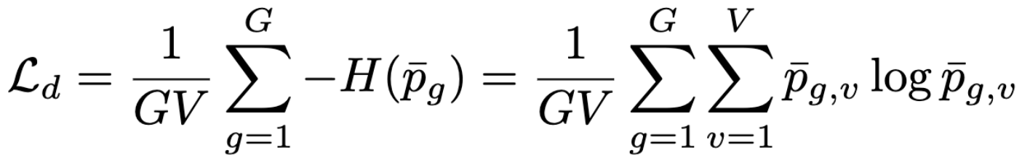
Contrastive self-supervised speech models
Wav2Vec 2.0
Contrastive loss (Similar to CPC)
  Given context network output c_{t} centered over masked time step t, the model needs to identify the true quantized latent speech representation q_{t} in a set of K + 1 quantized candidate representations q ~ Q_{t} which includes q_{t} and K distractors.
  Distractors are uniformly sampled from other masked time steps of the same utterance.
The loss is defined as follows, where sim(.,.) is the cosine similarity.
A diversity loss is also added to increase the use of the quantized codebook.
The loss maximizes the entropy of the averaged softmax distribution.

Slide 17
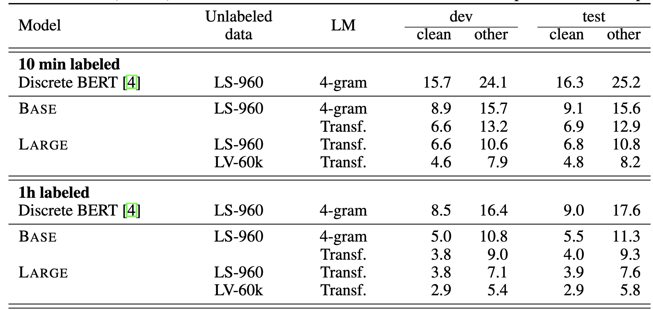
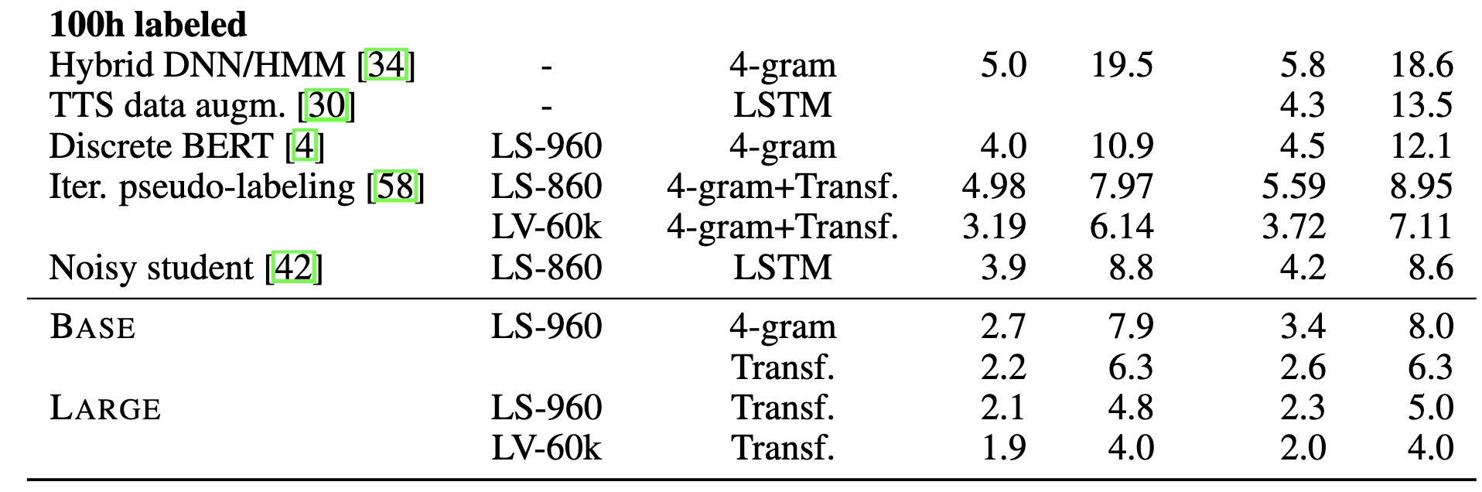
Contrastive self-supervised speech models
Wav2Vec 2.0

Slide 18
Predictive self-supervised speech models
HuBERT
Hsu, Wei-Ning, et al. "Hubert: Self-supervised speech representation learning by masked prediction of hidden units." IEEE/ACM Transactions on Audio, Speech, and Language Processing 29 (2021): 3451-3460.

Slide 19
Predictive self-supervised speech models
HuBERT vs Wav2Vec 2.0
The contrastive loss is replaced with a classification loss.
  Regular frame-level classification task.
The end-to-end quantization is replaced with K-means (not end-to-end).
  The first set of labels is estimated using MFCC (standard speech features).
    K-means on MFCC, a label is assigned to each frame
  In the second iteration a new set of labels is estimated
    K-means of the representations of an intermediate layer (11th for the large model).
This is arguably the most crucial difference between HuBERT and Wav2Vec 2.0
  W2V estimates labels very early (outputs of the CNN)
  HuBERT estimates them from already contextualized representations.
Hsu, Wei-Ning, et al. "Hubert: Self-supervised speech representation learning by masked prediction of hidden units." IEEE/ACM Transactions on Audio, Speech, and Language Processing 29 (2021): 3451-3460.

Slide 20
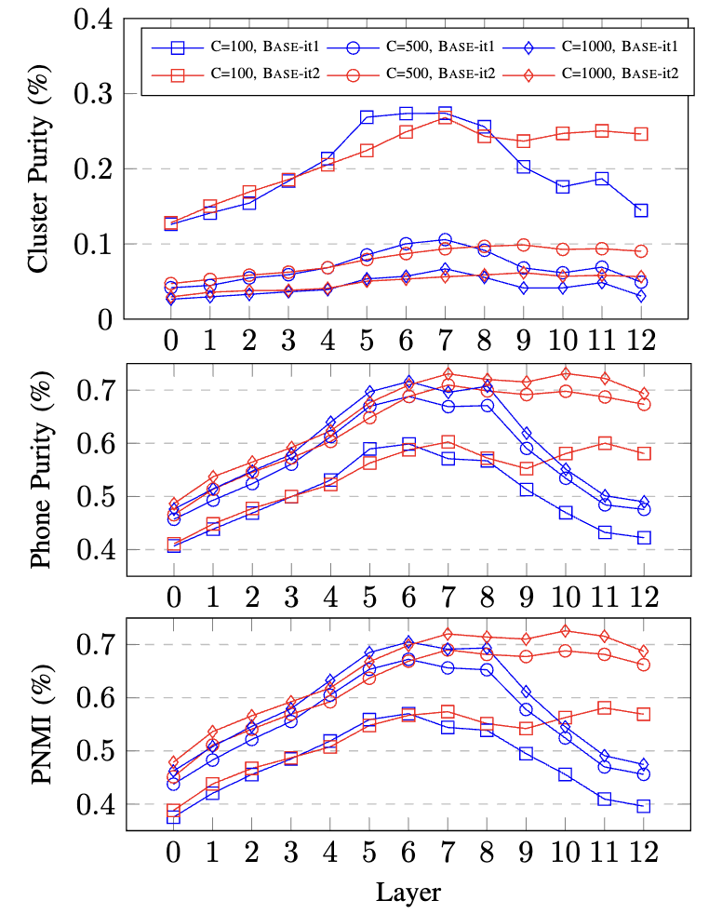
Self-supervised transformers in speech applications
HuBERT layer speech representations and Phone Normalized Mutual Information
In the first iteration where clustering is based on MFCC, the output (12th layer) is not well correlated with phones.
In the second iteration where clustering is based the 7th layer of the first iteration, the correlation is high.

Slide 21
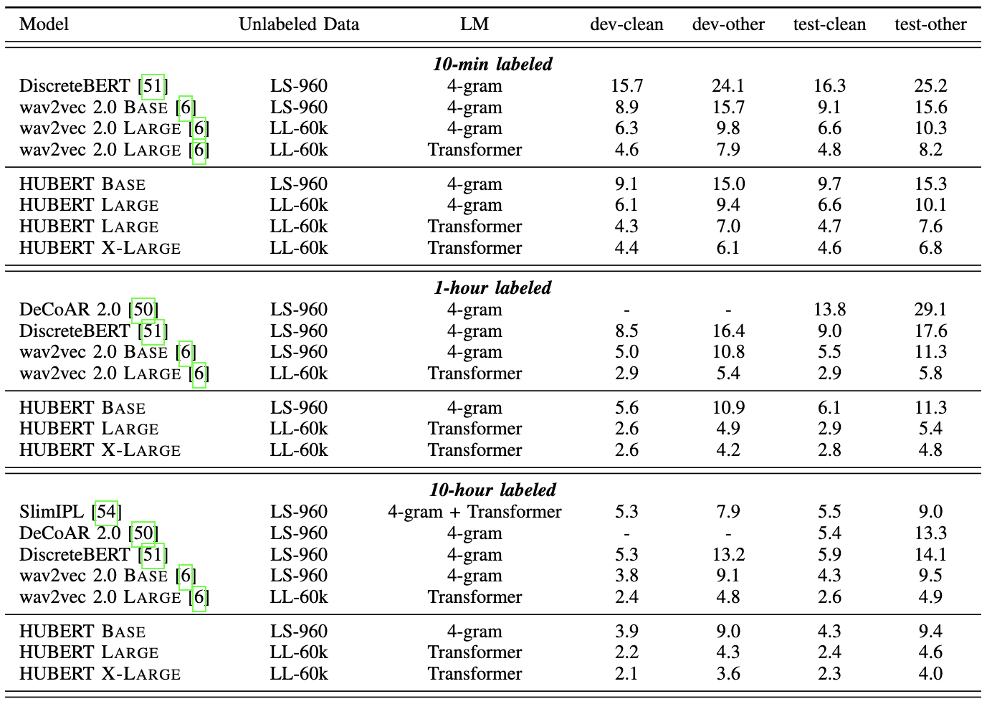
Self-supervised transformers in speech applications
HuBERT

Slide 22
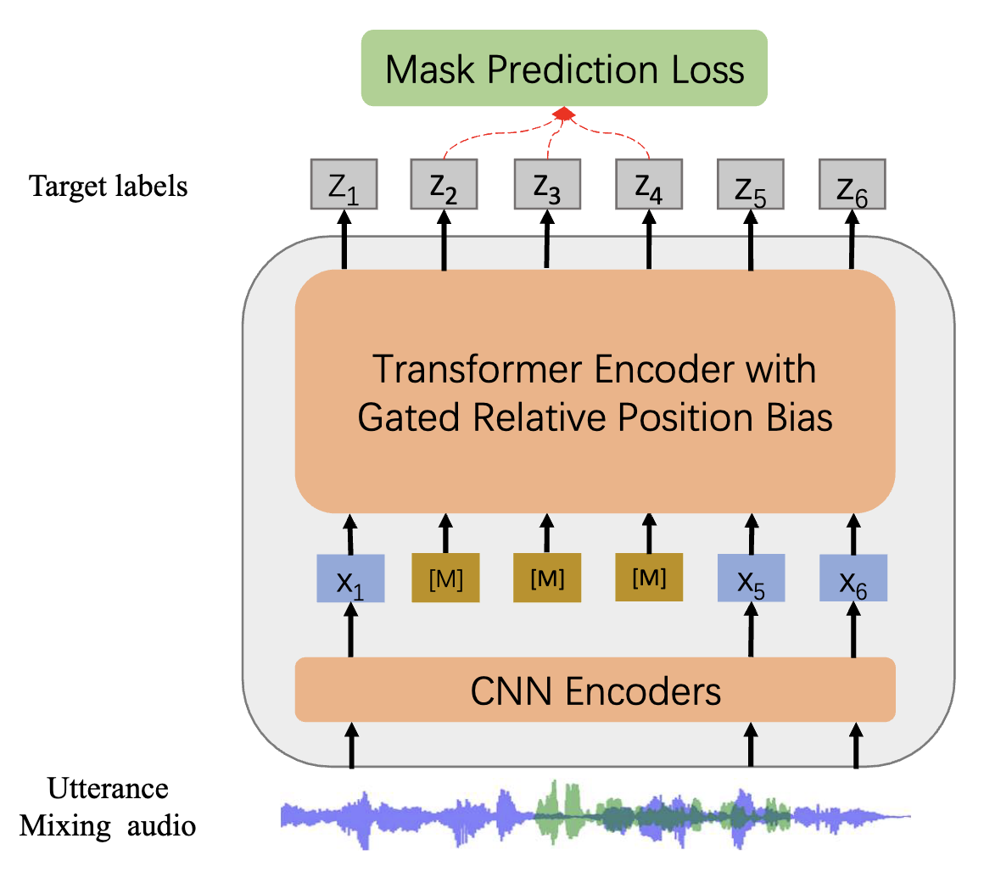
Self-supervised transformers in speech applications
WavLM
Similar to HuBERT
The input audio is mixed with another audio (speech from another speaker or noise).
The target labels correspond to those of the clean audio.
In encourages the network to learn how to denoise the input.
SOTA in speaker-related downstream tasks.
Chen, Sanyuan, et al. "Wavlm: Large-scale self-supervised pre-training for full stack speech processing." IEEE Journal of Selected Topics in Signal Processing, 2022

Slide 23
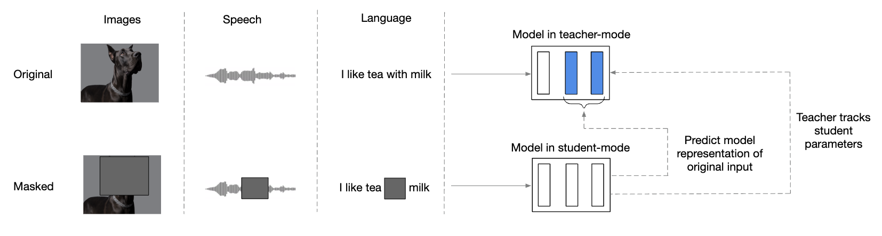
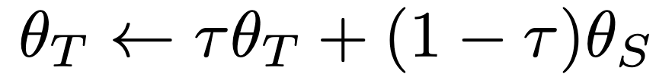
Self-supervised transformers in speech applications
data2vec
Multimodal (Images, Speech, Language)
Continuous representations as targets
Teacher-Student approach (Teacher: θT, Student: θS)
Targets are provided by the teacher model
The teacher model does not receive gradients, but is updated with exponential moving average
This is known as momentum encoder (used in BYOL, DINO a.o.)

Slide 24
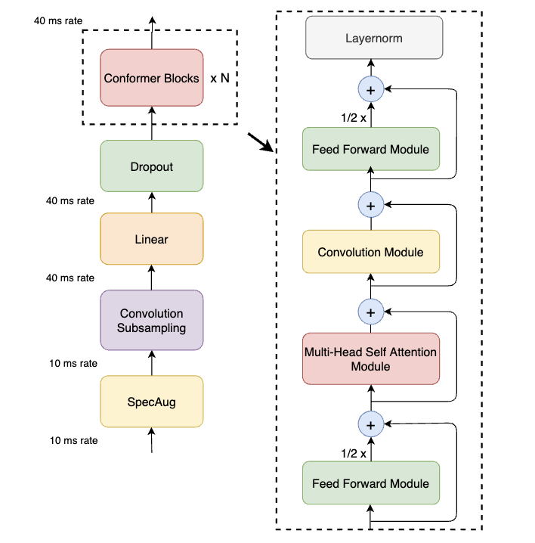
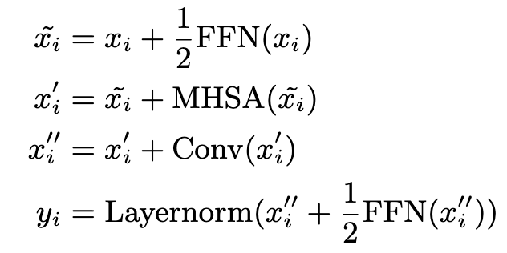
Transformers augmented with convolutions
Conformer
Similar to Transformer
Adds a convolutional layer after MHSA
Μodel both local and global dependencies of audio sequences
Gives improvements in several tasks
Gulati, Anmor, et al. "Conformer: Convolution-augmented Transformer for Speech Recognition”, Interspeech 2020

Slide 25
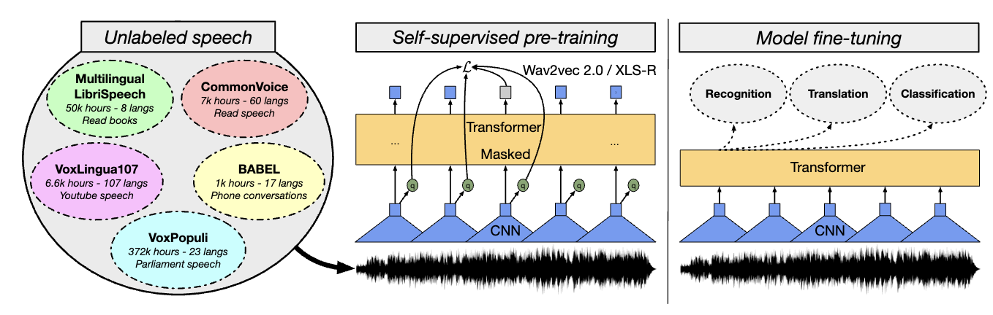
Self-supervised transformers in speech applications
XLS-R
Cross-lingual speech representation learning based on wav2vec 2.0.
Models with up to 2B parameters
Half a million hours of publicly available speech audio
128 languages
Babu, A., et al (2022). XLS-R: Self-supervised Cross-lingual Speech Representation Learning at Scale.

Slide 26
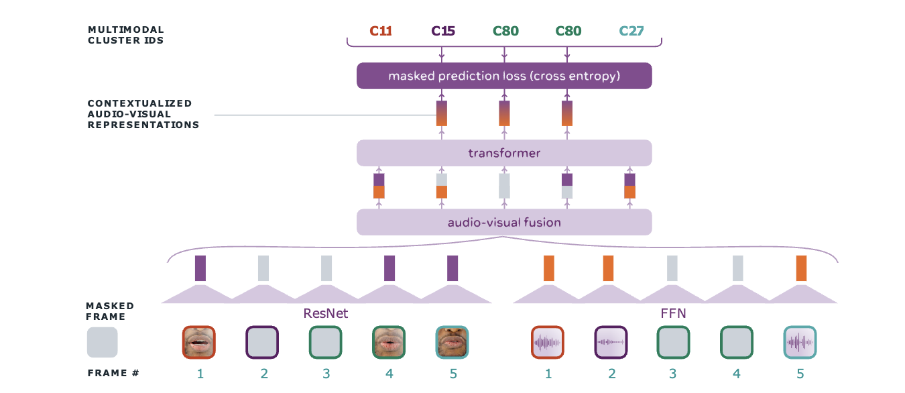
SSL audiovisual speech models
AV-HuBERT
  Self-supervised pretraining of audio-visual transformers for speech recognition
  Audio and video frames from the mouth region
Shi, Bowen, et al. "Learning audio-visual speech representation by masked multimodal cluster prediction.", ICLR 2022.

Slide 27
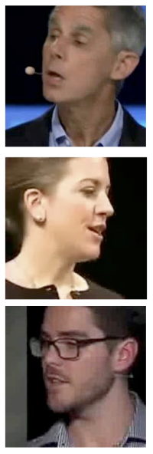
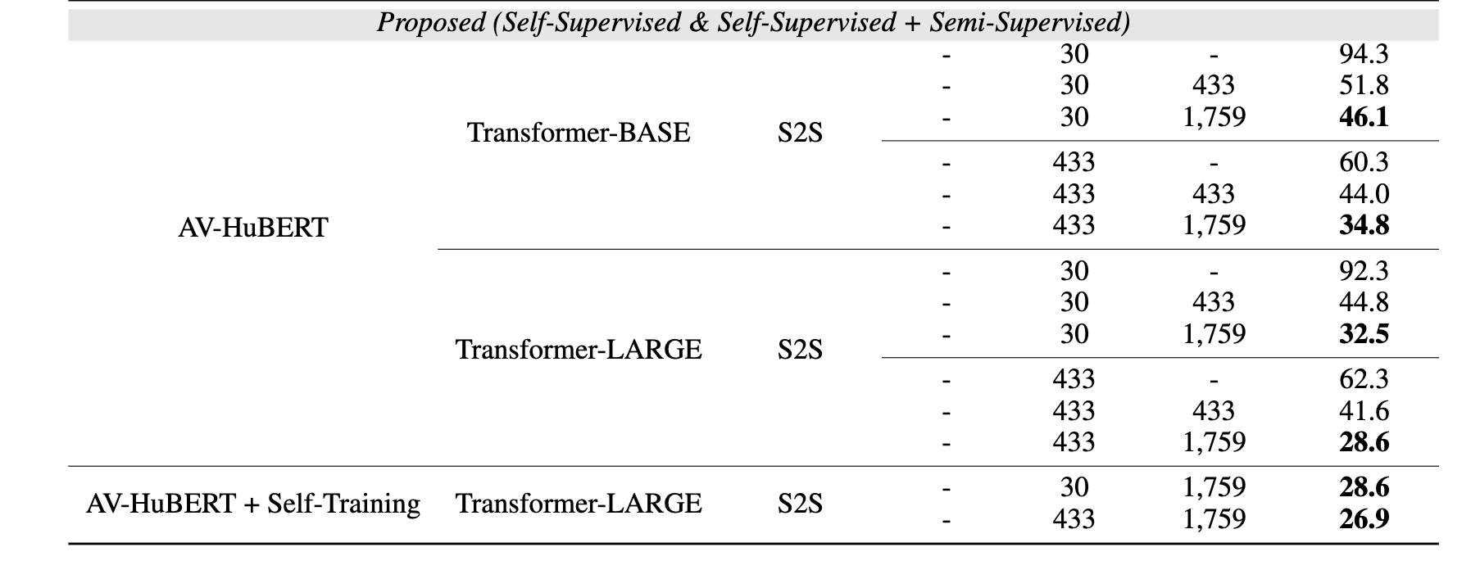
SSL audiovisual speech models
AV-HuBERT
Table: WER (%) in visual speech recognition (lipreading) in LRS3 dataset (TED talks)
Shi, Bowen, et al. "Learning audio-visual speech representation by masked multimodal cluster prediction.", ICLR 2022.

Slide 28
Discrete units via SoundStream
SoundStream neural codec
A neural audio codec based on Residual Vector Quantization (RVQ)
CNN-based Enc-Dec model with additional adversarial loss
A single model operates across variable bitrates (3 kbps - 18 kbps) thanks to the structured dropout
Performs joint compression and enhancement
Zeghidour, Neil, et al. "Soundstream: An end-to-end neural audio codec." IEEE/ACM Transactions on Audio, Speech, and Language Processing 30 (2021): 495-507.
‹#›

Slide 29
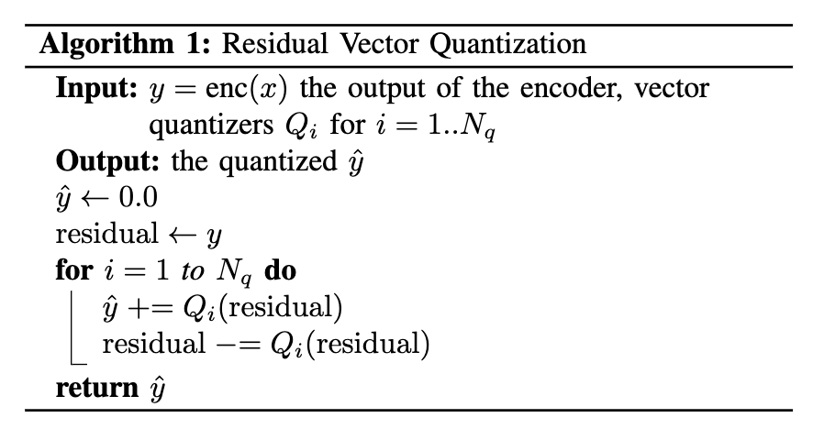
Discrete units via SoundStream
SoundStream’s RVQ
A neural audio codec based on Residual Vector Quantization (RVQ)
CNN-based Enc-Dec model with additional adversarial loss
A single model operates across variable bitrates (3 kbps - 18 kbps) thanks to the structured dropout
Performs joint compression and enhancement
Zeghidour, Neil, et al. "Soundstream: An end-to-end neural audio codec." IEEE/ACM Transactions on Audio, Speech, and Language Processing 30 (2021): 495-507.
‹#›

Slide 30
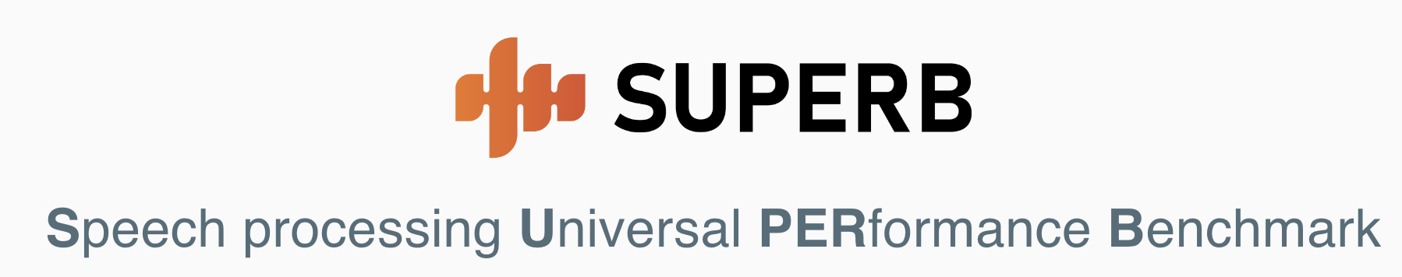

SSL speech model evaluation
Leaderboard for SSL models
Code to fine-tune and evaluate models
Several tasks (ASR, Speaker-related, Enhancement, Keyword-spotting, etc)

Slide 31
SSL speech model evaluation
Tasks
Recognition (Phoneme Recognition, ASR)
Detection (Keyword Spotting, Query-by-Example)
Semantics (Intent Classification, Slot Filling, Speech Translation)
Speaker (Recognition, Verification, Diarization)
Paralinguistics (Emotion Recognition)
Generation (Speech enhancement, Speech Separation)
Code
https://github.com/s3prl/s3prl

Slide 32
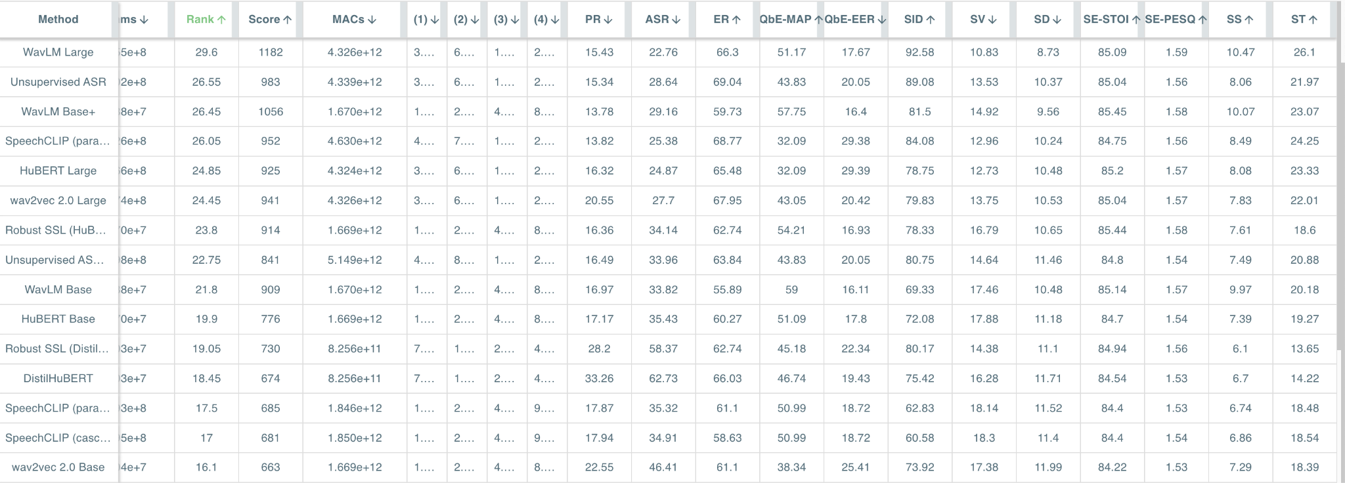
SSL speech model evaluation
Leaderboard

Slide 33
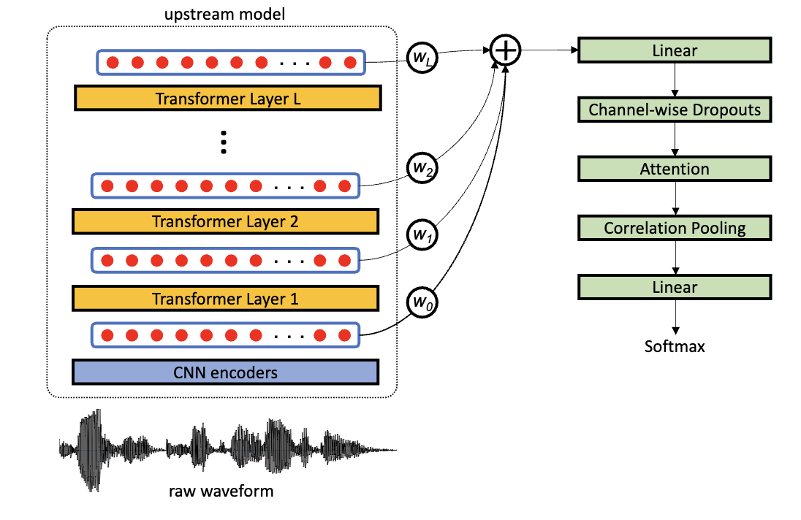
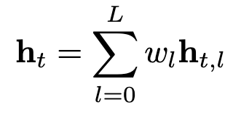
SSL speech model evaluation
In the main setting of SUPERB the SSL model is frozen and only the classifier is trained, together with a set of layer pooling weights (a set of weights) that pools information from all the layers.
Different layers are more effective for different tasks.
Q: Why such a pooling layer makes sense, given that the transformer is trained with features from the final layer?
A: Thanks to the skip connections
Kakouros, Sofoklis, et al. "Speech-based emotion recognition with self-supervised models using attentive channel-wise correlations and label smoothing." ICASSP 2023

Slide 34
Discrete units in speech
So far, discrete units were used only as targets to train the SSL model.
Can we also use them as latent representations?
  E.g. can we extract HuBERT units and use them for TTS, ASR or SLU?
Can we combine different discrete representations (or “tokenizers”)?
Which speech applications can benefit from discrete units?
  Speech-to-speech translation, especially for languages without written form
  End-to-end speech language models (e.g. automatic completion of phrases)
  Text-to-speech that mimics LLMs
‹#›

Slide 35
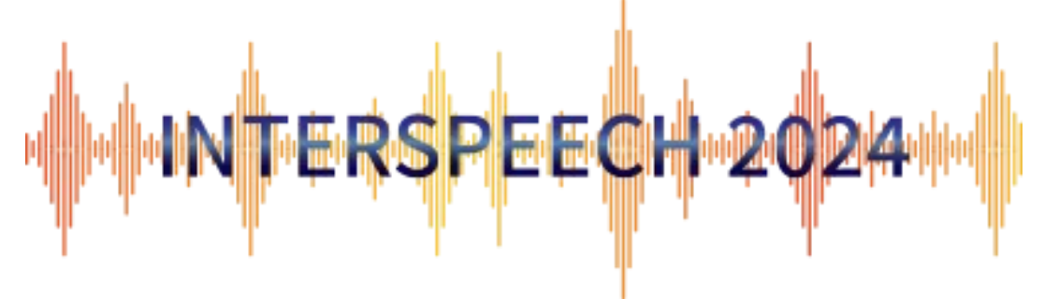
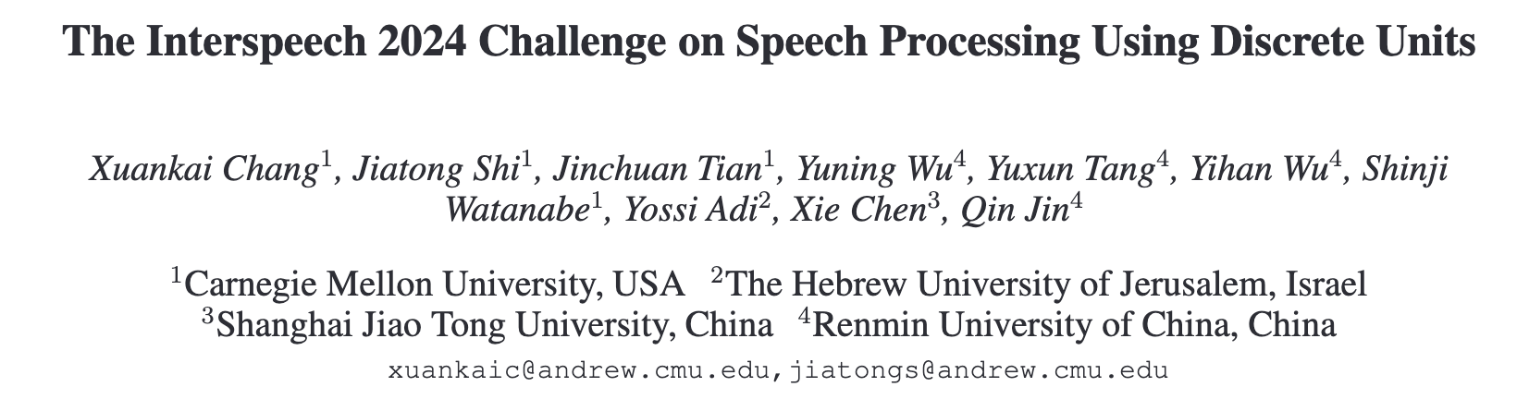
Interspeech 2024 Challenge
Tracks
ASR: multilingual speech recognition from ML-SUPERB challenge.
TTS: (a) single-speaker TTS track and (b) multi-speaker vocoder track
SVS: synthesizing single-singer singing from musical score information.
‹#›

Slide 36
Textless NLP
Generating expressive speech from raw audio
Training AI models directly from raw audio, without text or labels.
Children learn to speak several years before they can read and write.
Relevant for low-resource languages, and languages with no written form.
Also for high-resource languages:
  Speech is the primary source of communication.
  The cascaded pipeline misses the full range of expressivity of oral language.
  There is also intonation, emphasis, non-verbal cues, which are removed from text.
  These elements are lost in the cascaded pipeline ASR→LM→TTS.
Lakhotia, Kushal, et al. "On generative spoken language modeling from raw audio." Transactions of the Association for Computational Linguistics 9 (2021): 1336-1354.
‹#›

Slide 37
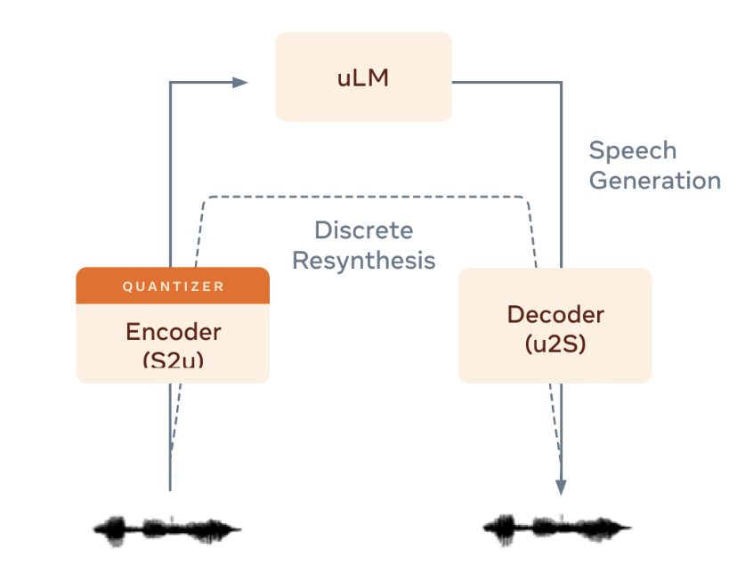
Textless NLP
Generative Spoken Language Model (GSLM)
The GSLM consists of
an encoder that converts speech into discrete units that represent frequently recurring sounds in spoken language (HuBERT),
an autoregressive, unit-based transformer language model that’s trained to predict the next discrete unit based on what it’s seen before,
and a decoder that converts units into speech.
Fig. The GSLM architecture
Lakhotia, Kushal, et al. "On generative spoken language modeling from raw audio." Transactions of the Association for Computational Linguistics 9 (2021): 1336-1354.
‹#›

Slide 38
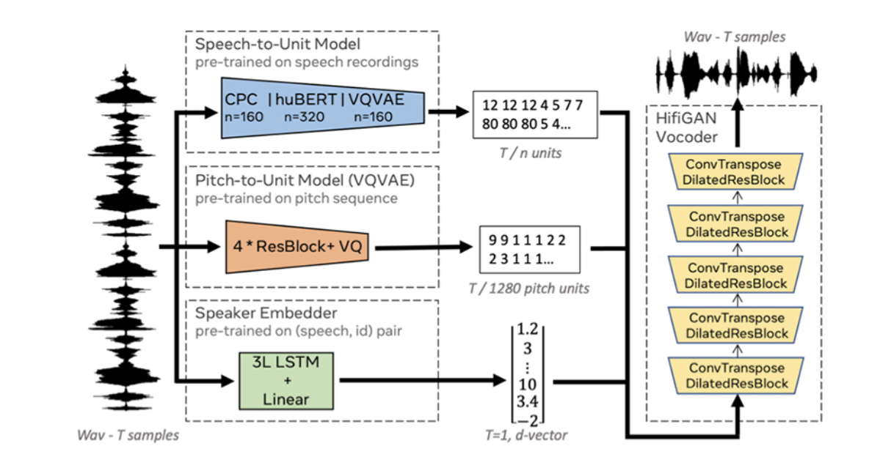
Textless NLP
Generative Spoken Language Model (GSLM)
Discrete Resynthesis
Three representations are extracted:
  the pseudo-text units (e.g. via HuBERT),
  the quantized pitch units, and
  the speaker embeddings.
The decoder (HifiGAN Vocoder) reconstructs the waveform.
The Discrete Resynthesis is trained using original recordings (e.g. audiobooks).
As in VQ-VAE, uLM is not trained jointly with the Discrete Resynthesis architecture.
Fig. Discrete Resynthesis
Lakhotia, Kushal, et al. "On generative spoken language modeling from raw audio." Transactions of the Association for Computational Linguistics 9 (2021): 1336-1354.
‹#›

Slide 39

Textless NLP
Generative Spoken Language Model (GSLM)
Here are continuations from the prompt "She was quite shocked when I asked her whether wine was allowed [..]" from an expressive rendering of Jane Austen’s novel Mansfield Park:
Fig. The GSLM architecture
https://speechbot.github.io/pgslm/
Lakhotia, Kushal, et al. "On generative spoken language modeling from raw audio." Transactions of the Association for Computational Linguistics 9 (2021): 1336-1354.
‹#›

Slide 40
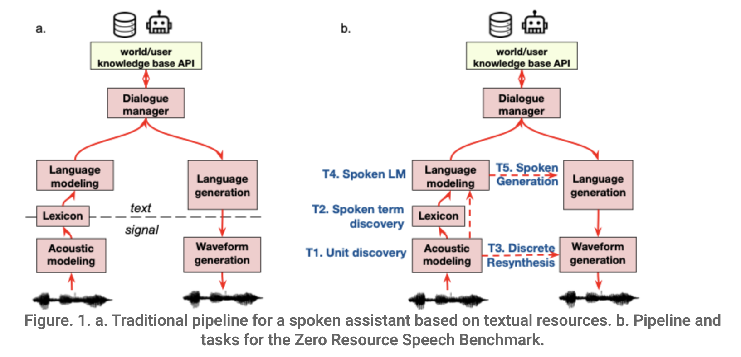
The Zero Resource Speech challenge
The objective is to enable researchers to build a spoken dialogue system directly from raw audio recordings (no text, no labels!).
Four subtasks:
  Acoustic Unit Discovery
  Spoken Term Discovery
  Discrete Resynthesis
  Spoken Language Modeling
https://zerospeech.com/
‹#›

Slide 41
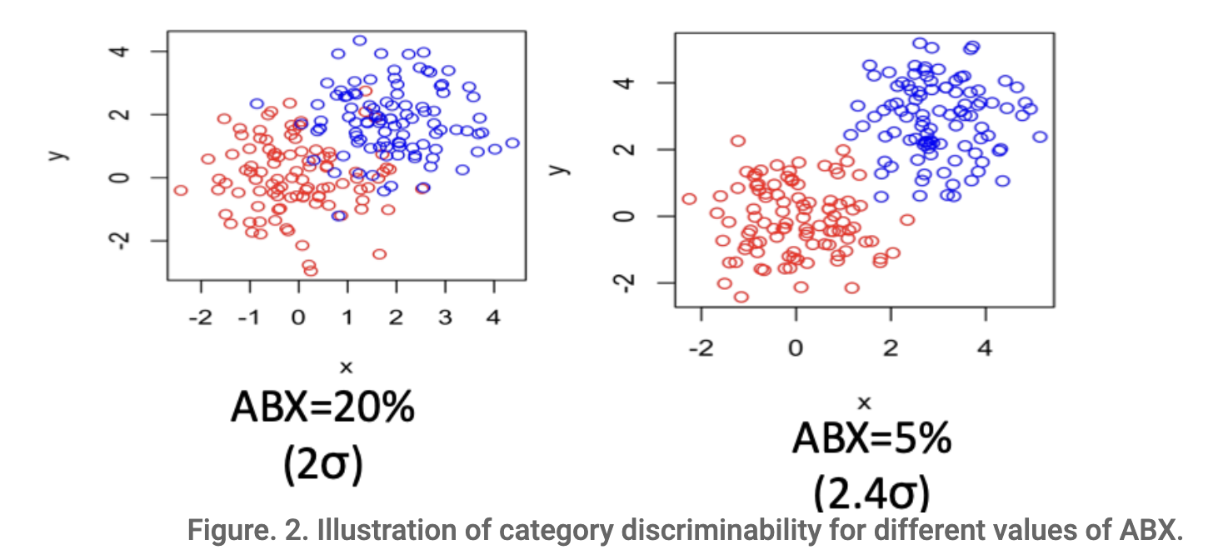
The Zero Resource Speech challenge
Acoustic Unit Discovery/Speech Representation Learning
Measures the Phonemic Contrast of the representations. Phonemes are defined as the smallest elements of speech that make a difference in meaning between words (e.g., /bit/ versus /but/).
Representations should be distinguishing pairs of phonemes within the same context, while ignoring non-linguistic variations.
The ABX metric: For A and B being acoustic realizations of e.g., /bit/ and /but/ and X a realization of e.g., /bit/ then d(A,X)<d(B,X), where d(.,.) an appropriate distance measure.
Fig. An Illustrative example of ABX test
https://zerospeech.com/
‹#›

Slide 42
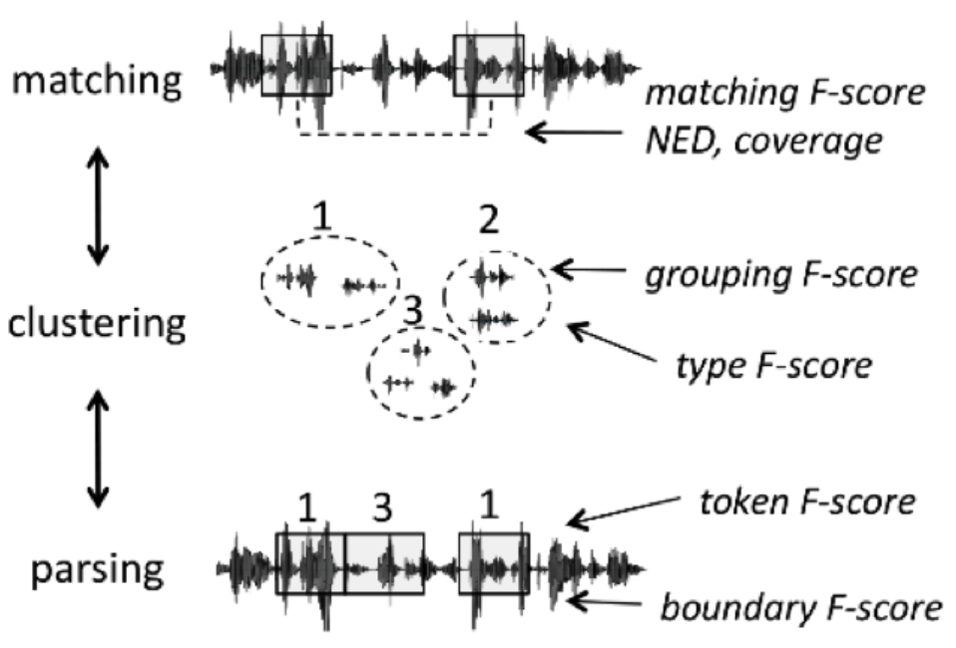
The Zero Resource Speech challenge
Spoken term Discovery / Word segmentation
Matching: find all pairs of speech fragments that are instances of the same sequence of phonemes.
Lexicon discovery: group these fragments into clusters (as opposed to simple pairwise matching). The goal is to find a lexicon of types.
Word segmentation: find onsets and offsets of fragments that are aligned with the word boundaries as defined in the gold-standard text.
Fig. Term discovery subtasks and metrics
https://zerospeech.com/
‹#›

Slide 43
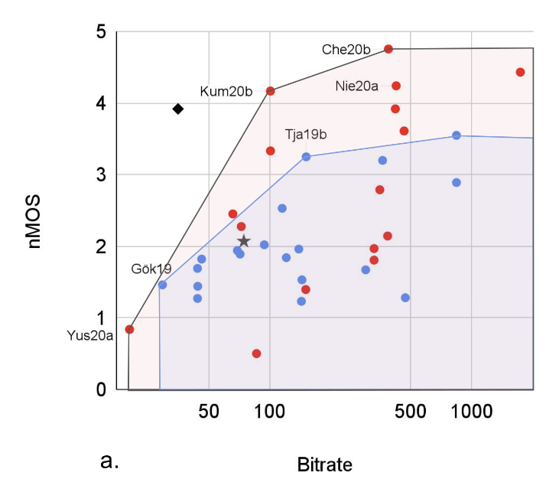
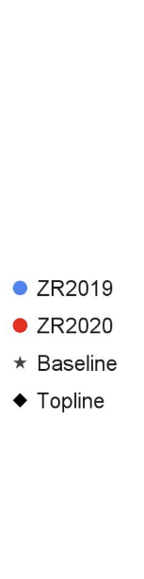
The Zero Resource Speech challenge
Discrete Resynthesis / TTS without T
Measures
The quality of the resynthesis, assessed by using human evaluations (principally Mean Opinion Scores, MOS).
The bitrate, measured as the entropy of the symbols divided by the average duration of the symbols.
  Phonemic transcription is a highly-compressed representation of speech and hence of low-bitrate.
  The discovered units should ideally have the same property.
Fig. Bitrate vs norm. Mean Opinion Score
https://zerospeech.com/
‹#›

Slide 44
The Zero Resource Speech challenge
Spoken Language Modeling
Lexicon: the models are presented with a matched pair of spoken tokens: an existing word A and a matching nonword B. The model should give P(A)>P(B).
Syntax: Given pairs of matched grammatical and ungrammatical sentences A and B, the model should give P(A)>P(B).
Lexical Semantics: the task is to compute the similarity of the representation of pairs of words and compare it to human similarity judgements.
Prosody. Recording A one containing a break at a “natural” position and recording B a break at an “unnatural” position. The models should give P(A)>P(B).
https://zerospeech.com/
‹#›

Slide 45
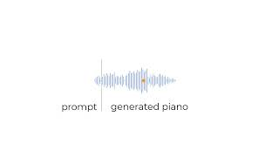
AudioLM
AudioLM (Google) produces consistent continuations while maintaining the original speaker voice, prosody and recording conditions (e.g., level of reverberation, background noise)
It also performs well on modeling piano music!
Borsos, Zalán, et al. "Audiolm: a language modeling approach to audio generation." IEEE/ACM transactions on audio, speech, and language processing 31 (2023): 2523-2533.
‹#›

Slide 46
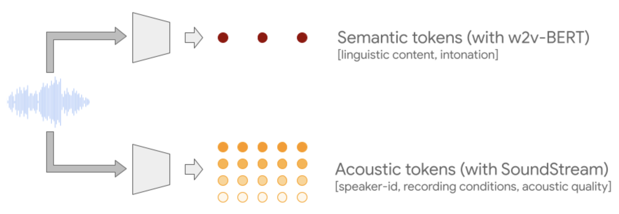
AudioLM
AudioLM (Google) produces consistent continuations while maintaining the original speaker voice, prosody and recording conditions (e.g., level of reverberation, background noise)
It also performs well on modeling piano music!
Borsos, Zalán, et al. "Audiolm: a language modeling approach to audio generation." IEEE/ACM transactions on audio, speech, and language processing 31 (2023): 2523-2533.
‹#›

Slide 47
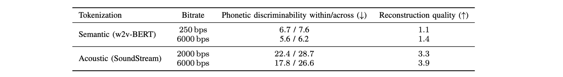
AudioLM
Why using two tokenizers?
Achieving both high quality and long-term consistency with only one of the tokenizers is challenging.
  Semantic tokens (w2v-BERT) → high phonetic discrimination
  Acoustic tokens (SoundStream) → high reconstruction quality
Table. ABX error rate measures how often a random instance X of a trigram (“bit”) is closer to an instance B of another trigram (“but”) rather than to a different instance A of the same trigram (“bit”). Within/across refers to the speaker.
Borsos, Zalán, et al. "Audiolm: a language modeling approach to audio generation." IEEE/ACM transactions on audio, speech, and language processing 31 (2023): 2523-2533.
‹#›

Slide 48
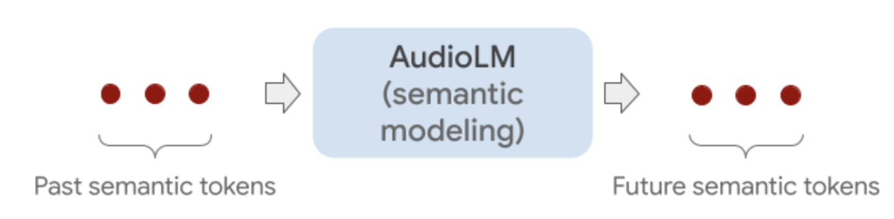
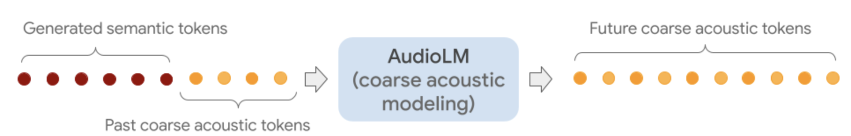
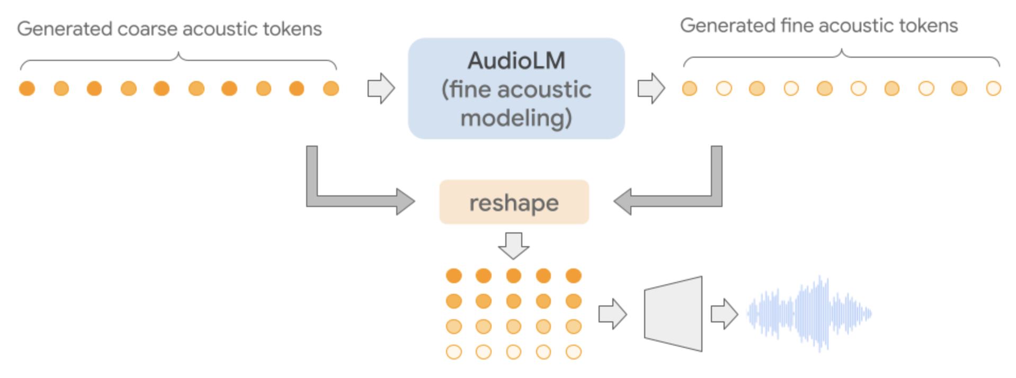
AudioLM - Hierarchical modeling
Level 1
Level 2
Level 3

Slide 49
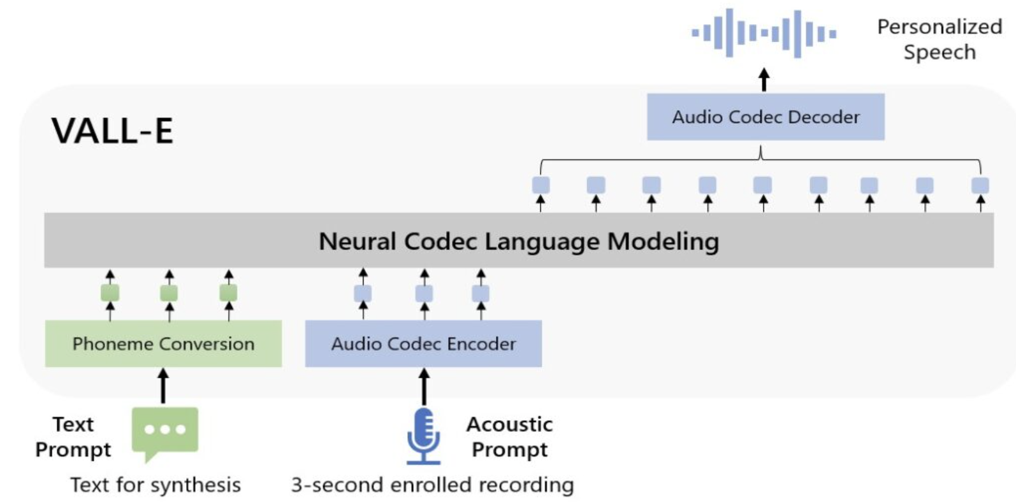
Discrete units for TTS
From speech continuation to TTS
Samples: https://www.microsoft.com/en-us/research/project/vall-e-x/
Wang, Chengyi, et al. "Neural codec language models are zero-shot text to speech synthesizers." arXiv preprint arXiv:2301.02111 (2023).
‹#›

Slide 50
Discrete units for TTS
VALL-E
trains a neural codec language model using discrete codes (SoundStream) and regards TTS as a conditional language modeling task,
can be used to synthesize high-quality personalized speech with only a 3-second enrolled recording of an unseen speaker as a prompt,
is SOTA zero-shot TTS system in speech naturalness and speaker similarity,
can preserve the speaker’s emotion and acoustic environment of the acoustic prompt in synthesis.
Wang, Chengyi, et al. "Neural codec language models are zero-shot text to speech synthesizers." arXiv preprint arXiv:2301.02111 (2023).
‹#›

Slide 51
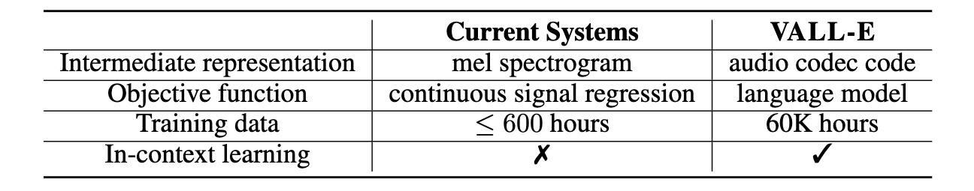
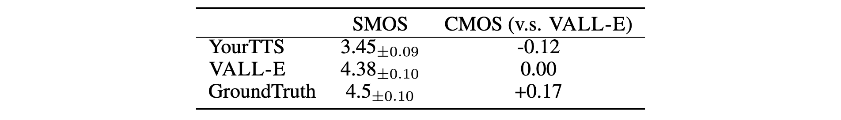
Discrete units for TTS
Table: A comparison between VALL-E and current cascaded TTS systems.
Table: Human evaluation in LibriSpeech with 3-second enrolled recording.
Wang, Chengyi, et al. "Neural codec language models are zero-shot text to speech synthesizers." arXiv preprint arXiv:2301.02111 (2023).
‹#›

Slide 52
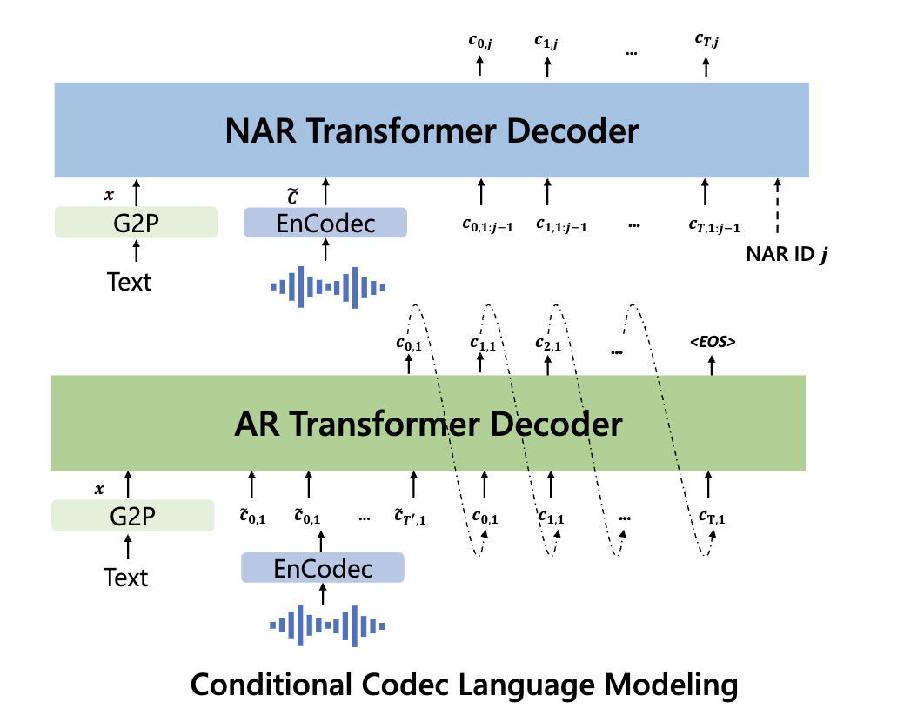
Discrete units for TTS
Fig. The structure of the conditional codec LM, which is built in a hierarchical manner.
Wang, Chengyi, et al. "Neural codec language models are zero-shot text to speech synthesizers." arXiv preprint arXiv:2301.02111 (2023).
‹#›

Slide 53
VALL-E samples
Stochasticity thanks to discrete units and LLM-style sampling
“He has not been named.”
Preservation of acoustic conditions
“As friends thing I definitely I’ve got more male friends.”
“I think it’s like you know um more convenient too.”
Zhang, Ziqiang, et al. "Speak foreign languages with your own voice: Cross-lingual neural codec language modeling." arXiv preprint arXiv:2303.03926 (2023).
‹#›

Slide 54
VALL-E samples
Speaker emotion maintenance
“We have to reduce the number of plastic bags.”
Anger
Sleepy
Neutral
Amused
Disgusted
Zhang, Ziqiang, et al. "Speak foreign languages with your own voice: Cross-lingual neural codec language modeling." arXiv preprint arXiv:2303.03926 (2023).
‹#›

Slide 55

Can we detect synthetic speech?
Doable with Deep Neural Networks trained to classify real vs synthetic speech
Fairly easily for known and old TTS systems
Harder for new systems which are unseen during training
asvspoof.org
‹#›

Slide 56

SSL speech models for synthetic speech detection?
A Wav2Vec 2.0, combined with a backend model and finetuned to discriminate between genuine and synthetic speech is the current state-of-the-art.
Tak, Hemlata, et al. "Automatic Speaker Verification Spoofing and Deepfake Detection Using Wav2vec 2.0 and Data Augmentation." The Speaker and Language Recognition Workshop (Odyssey 2022). ISCA, 2022.
‹#›

Slide 57

SSL speech models for synthetic speech detection?
A fine-tuned Wav2Vec 2.0, combined with a backend model and finetuned to discriminate between genuine and synthetic speech is the current state-of-the-art.
Table. Pooled EER and pooled min t-DCF results for the ASVspoof 2021 LA database evaluation set, for the sinc-layer and wav2vec 2.0 front-ends. SA refers to the self-attentive aggregation layer whereas DA refers to data augmentation. Results are the best (average) obtained from three runs of each experiment with different random seeds.
Tak, Hemlata, et al. "Automatic Speaker Verification Spoofing and Deepfake Detection Using Wav2vec 2.0 and Data Augmentation." The Speaker and Language Recognition Workshop (Odyssey 2022). ISCA, 2022.
‹#›

Slide 58
Advancements in self-supervised learning for speech technologies
Thank you!
Happy to answer your questions.
ESSAI & ACAI 2024

