Slide 1
Human decision-making
How humans judge
and decide with AI
Andrea Beretta

Slide 2
Outline
Human cognitive process of Judgement and Decision-Making
what is decision-making?
errors in judgement and heuristics
determine the right course of action under uncertainty
Aligning AI to the human mental models
mental models
Trust and Reliance on cognitive artifacts
Human-Centered AI
Six important features
the eight golden rules
open challenges

Slide 3
1
Behavioral Economics
Notes:
HCAI (Human-Centered AI) is defined as an approach that emphasizes human values such as rights, justice, and dignity. It focuses on designing AI systems that support human self-efficacy, creativity, responsibility, and social connections. HCAI aims to create highly automated systems that preserve human control, ensuring that AI serves human needs and enhances human performance.

Slide 4
WHAT IS A DECISION?
ALTERNATIVES
EXPECTATIONS
CONSEQUENCES
A decision is characterized by the chance to evaluate more than one path of actions
The presence of expectations (subjective probabilities) of the likelihood to achieve the outcome of each path of action
The consequences associated with the outcomes (they can be assessed based on personal values and objectives of the decision maker)
Hastie & Dawes, 2001
Notes:
A decision is our reaction to a situation characterized by three different components: • A chance to evaluate more than one path of action (alternatives). • The presence of expectations (subjective probabilities) regarding the likelihood of achieving the outcome of each path of action. • The presence of consequences associated with the outcomes (consequences that can be assessed based on personal values and objectives of the decision maker).

Slide 5
Decision, Judgement, Choice
Decision
Judgement
Choice
The process of selection of an action (problem representation, estimate, evaluation of outcomes, alternative selection
components of the decision process relative to evaluation of outcomes & of the consequences to each outcome
Indicates the sub-process of the decision in which an alternative is chosen among several other options
Notes:
Representation of the problem. • Estimate of expectations. • Evaluation of outcomes. • Selection of an alternative.
Judgment: It is referred to the components of the decision process relative to: • Evaluation of outcomes. • Evaluation of the consequences associated to each outcome. • Choice: Indicates the sub-process of the decision in which an alternative is chosen among several other options. 7

Slide 6
Uncertainty, Risk, and Ambiguity
Uncertainty
Risk
Ambiguity
Lack of knowledge about future events or outcomes, it relates to the inability to predict what will happen
It involves the measurement of uncertainty, it is related to the probability of specific outcome
It refers to situations open to multiple interpretations. it involves uncertainty, complexity in decision-making
Notes:
Decisions are made under uncertainty when: • We do not know exactly what is going to happen... • But we know the likelihood of each possible outcome. • In this circumstances people evaluate risk (the likelihood that the expected outcome will not be achieved) in a subjective way: • As we will see, there is no such thing as risk aversion. • Rather, psychologists speak of loss aversion.
Decisions are made under ambiguity when: • We do not know exactly what is going to happen... • We do not even know the likelihood of each outcome to happen. 10
One of the points in which the normative and psychological approaches differ the most is people’s attitude towards: • Choices under uncertainty. • Risk perception. • Choice under ambiguity. • What are uncertainty, risk, and ambiguity?
Uncertainty: Uncertainty refers to a lack of knowledge or information about future events or outcomes. It involves the inability to predict or determine with confidence what will happen. Uncertainty is characterized by unpredictability and the presence of unknown variables that make outcomes unclear 6. In liberal governance, uncertainty is managed through individual responsibility and reasonable foresight rather than precise calculations 6.
Risk: Risk is a concept closely related to uncertainty but with a key difference. Risk involves the quantification or measurement of uncertainty. It is the probability or likelihood of a specific outcome or event occurring, allowing for some level of calculation or estimation of potential losses or gains 4. Risk can be managed through various strategies such as risk assessment, mitigation, and transfer.
Ambiguity: Ambiguity refers to a situation or concept that is open to multiple interpretations or meanings. It involves uncertainty or vagueness that makes it difficult to determine the true nature or implications of a situation 7. Ambiguity introduces complexity and challenges in decision-making processes as it allows for different understandings and perspectives to coexist.

Slide 7
Uncertainty, Risk, and Ambiguity
Uncertainty
Risk
Ambiguity
Lack of knowledge about future events or outcomes, it relates to the inability to predict what will happen
It involves the measurement of uncertainty, it is related to the probability of specific outcome
It refers to situations open to multiple interpretations. it involves uncertainty and complexity in decision-making
Notes:
Decisions are made under uncertainty when: • We do not know exactly what is going to happen... • But we know the likelihood of each possible outcome. • In this circumstances people evaluate risk (the likelihood that the expected outcome will not be achieved) in a subjective way: • As we will see, there is no such thing as risk aversion. • Rather, psychologists speak of loss aversion.
Decisions are made under ambiguity when: • We do not know exactly what is going to happen... • We do not even know the likelihood of each outcome to happen. 10
One of the points in which the normative and psychological approaches differ the most is people’s attitude towards: • Choices under uncertainty. • Risk perception. • Choice under ambiguity. • What are uncertainty, risk, and ambiguity?
Uncertainty: Uncertainty refers to a lack of knowledge or information about future events or outcomes. It involves the inability to predict or determine with confidence what will happen. Uncertainty is characterized by unpredictability and the presence of unknown variables that make outcomes unclear 6. In liberal governance, uncertainty is managed through individual responsibility and reasonable foresight rather than precise calculations 6.
Risk: Risk is a concept closely related to uncertainty but with a key difference. Risk involves the quantification or measurement of uncertainty. It is the probability or likelihood of a specific outcome or event occurring, allowing for some level of calculation or estimation of potential losses or gains 4. Risk can be managed through various strategies such as risk assessment, mitigation, and transfer.
Ambiguity: Ambiguity refers to a situation or concept that is open to multiple interpretations or meanings. It involves uncertainty or vagueness that makes it difficult to determine the true nature or implications of a situation 7. Ambiguity introduces complexity and challenges in decision-making processes as it allows for different understandings and perspectives to coexist.

Slide 8
Expected Utility Theory
Oskar Morgenstern & John Von Neumann
Notes:
Normative decision making theories: how we should make decisions
A further fundamental contribution to the integration of utility into economic models was provided by von Neumann and Morgenstern (1947). • These scholars proposed the Expected Utility Theory. • Following in their footsteps, Savage (1954) proposed a development of the theory, which is now known as Subjective Expected Utility Theory.
The theory of rational decision has been developed starting from the work of mathematicians, philosophers, and economists who, for a very long time, tried to answer this question: • What’s the rational way to make a decision when the outcomes are uncertain?

Slide 9
Expected Utility Theory
Developed a model of decision making that would enable the value of what are called «mixed strategies» in the theory of games.
Individuals are supposed to be rational; they are able to determine what they want and order the possible alternatives according to a logic.
if alternative A is preferred to B, and B to C, then A must be preferred to C.
When they have to make a risky decision, think of a bet, individuals are able to calculate the expected utility: it is the sum of the possible outcomes of the bet, i.e., the wins and losses, multiplied by the odds
Theory of Games and Economic Behavior (1944)
Notes:
von Neumann and Morgenstern showed that: • Starting from the hypothesis that a decision maker must respect a set of rational axioms, it is possible to quantify the decision maker personal values in a way that an option with probabilistic outcomes will be chosen, only and only if: Expected utility of the option > Expected utility of all other options

Slide 10
Expected Value Function
Examples of computation of EV:
A bet with 50% change to win 100€
EV= (0,50 * 100) = 50 €
A bet with 50% chance to win 100€, a 30% to win 1000€, and a 20% chance to loose 2000€
EV= (0,50 * 100) + (0,30 * 1000) + [0,20 * (-2000)] = 50 + 300 + [-400] = 350 – 400 = - 50€
Notes:
Mathematicians and economists suggest to compute the «rational» price of the game with the formula for the expected value: EV = Σi pi vi • What it tells is basically that people should multiply: • The value of each outcome with its own likelihood of happening. • Then to sum up all these products. •
Utility is a measure of people’s satisfaction associated with the consumption of goods and services. • A utility function must: • Define the personal value a person attaches to a certain quantity of a good or service.

Slide 11
Axioms of Expected Utility Theory
1
2
3
4
5
Independence
Transitivity
Dominance
Regularity
Invariance
Preferences should depend exclusively on the outcomes that are
different between alternatives
If a person prefers alternative A to alternative B, then it should
always prefer A to B.
If alternative A is better than B on one attribute and it is not inferior on all other attributes then it will always be chosen
In a binary choice, the preference for an alternative depends on
its relative utility compared to the other
If an alternative is preferred to another one, such preference
should not change
Notes:
1. Independence axiom (or Cancellation). 2. Transitivity axiom. 3. Dominance axiom. 4. Regularity axiom. 5. Invariance axiom.

Slide 12
2
Behavioral Economics
Notes:
HCAI (Human-Centered AI) is defined as an approach that emphasizes human values such as rights, justice, and dignity. It focuses on designing AI systems that support human self-efficacy, creativity, responsibility, and social connections. HCAI aims to create highly automated systems that preserve human control, ensuring that AI serves human needs and enhances human performance.

Slide 13
The influence of Behavioral Economics
Amos Tvensky & Daniel Kahneman
Notes:
Starting from work on the violation of rational axioms, Kahneman and Tversky (1979; 1992) developed a model to describe more accurately how real people make decisions. • This model is Prospect Theory. • Prospect Theory is not in opposition to the Theory of Expected Utility, but aims at integrating and extending it. • Expected Utility Theory provided a model about how people should make the best possible decision (normative model). • Prospect Theory provides a model about the processes that induce people to make suboptimal decisions (descriptive model).

Slide 14
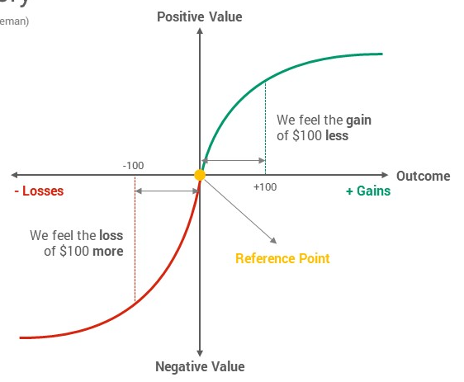
Prospect Theory
Notes:
Prospect theory stems from Loss aversion, where the observation is that agents asymmetrically feel losses greater than that of an equivalent gain. It centralises around the idea that people conclude their utility from "gains" and "losses" relative to a certain reference point. This "reference point" is different for each person and relative to their individual situation. Thus, rather than making decisions like a rational agent (i.e using expected utility theory and choosing the maximum value), decisions are made in relativity not in absolutes
The status quo is the central point (with 0 value), while the horizontal axis does not represent the total wealth acquired, but the gains (on the right) or losses (on the left). The vertical axis measures the utility as defined by Prospect Theory: V (value).

Slide 15
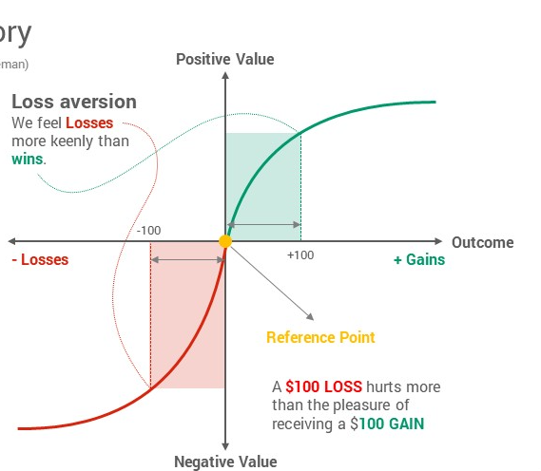
Prospect Theory
Notes:
The Reflection Effect = the different shape of the function associated with the value of gains (concave) and the value of losses (convex) has an inverse impact on our willingness to take risks in the domains of gains and losses.
Gains: Risk Aversion 🡪 the Utility Function of gains has a concave shape: we do not want to lose a certain gain for a possible bigger gain which is only likely.
Losses: risk seeking 🡪 the Utility Function of losses has a convex shape: we are prepared to risk losses (“risk seeking”), i.e. to avoid a certain loss, we are prepared to risk incurring bigger losses which are likely rather than certain.

Slide 16
Prospect Theory

Slide 17
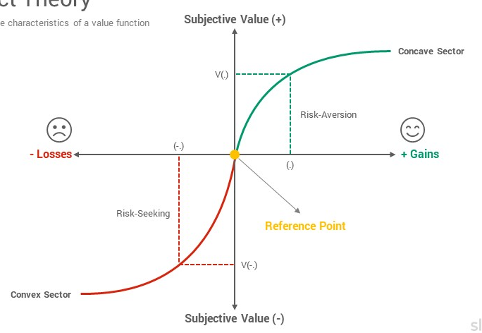
Prospect Theory

Slide 18
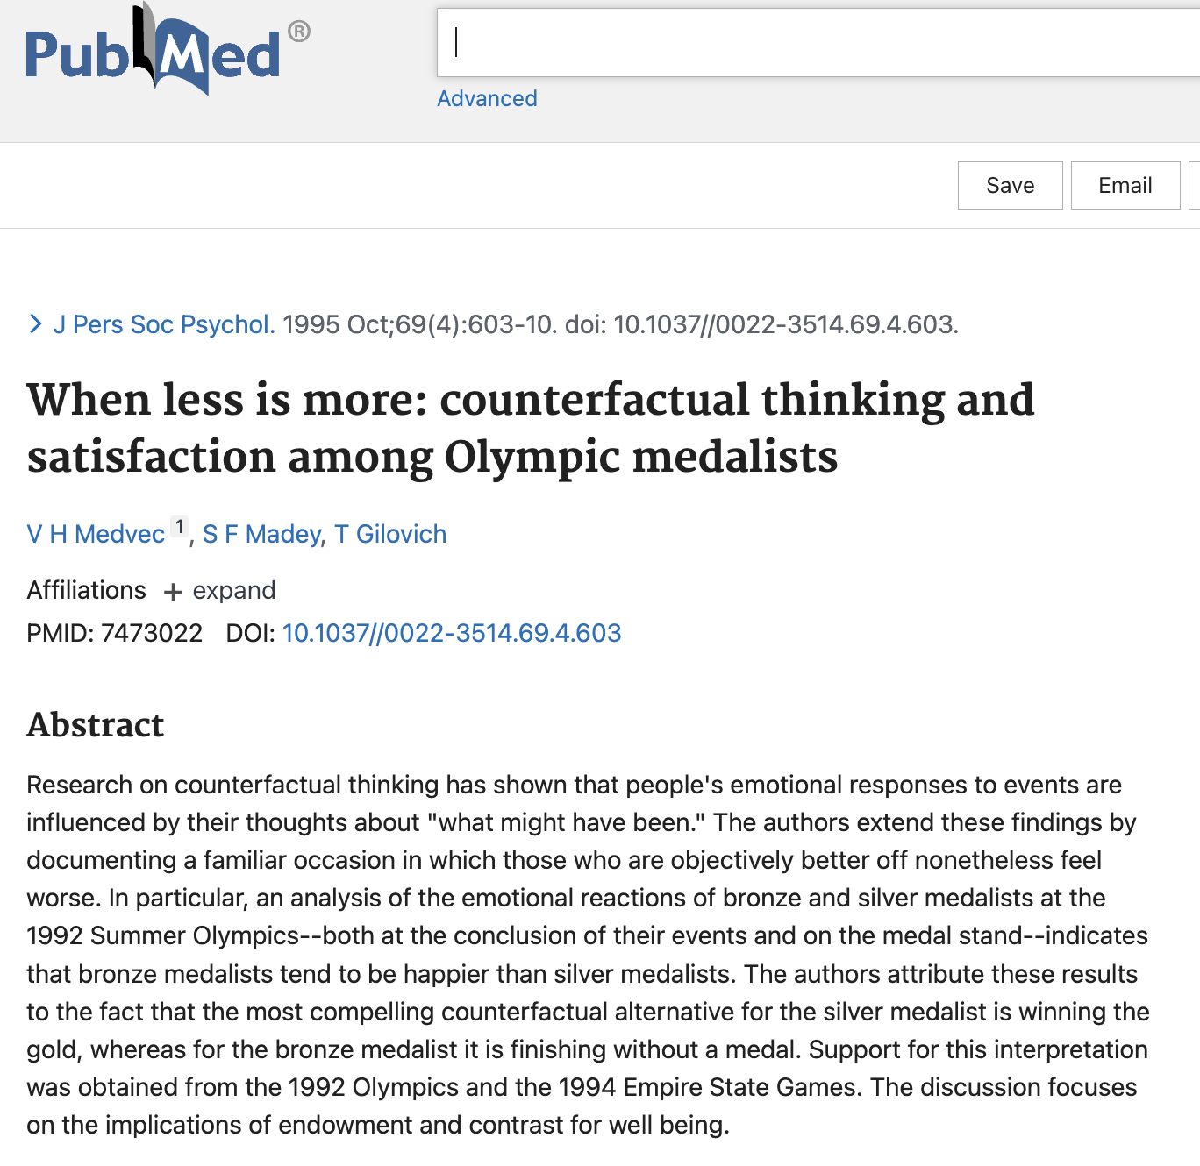
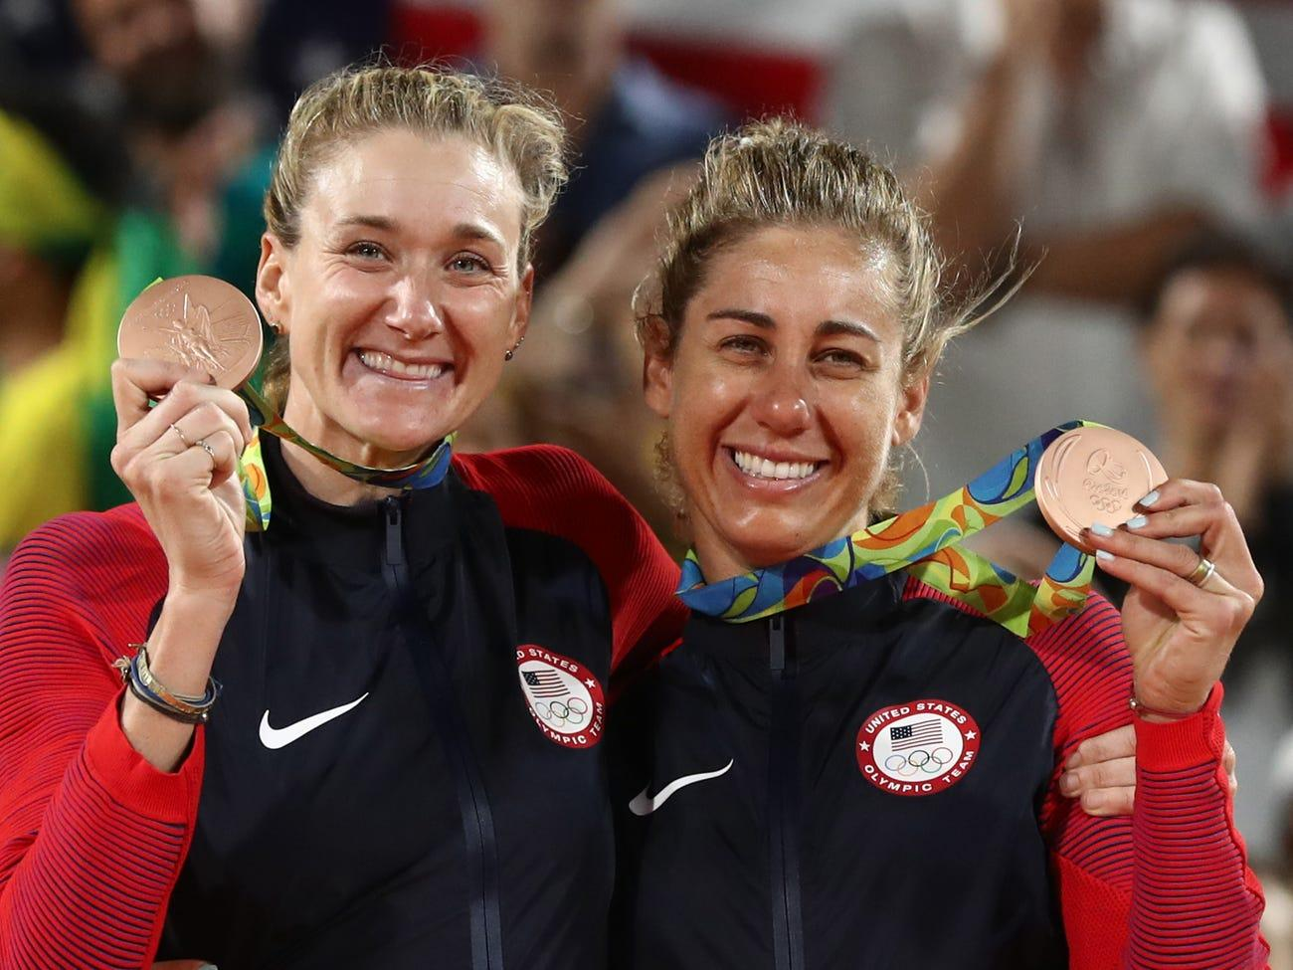
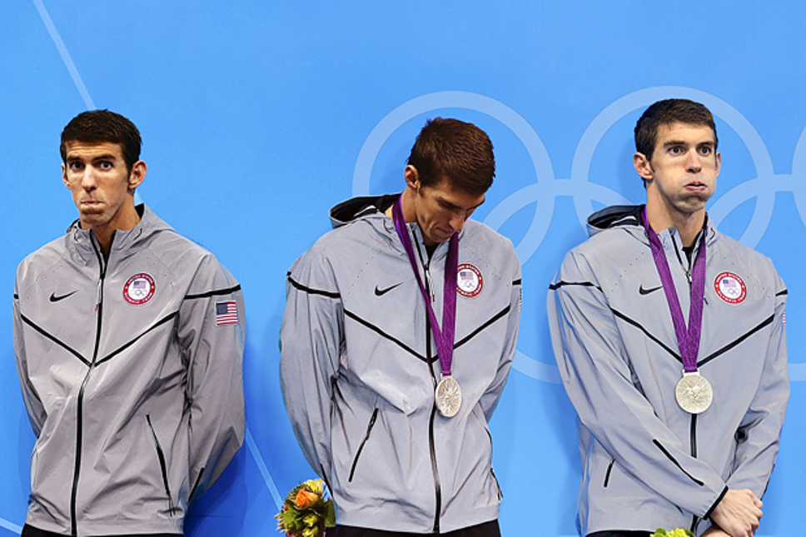

Slide 19
Framing Effect
Refers to:
a) the particular way in which the experimenter presents the problem
b) the way in which the decision maker represents the problem
Tversky and Kahneman applied this to the “Asian Disease Problem”
Notes:
The framing effect is a cognitive bias where people decide on options based on whether the options are presented with positive or negative connotations; e.g. as a loss or as a gain.

Slide 20
The Asian Disease problem
Imagine that the U.S. is preparing for the outbreak of an unusual Asian Disease, which is expected to kill 600 people. Two alternative programs to combat the disease have been proposed. Assume that the exact scientific estimate of the consequences of the programs are as follows:

Slide 21
The Asian Disease problem
Imagine that the U.S. is preparing for the outbreak of an unusual Asian Disease, which is expected to kill 600 people. Two alternative programs to combat the disease have been proposed. Assume that the exact scientific estimate of the consequences of the programs are as follows:
A
200 people will be saved.
B
1/3 probability that 600 people will be saved, and 2/3 probability that no people will be saved.

Slide 22
The Asian Disease problem
Imagine that the U.S. is preparing for the outbreak of an unusual Asian Disease, which is expected to kill 600 people. Two alternative programs to combat the disease have been proposed. Assume that the exact scientific estimate of the consequences of the programs are as follows:
A
200 people will be saved.
Which of the two programs would you favor?
B
1/3 probability that 600 people will be saved, and 2/3 probability that no people will be saved.

Slide 23
The Asian Disease problem
Imagine that the U.S. is preparing for the outbreak of an unusual Asian Disease, which is expected to kill 600 people. Two alternative programs to combat the disease have been proposed. Assume that the exact scientific estimate of the consequences of the programs are as follows:
C
400 people will die.
D
1/3 probability that nobody will die, and 2/3 probability that 600 people will die.

Slide 24
The Asian Disease problem
Imagine that the U.S. is preparing for the outbreak of an unusual Asian Disease, which is expected to kill 600 people. Two alternative programs to combat the disease have been proposed. Assume that the exact scientific estimate of the consequences of the programs are as follows:
C
400 people will die.
Which of the two programs would you favor?
D
1/3 probability that nobody will die, and 2/3 probability that 600 people will die.

Slide 25
The Asian Disease problem
Imagine that the U.S. is preparing for the outbreak of an unusual Asian Disease, which is expected to kill 600 people. Two alternative programs to combat the disease have been proposed. Assume that the exact scientific estimate of the consequences of the programs are as follows:
A
200 people will be saved.
C
400 people will die.
B
1/3 probability that 600 people will be saved, and 2/3 probability that no people will be saved.
D
1/3 probability that nobody will die, and 2/3 probability that 600 people will die.

Slide 26
The Asian Disease problem
RESULTS
the majority of people in the first group chooses the first treatment (certain gain);
the majority of people in the second group chooses the second treatment (the bet).
However, The utilities associated with the 4 consequences are the same.

Slide 27
Framing Effect
The framing effect is a violation of the invariance principle: we tend to manipulate the reference point and to take different decisions depending on how we represent it.
The most important aspects of Kahneman and Tversky’s value curve (according to Thaler):
1.Losses and gains have asymmetrical values.
2.Events are evaluated firstly individually and later on together.
Notes:
Thaler: “who is happier, person A who is given a lottery ticket worth $75 or person B who is given two lottery tickets, one worth $50 and the other $25?”
1. Recommended strategy: keep gains divided. You can increase the total value of a gain by dividing it into parts.
Thaler: “who would feel worse, person A who receives a tax bill for $150 or person B who receives two bills, one for $50 and another for $100?”
2. Recommended strategy: keep losses together. When considering two losses together they seem less heavy than the same losses considered separately.

Slide 28
1
Prospect Theory stems from loss aversion. We decide differently if we think in terms of gains or losses
2
Loss aversion and reference point (status quo) influence how we perceive results and outcomes
To Sum up
3
Framing Effect and the Asian disease problem as a violation of invariance principle
Notes:
circa 13-15 minuti
Trust emerged in describing human-human relationships, then HCI examined the commonalities with the automation
Differences between the concepts of Reliance, Trust and Credibility
Design for appropriate trust, not greater trust
Carefully evaluate any anthropomorphizing of the automation

Slide 29
3
The Two Systems
Notes:
30 min

Slide 30
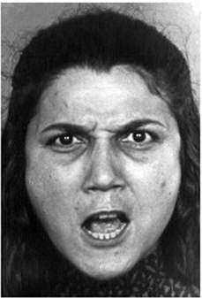
Notes:
To observe your mind in automatic mode, glance at the image.
Your experience as you look at the woman’s face seamlessly combines what we normally call seeing and intuitive thinking. As surely and quickly as you saw that the young woman’s hair is dark, you knew she is angry. Furthermore, what you saw extended into the future. You sensed that this woman is about to say some very unkind words, probably in a loud and strident voice. A premonition of what she was going to do next came to mind automatically and effortlessly. You did not intend to assess her mood or to anticipate what she might do, and your reaction to the picture did not have the feel of something you did. It just happened to you. It was an instance of fast thinking.

Slide 31
Notes:
Now look at the following problem: 17 × 24 You knew immediately that this is a multiplication problem, and probably knew that you could solve it, with paper and pencil, if not without. You also had some vague intuitive knowledge of the range of possible results. You would be quick to recognize that both 12,609 and 123 are implausible. Without spending some time on the problem, however, you would not be certain that the answer is not 684. A precise solution did not come to mind, A precise solution did not come to mind, and you felt that you could choose whether or not to engage in the computation. If you have not done so yet, you should attempt the multiplication problem now, completing at least part of it. You experienced slow thinking as you proceeded through a sequence of steps. You first retrieved from memory the cognitive program for multiplication that you learned in school, then you implemented it. Carrying out the computation was a strain. You felt the burden of holding much material in memory, as you needed to keep track of where you were and of where you were going, while holding on to the intermediate result.

Slide 32
SYSTEM 1
SYSTEM 2
Intuition & Instinct
Rational Thinking
95 %
5 %
Unconscious
Fast
Associative
Automatic pilot
Takes Effort
Slow
Logical
Lazy
Indecisive
Notes:
System 1 (intuitive): • It works automatically, it is quick to reach a conclusion, does not require much cognitive effort since it does not require voluntary control. • System 2 (analytic): • Works directing attention towards demanding mental activities, requires more effort and it is slower than the intuitive system. It requires voluntary action, and the employment of attention, working memory, and self control.
20240328 rubaltellin pg. 6 slides dual process 1

Slide 33
The two systems
System 1 (intuitive)
System 2 (analytic)
It works automatically, it is quick to reach a conclusion, does not require much cognitive effort since it does not require voluntary control.
Works directing attention towards demanding mental activities, requires more effort and it is slower than the intuitive system. It requires voluntary action, and the use of attention.
Usually, we rely on the intuitive system, while the analytic system remains inactive. In this way we can save cognitive energies and spend as less energy as possible
Notes:
System 1 (intuitive):
It works automatically, it is quick to reach a conclusion, does not require much cognitive effort since it does not require voluntary control.
• System 2 (analytic):
Works directing attention towards demanding mental activities, requires more effort and it is slower than the intuitive system. It requires voluntary action, and the employment of attention, working memory, and self control.

Slide 34
The role of Attention
System 1 (intuitive): It works automatically, it is quick to reach a conclusion, does not require much cognitive effort since it does not require voluntary control.
System 2 (analytic): Works directing attention towards demanding mental activities, requires more effort and it is slower than the intuitive system. It requires voluntary action, and the employment of attention, working memory, and self control.
The control of attention is shared by both systems.
It is important to remember that attention is a limited resource.
It is not possible to pay attention to a large number of stimuli at the same time.
Usually, demanding mental processes compete to use the same cognitive/attentional resources and interfere with one another.
Notes:
System 1 (intuitive): • It works automatically, it is quick to reach a conclusion, does not require much cognitive effort since it does not require voluntary control. • System 2 (analytic): • Works directing attention towards demanding mental activities, requires more effort and it is slower than the intuitive system. It requires voluntary action, and the employment of attention, working memory, and self control.
the control of attention is shared by both systems. • When we hear a loud noise, we automatically direct our attention towards the source or direction of the sound (automatic response). • Afterwards, we focus our attention on that sound to understand what has happened (deliberative response).
It is important to remember that attention is a limited resource. • It is not possible to pay attention to a large number of stimuli at the same time. • Usually, demanding mental processes compete to use the same cognitive/attentional resources and interfere with one another.

Slide 36
The role of Attention
No one would ever miss the gorilla if not for the instruction to count the number of passes made by people with the white shirt...
The task of counting the passes is difficult enough to require cognitive effort and selective attention.
Thousands of people watched the videos and half of them did not see the gorilla the first time.
Many people did not believe the gorilla was actually present and thought it was added in the replay.
When we focus on something important we become “blind to evidence” and “blind to our own blindness”.

Slide 37
Interaction between the two systems
Usually, we rely on the intuitive system, while the analytic system remains
inactive. This way we can save cognitive energies and spend as less
energy as possible.
Only when the intuitive system fails to reach a plausible conclusion the
analytic one steps in and assesses the situation.
The interaction between the two systems is very efficient because it allows to minimize the effort and optimize decision quality. The intuitive system is generally able to:
Have a good representation of familiar situations.
Can make short time predictions. However, it is also prone to errors and biases

Slide 38
BLUE GREEN
RED
GREEN BLUE
RED

Slide 39
GREEN BLUE
RED
BLUE GREEN
RED

Slide 40
Conflicts between the two systems
Usually we do not care about the color used to write a word, because we automatically focus on its meaning.
As a result, when we are asked to report the color instead of the actual word we experience a conflict.
The meaning of the word is elaborated automatically and interferes with the task we are asked to complete (reporting the color)
The analytic system has to inhibit the intuitive response and this makes the task more difficult (and our responses become slower).

Slide 41
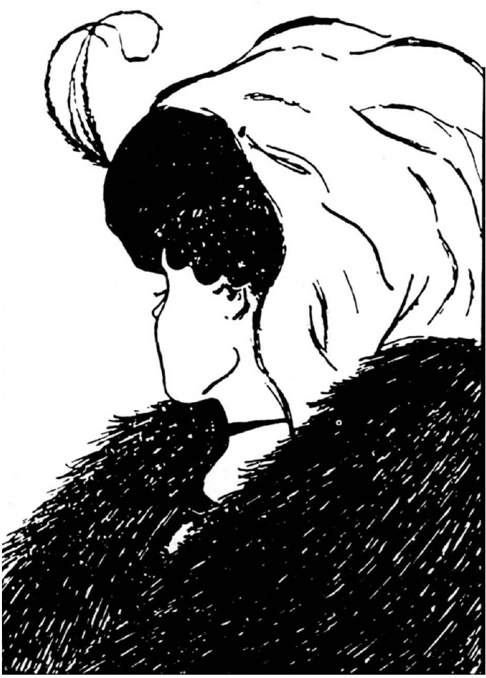
Conflicts between the two systems

Slide 42
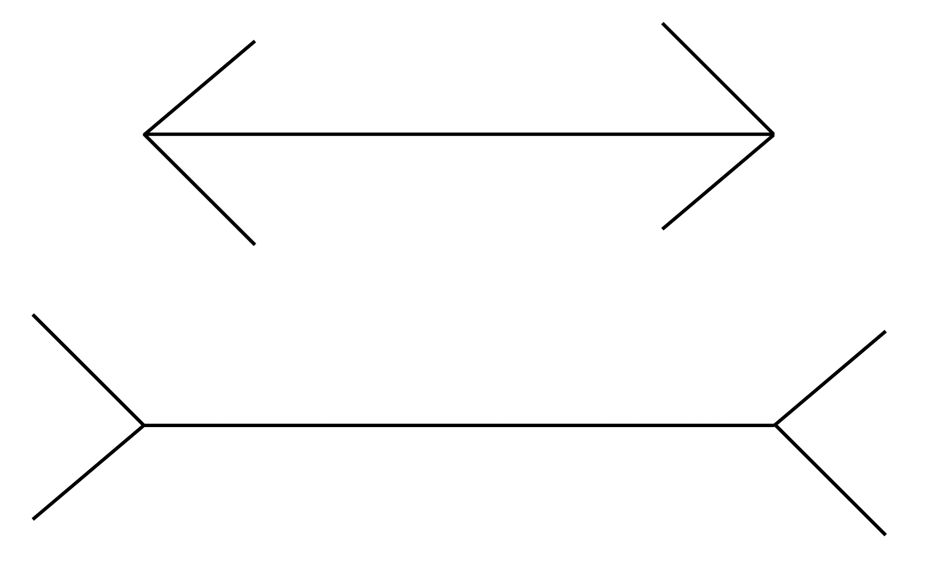
Conflicts between the two systems

Slide 43
Conflicts between the two systems

Slide 44
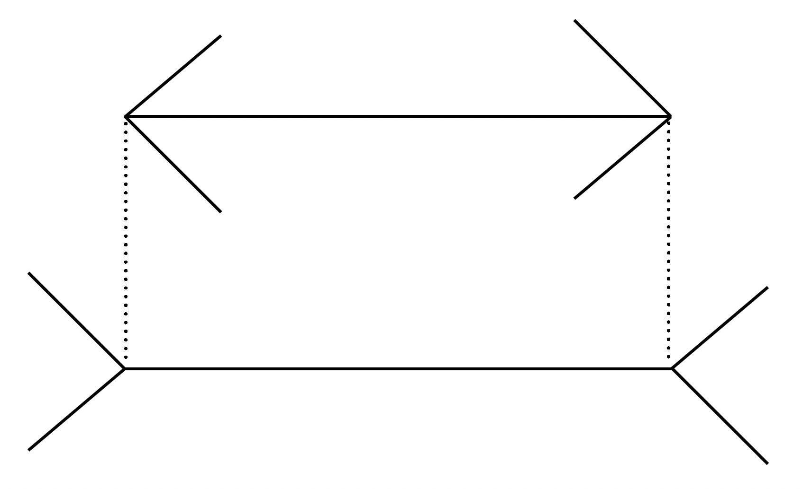
Conflicts between the two systems
Notes:
Quella rappresentata nella pagina precedente è una classica illusione
percettiva: la Muller-Lyer illusion.
Chi conosce questa illusione sa che le due linee hanno la stessa
lunghezza, tuttavia, d’istinto, continuerà a vedere una linea più
lunga dell’altra.
- Anche se misurate le due linee e decidete di fidarvi della
misurazione, che conferma che sono uguali, il sistema intuitivo
continuerà a vedere la seconda linea come più lunga.

Slide 45
1
System 1 and System 2 are two ways of reasoning and both are important
2
The role of attention in using the two systems is essential even if it is limited
To Sum up
3
Interaction and conflicts of the two systems stem from unfamiliar situation and S1 is uncontrollable
Notes:
circa 13-15 minuti
Trust emerged in describing human-human relationships, then HCI examined the commonalities with the automation
Differences between the concepts of Reliance, Trust and Credibility
Design for appropriate trust, not greater trust
Carefully evaluate any anthropomorphizing of the automation

Slide 46
4
Heuristics and Biases

Slide 47
What are cognitive biases?
1
Features of ordinary human psychology

Slide 48
What are cognitive biases?
1
Features of ordinary human psychology
2
make us prone to errors in how we form beliefs and make decisions

Slide 49
What are cognitive biases?
1
Features of ordinary human psychology
2
make us prone to errors in how we form beliefs and make decisions
3
are judged compared to some accepted standard of «good reasoning»

Slide 50
The Three Heuristics

Slide 51
The Three Heuristics
1
Representativeness

Slide 52
The Three Heuristics
1
Representativeness
2
Availability

Slide 53
The Three Heuristics
1
Representativeness
2
Availability
3
Anchoring and Adjustment

Slide 54
The Three Heuristics
1
These heuristics are like mental “shortcuts” that people use in an unconscious way
Representativeness
2
Availability
3
Anchoring and Adjustment

Slide 55
The Three Heuristics
1
These heuristics are like mental “shortcuts” that people use in an unconscious way
Representativeness
2
Availability
As a result, they are very difficult to avoid because we only realize we used them after they affected our judgements
3
Anchoring and Adjustment
Notes:
As a result, they are very difficult to avoid because we only realize we used them after they affected our judgements

Slide 56
Representativeness
The representativeness heuristic is used to answer questions like:
What is the likelihood that object A belongs to class B?
What is the likelihood that the event A originates from process B?
Likelihoods are assessed on the basis of how much A is representative of B
If A is highly representative of B then the likelihood that A originated from B is judged as high.
Notes:
The representativeness heuristic involves making a decision by comparing the present situation to the most representative mental prototype.

Slide 57
Representativeness
People make mistakes when they judge whether a particular event belongs to a specific process or category
In other words, likelihood judgements are made based on how much an event is representative of the process being evaluated…
In doing these evaluations people end up NEGLECTING sample size or the laws of probability.

Slide 58
Availability Heuristic
People rely on this heuristic when they need to make judgments regarding the likelihood of future events
In making this type of judgments they use the information that comes more easily to their minds.
However, our memory:
is not perfect
Does not work by employing statistical principles
Is influenced by psychological factors like our cognitive limitations
Notes:
The availability heuristic involves making decisions based upon how easy it is to bring something to mind.

Slide 59
Availability Heuristic
The psychological processes behind the availability heuristic are
particularly powerful and pervasive. Some of them are:
Likeness-driven associations.
Perceptual errors (some events are easier to remember and remain impressed in our memory).
Memory is selective and attention plays always a main role in recalling the events.

Slide 60
Availability Heuristic
When judging the likelihood of an event people try to remember or
mentally generate examples that can be used as useful hints.
Since this a psychological phenomenon, we already know it wont follow precisely the rules of randomness (no normal distribution).
For instance, vivid events look more frequent than they actually are:
think about terrorist events or people who hurt you.

Slide 61
Availability Heuristic
The examples that come to our mind are not like objective information,
but a “psychological sampling” that we use to make inferences regarding
the likelihood of an event.
Usually, the examples that come more easily to our mind are those:
Vivid.
Linked to our previous experiences.
Most recent.

Slide 62
Anchoring and Adjustment
•Often, when we are asked for numerical estimates we tend to anchor to a particular value and then adjust the estimate in the direction we believe the correct answer is to be found.
• This happens when we are asked for a precise, numeric estimate on a subject we do not know well enough, therefore we are tempted to look around for a point to start from.
Notes:
The anchoring bias involves the tendency to be overly influenced by the first bit of information we hear or learn. This can make it more difficult to consider other factors and lead to poor choice

Slide 63
Anchoring and Adjustment
Tversky and Kahneman studies (as well as those of many other scholars)
demonstrated that people can use these starting values even when:
They are told that the number was selected randomly.
When anchors are absolutely implausible (extremely high or low values)
When there are no available numbers, people create them (self-generated anchors).

Slide 64
5
Mental Models

Slide 65
Mental Models
MM are how we understand the world. They are simulations of the world that your mind constructs when you think and reason.
However…
These simulation about how the world work aren’t always correct…
«The human mind is not designed to understand the complexities of all these systems.»
Don Norman
Notes:
Alfred Korzybski, father of general semantics
The map is not the territory

Slide 66
Gulfs of interaction

Slide 67
Cognitive Artifacts
A cognitive artifact is something physical or digital for the purpose of aiding, enhancing or improving the human cognition.
Cognitive artifacts can be used to guide decision-making, recall, and/or thinking.
Notes:
Cole, M. (1990). Cultural psychology: A once and future discipline? Paper presented at the Nebraska Symposium, 1989.

Slide 68
7
Reliance, Credibility, and Trust

Slide 69
Reliance
﻿Reliance: is a discrete process of engaging or disengaging, automation/AI can be a very complex combination of many modes and it is often a more graded process.
Reliance encompasses the user's willingness to rely on the system's functionality, information, and recommendations in order to accomplish their goals effectively and efficiently.
Notes:
﻿reliance on automation as a discrete process of engaging or disengaging, automation can be a very complex combination of many modes and reliance is often a more graded process. Automation reliance is not a simple binary process, but the simplification makes the discussion of misuse and disuse more tractable. Understanding how to mitigate disuse and misuse of automation is a critically important problem with broad ramifications.
Recent
Reliance in HCI involves a cognitive and behavioral aspect, where users place their confidence in the system's capabilities and adapt their actions and decision-making accordingly.

Slide 70
Credibility
﻿Credibility is a perceived quality; it doesn’t reside in an object, a person, or a piece of information.
Credibility is synonymous with believability, and is the resulting outcome of trustworthiness and expertise. Thus, credibility is an individual characteristic.

Slide 71
Credibility
Perceived Trustworthiness
Perceived Expertise
Perceived credibility
Trustworthiness: the perceived goodness or morality of the source
Expertise: the perceived knowledge, skill, and experience ofthe source
﻿credibility is a perceived quality;it doesn’t reside in an object, a person, or a piece of information.
Notes:
﻿Trustworthiness is a key factor in the credibility equation. The trustworthiness dimension of credibility captures the perceived goodness or morality of the source. In the context of computers, a computer that is “trustworthy” is one that is perceived to be truthful, fair, and unbiased. People in certain professions, such as judges, physicians, priests, and
referees, are generally perceived to be trustworthy. These individuals have a professional duty to be truthful, unbiased, and fair. If it’s perceived that they are not trustworthy, they lose credibility.
﻿The second dimension of credibility is expertise—the perceived knowledge, skill, and experience ofthe source.Manycues lead to perceptions of expertise. Among them are labels that proclaim one an expert (such as the title “professor” or “doctor”), appearance cues (such as a white lab
coat), and documentation ofaccomplishments (such as an award for excellent performance).

Slide 72
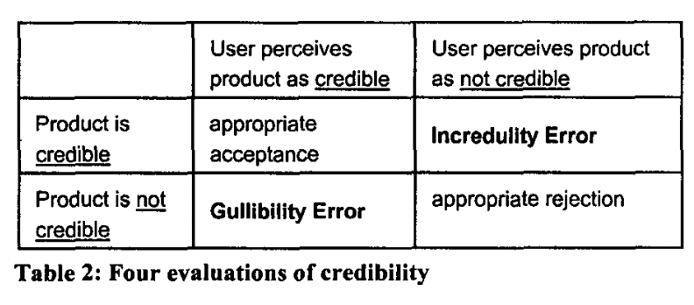
Fogg, B. J., & Tseng, H. (1999). The elements of computer credibility. CHI ’99, 80–87. https://doi.org/10.1145/302979.303001

Slide 73
Which is the worst error?
 | User follows AI | User not follows AI
AI is correct | Appopriate reliance | Incredulity error
AI is incorrect | Gullibility error | Appropriate rejection

Slide 74
Which is the worst error?
 | User follows AI | User not follows AI
AI is correct | Appopriate reliance | Incredulity error
AI is incorrect | Gullibility error | Appropriate rejection
Notes:
Perché si fida e sbaglia, perde la fiducia

Slide 75
Trust
The attitude that an agent will help achieve an individual’s goal in a situation characterized by uncertainty and vulnerability
Trust: Cognitive learning process obtained from social experiences based on the consequences of trusting behavior
the expectation of an agent (the trustor) that another agent (the trustee) will help to achieve the trustor’s goals in an uncertain and vulnerable situation
Notes:
﻿reliance on automation as a discrete process of engaging or disengaging, automation can be a very complex combination of many modes and reliance is often a more graded process. Automation reliance is not a simple binary process, but the simplification makes the discussion of misuse and disuse more tractable. Understanding how to mitigate disuse and misuse of automation is a critically important problem with broad ramifications.
Recent
Reliance in HCI involves a cognitive and behavioral aspect, where users place their confidence in the system's capabilities and adapt their actions and decision-making accordingly.

Slide 76
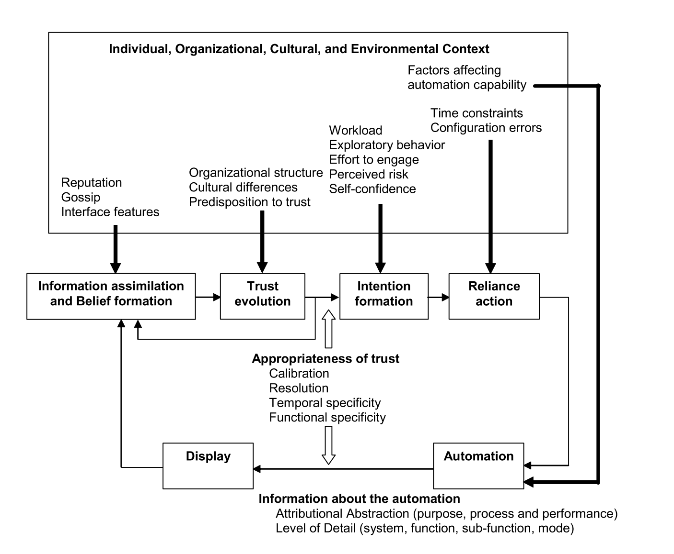

Slide 77
Notes:
Attitude: Attitude refers to an individual's overall evaluation or assessment of performing a particular behavior. It encompasses beliefs about the outcomes or consequences of the behavior and the subjective value attached to those outcomes.
Subjective Norm: Subjective norm refers to the perceived social pressure or influence individuals perceive from others regarding the performance or non-performance of a behavior. It reflects the individual's perception of whether significant others approve or disapprove of the behavior and the motivation to comply with those perceived norms.
Perceived Behavioral Control: Perceived behavioral control (PBC) refers to an individual's perception of the ease or difficulty in performing a behavior. It encompasses beliefs about the presence of facilitating or hindering factors, as well as one's perceived ability to overcome obstacles and exercise control over the behavior.
Intention: Intention represents an individual's readiness or willingness to engage in a specific behavior within a given context and timeframe. It serves as a proximal determinant of actual behavior and is influenced by attitudes, subjective norms, and perceived behavioral control.
Behavior: Behavior refers to the observable actions or conduct exhibited by individuals in a specific context. It encompasses any action, whether overt or covert, that can be directly observed, measured, or reported.

Slide 78
Trust Bases: goal-oriented information
Purpose
Process
Performance
The degree to which a system is being used within the realm of the designer’s intent
The appropriateness of a system’s algorithm for the situation in which it is working and the extent to which it can contribute to the team’s goals
Related to an automated system’s demonstrated operations, such as reliability, predictability and ability

Slide 79
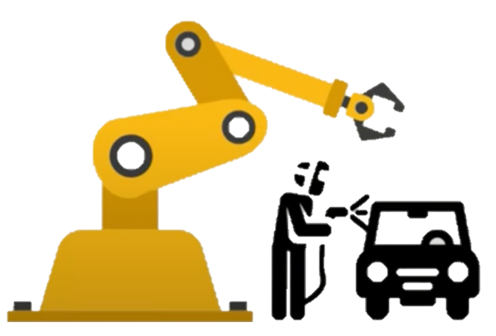
Trust bases
Purpose: The degree to which a system is being used within the realm of the designer’s intent
“I can lift parts weighing up to 100 kg and move them, but I cannot sense if you are in my workspace”
Notes:
Consider the example of a robot and a human working togheter in a manufacturing setting. The robot is responsible for picking up and moving parts and the human is responsible for welding them. a Robot providing purpose-related information might tell human something about what it is designed to do

Slide 80
Trust bases
Process: The appropriateness of a system’s algorithm for the situation in which it is working and the extent to which it can contribute to the team’s goals
“I decide which objects to move and where to move them based on pre-programmed schedules, and I cannot move un-programmed objects”
Notes:
In providing process related information. The R provide how it goes about doing its tasks. Such as….

Slide 81
Trust bases
Performance: Related to an automated system’s demonstrated operations, such as reliability, predictability and ability
“I correctly place items I move 90% of the time”
Two aspects of performance:
Task performance
Explanation performance
Notes:
Performance related should tell the human how well it performs the task that is doing. Eg…
Two aspects: 1 provide information about its performance as primary task
2 how effectively can explain its behavior, in other words its explanation performance
Eg. A system that performs object detection and classification. The r perform the task very well and it is accurate. However, it might not be able to explain the factors that impacted its classification and the edge cases in which it might make mistakes. Both types of info are valuabe and support trustworthiness

Slide 82
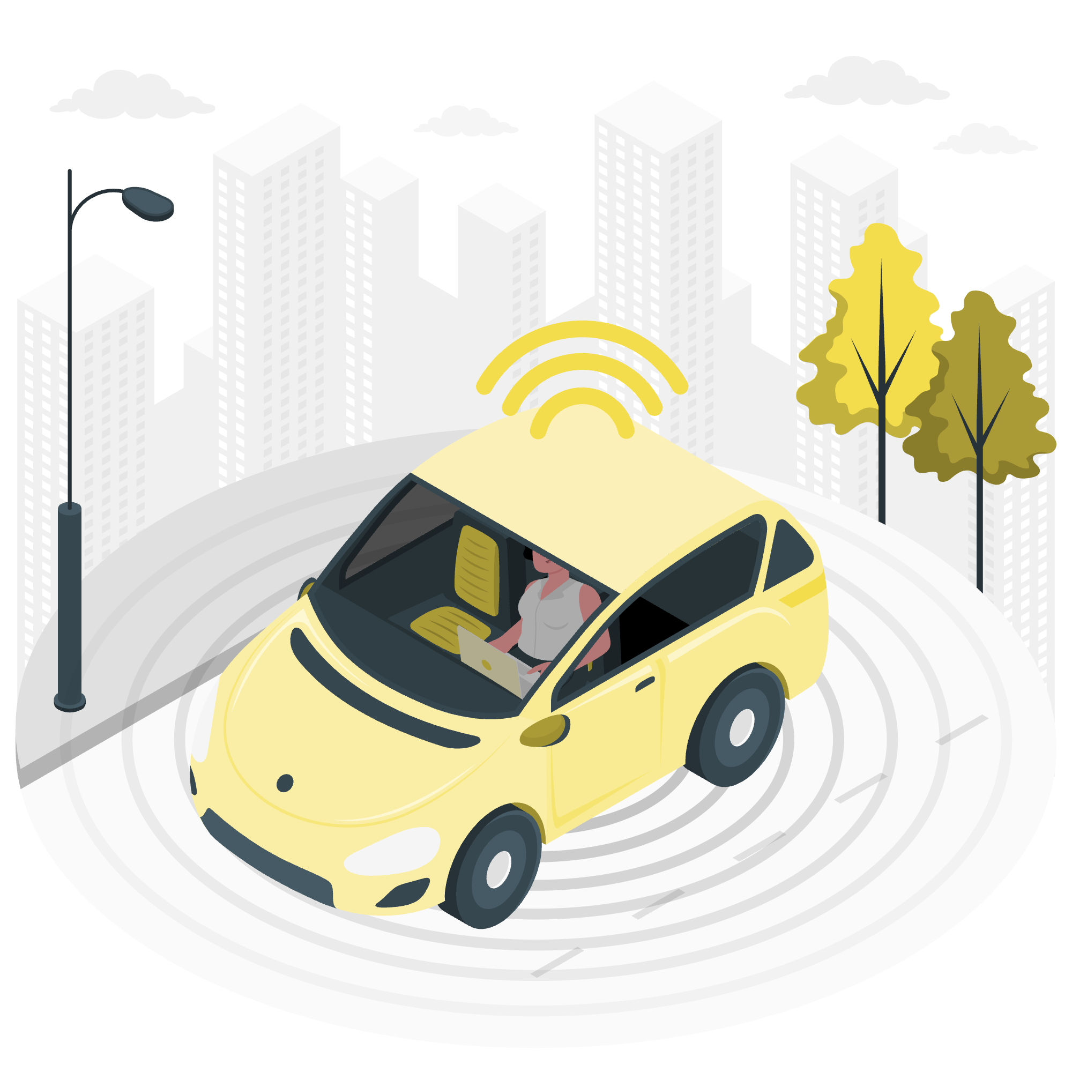
Trust Calibration
Trust Calibration: The correspondence between a person’s trust in the automation and the automation’s true capabilities
Overtrust -> Misuse
Undertrust -> Disuse
Notes:
It is appropriate to increase trust when the system is trustworthy
Someone should only maintain the attitude that an agent will help them
Achieve their goals to the extent that the agent is actually able to do so.
More important than increasing trust in AI systems as stated in many explanation techniques, IS APPROPRIATELY CALIBRATING TRUST TO ENSURE APPROPRIATE USE.
Overtrust can lead to misuse, when the system cannot actually accomplish the task that it’s trusted with.
For example selfdriving car cannot perform well on city streets and might rely to the human driver to be engaged enough to take over control for emergency situation. If the human overtrust the car can be not attentive enough
UNDERTRUST: if the H perceives a robot to not be reliable and the robot warns the human of the potential emergency situation, the human might ignore the warning.
When developing XAI considering how explanation affect trust the goal should not be solely to increase trust, but instead to align user trust with system’s true capabilities.
Appropriate trust calibration can be enabled through explanation about system’s capabilities, limitations, and confidence. And XAI should take care to support trust calibration through explanation that provide such information
﻿Such flawed partnerships between automation and people can be described in terms of misuse and disuse of automation (R. Parasuraman & Riley, 1997). Misuse refers to the failures that occur when people inadvertently violate critical assumptions and rely on automation inappropriately, whereas disuse signifies failures that occur when people reject the capabilities of automation. Misuse and disuse are two examples of inappropriate reliance on automation that can compromise safety and profitability.
﻿research suggests that misuse and disuse of automation may depend on certain feelings and attitudes of users, such as trust. This is particularly important as automation becomes more complex and goes beyond a simple tool with clearly defined and easily understood behaviors. In particular, many studies show that humans respond socially to technology, and reactions to computers can be similar to reactions to human collaborators (Reeves & Nass, 1996).
Misuse occurs when people rely on automation inappropriately, while disuse happens when they reject the capabilities of automation2. The paper emphasizes the importance of trust in automation, as it guides reliance, especially when complexity and unanticipated situations make a complete understanding of the automation impractical3. The goal is to design systems that encourage appropriate trust and reliance, thereby enhancing safety in HCAI.

Slide 83
1
Reliance, credibility, and trust are three different concept, referred at three different constructs
2
Supporting appropriate trust should take into account: Calibration, Resolution, and Specificity
To Sum up
3
To support appropriate trust calibration in AI designers should provide goal –oriented information
Notes:
circa 13-15 minuti
Trust emerged in describing human-human relationships, then HCI examined the commonalities with the automation
Differences between the concepts of Reliance, Trust and Credibility
Design for appropriate trust, not greater trust
Carefully evaluate any anthropomorphizing of the automation

Slide 84
Trust Calibration and XAI
AI Aversion
AI Overreliance
Lee, J. D., & See, K. A. (2004). Trust in automation: Designing for appropriate reliance. In Human Factors (Vol. 46, Issue 1, pp. 50–80).
Notes:
In recent years, has become the focus of the research community developing methods to explain AI models AI (XAI). Many XAI methods have been developed for the most varied type of data and algorithm, however the studies of the impact of such explanations on real users are few and mostly focused on laypeople. In our work we study the relationship between trust and AI explanations with a user study involving healthcare professionals.
Trust plays a central role in the adoption of new technologies, and explanations are often considered as the solution to trust issues. Ideally, explaining a DSS recommendations should help clinicianc with trust calibration.
We can see the trust calibration with technologies as a continuum between the algorithm aversion, or the discounting of algorithm suggestion often because of their complex reasoning.
On the other extreme, we can find the overreliance, also know as Automation Bias, due to the thought that AI is always correct

Slide 85
Some important aspects for trust
Algorithm aversion
People do not trust complex systems when they see them err
Algorithm Appreciation
People trust more algorithmic advice compared to human
Desire for Perfection
Users expect that “machines cannot be wrong”
Effect of what might have been
Impossibility to blame artifact
After a bad outcome with prior higher expectations, counterfactuals may arise stronger
Blame is a social emotion directed to other human beings, what about with an AI?

Slide 86
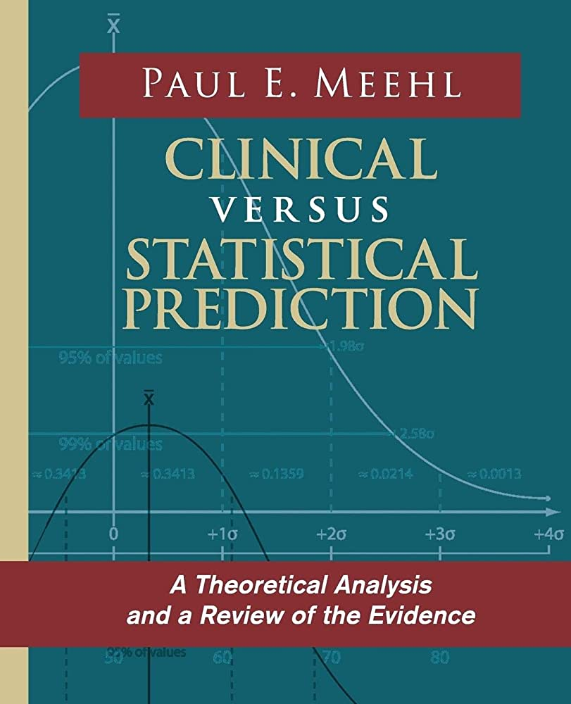
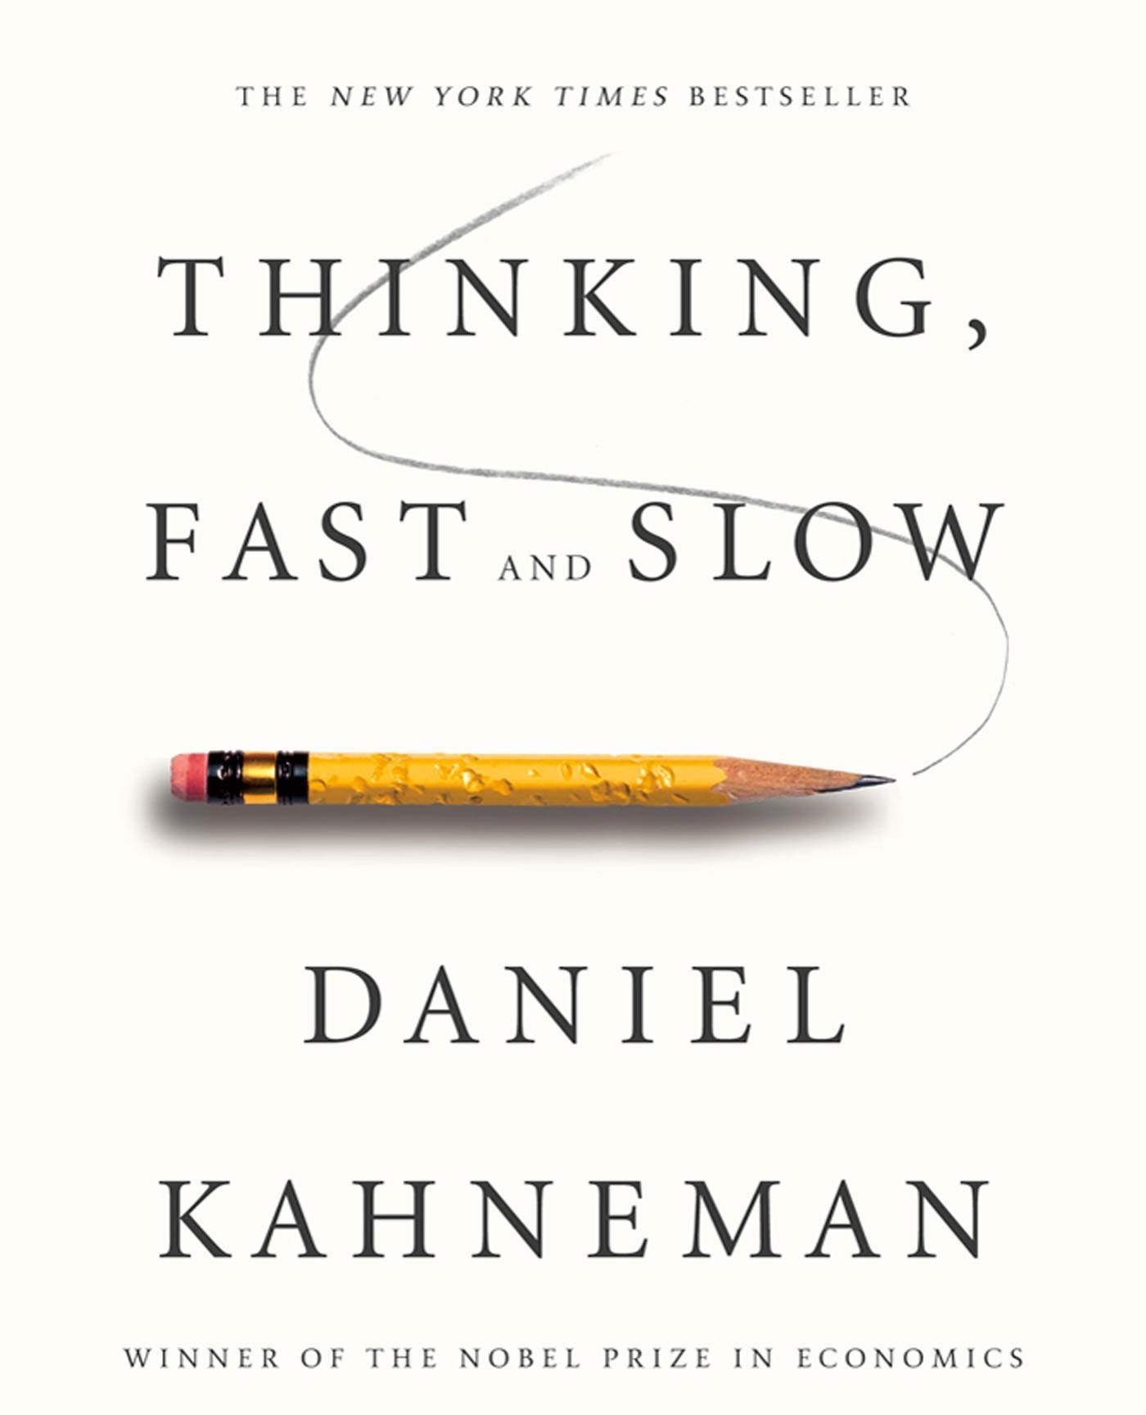
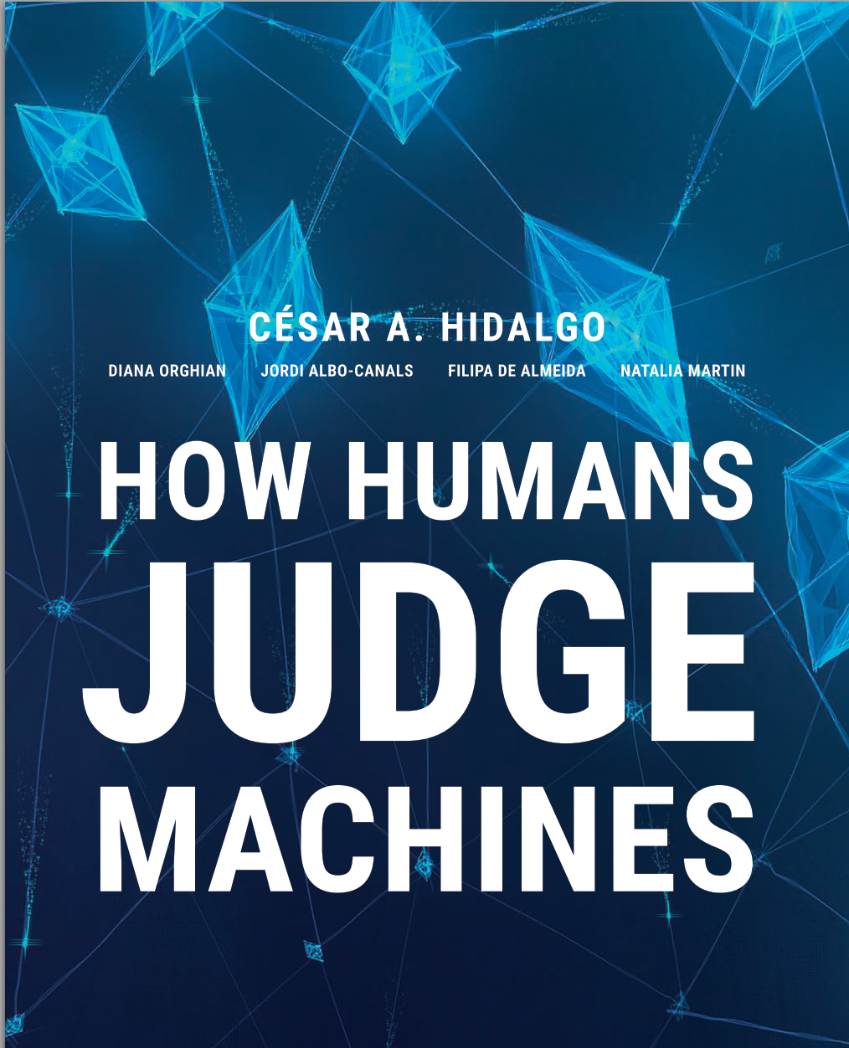
Algorithm aversion: a long history
1954
2011
2021
Notes:
ah complex decisions inconsistent people and poor judgments/kah decisioni complesse persone incoerenti e giudizi sommari﻿
Imagine that you are driving to work via your normal route. You run into traffic and you predict that a different route will be faster. You get to work 20 minutes later than usual, and you learn from a co-worker that your decision to abandon your route was costly; the traffic was not as bad as it seemed.
Many of us have made mistakes like this one, and most would shrug it off. Very few people would decide to never again trust their own judgment in such situations.
Now imagine the same scenario, but instead of you having wrongly decided to abandon your route, your traffic-sensitive GPS made the error. ﻿Upon learning that the GPS made a mistake, many of us would lose confidence in the machine, becoming ﻿reluctant to use it again in a similar situation. It seems that the errors that we tolerate in humans become less tolerable when machines make them

Slide 87
Some Causes for Algorithm Aversion
The desire for perfect forecasts
The inability of algorithms to learn
The presumed ability of human forecaster to improve through experience
The notion that algorithms are dehumanizing
The notion that algorithms cannot consider individual targets
Concerns about the ethicality of relying on algorithms to make important decisions
The presumed inability of algorithms to incorporate qualitative data
Notes:
﻿Some of the cited reasons for the cause of algorithm aversion include: the desire for perfect forecasts (Dawes, 1979;
2 ﻿Einhorn, 1986; Highhouse, 2008), the inability of algorithms to learn (Dawes, 1979), the presumed ability of human forecasters to improve through experience (Highhouse, 2008), the notion that algorithms are dehumanizing (Dawes, 1979; Grove & Meehl, 1996), the notion that algorithms cannot properly consider individual targets (Grove & Meehl, 1996), concerns about the ethicality of relying on algorithms to make important decisions (Dawes, 1979), and the presumed inability of algorithms to incorporate qualitative data (Grove & Meehl, 1996). On the one hand, these writings offer thoughtful and potentially viable hypotheses about why algorithm aversion occurs. On the other hand, the absence of empirical evidence means that we lack real insight into which of these (or other) reasons actually drive algorithm aversion.
﻿Imagine that you are driving to work via your normal route. You run into traffic and
you predict that a different route will be faster. You get to work 20 minutes later than usual, and you learn from a co-worker that your decision to abandon your route was costly; the traffic was not as bad as it seemed. Many of us have made mistakes like this one, and most would shrug it off. Very few people would decide to never again trust their own judgment in such situations. Now imagine the same scenario, but instead of you having wrongly decided to
abandon your route, your traffic-sensitive GPS made the error. ﻿Upon learning that the GPS made a mistake, many of us would lose confidence in the machine, becoming ﻿reluctant to use it again in a similar situation. It seems that the errors that we tolerate in humans become less tolerable when machines make them

Slide 88
Algorithm Aversion
It occurs when:
﻿people prefer humans’ forecasts to algorithms’ forecasts
more strongly weight human input than algorithmic input
and more harshly judge professionals who seek out advice from an algorithm rather than from a human
«﻿Algorithm aversion is costly, as it leads to suboptimal outcomes in important domains including: forecasting, hiring decisions, making medical diagnoses.»
Berkeley Dietvorst
Notes:
to explore the consequences of the human willingness to rely on algorithms and their broader theory of machine. Doing so can help decision makers increase their awareness of being potentially manipulated and also help them better extract the knowledge that is available in order to thrive in the world of “big data.”
﻿As humans interact more frequently with programmed agents in
their workplaces, homes, and cars, we need to understand their theory of machine. Theory of machine, like theory of mind, requires people to consider the internal processes of another agent. Philosophical work on theory of mind considers how people infer other people’s intentions and beliefs (Dennett, 1987; Saxe, 2007), In contrast, theory of machine considers people’s lay perceptions of how algorithmic and human judgment differ in their input, process, and output. This theoretical fra- mework can guide future research in examining the psychological mechanisms that shape how people expect human and algorithmic judgment, at their finest, to differ. Social

Slide 89
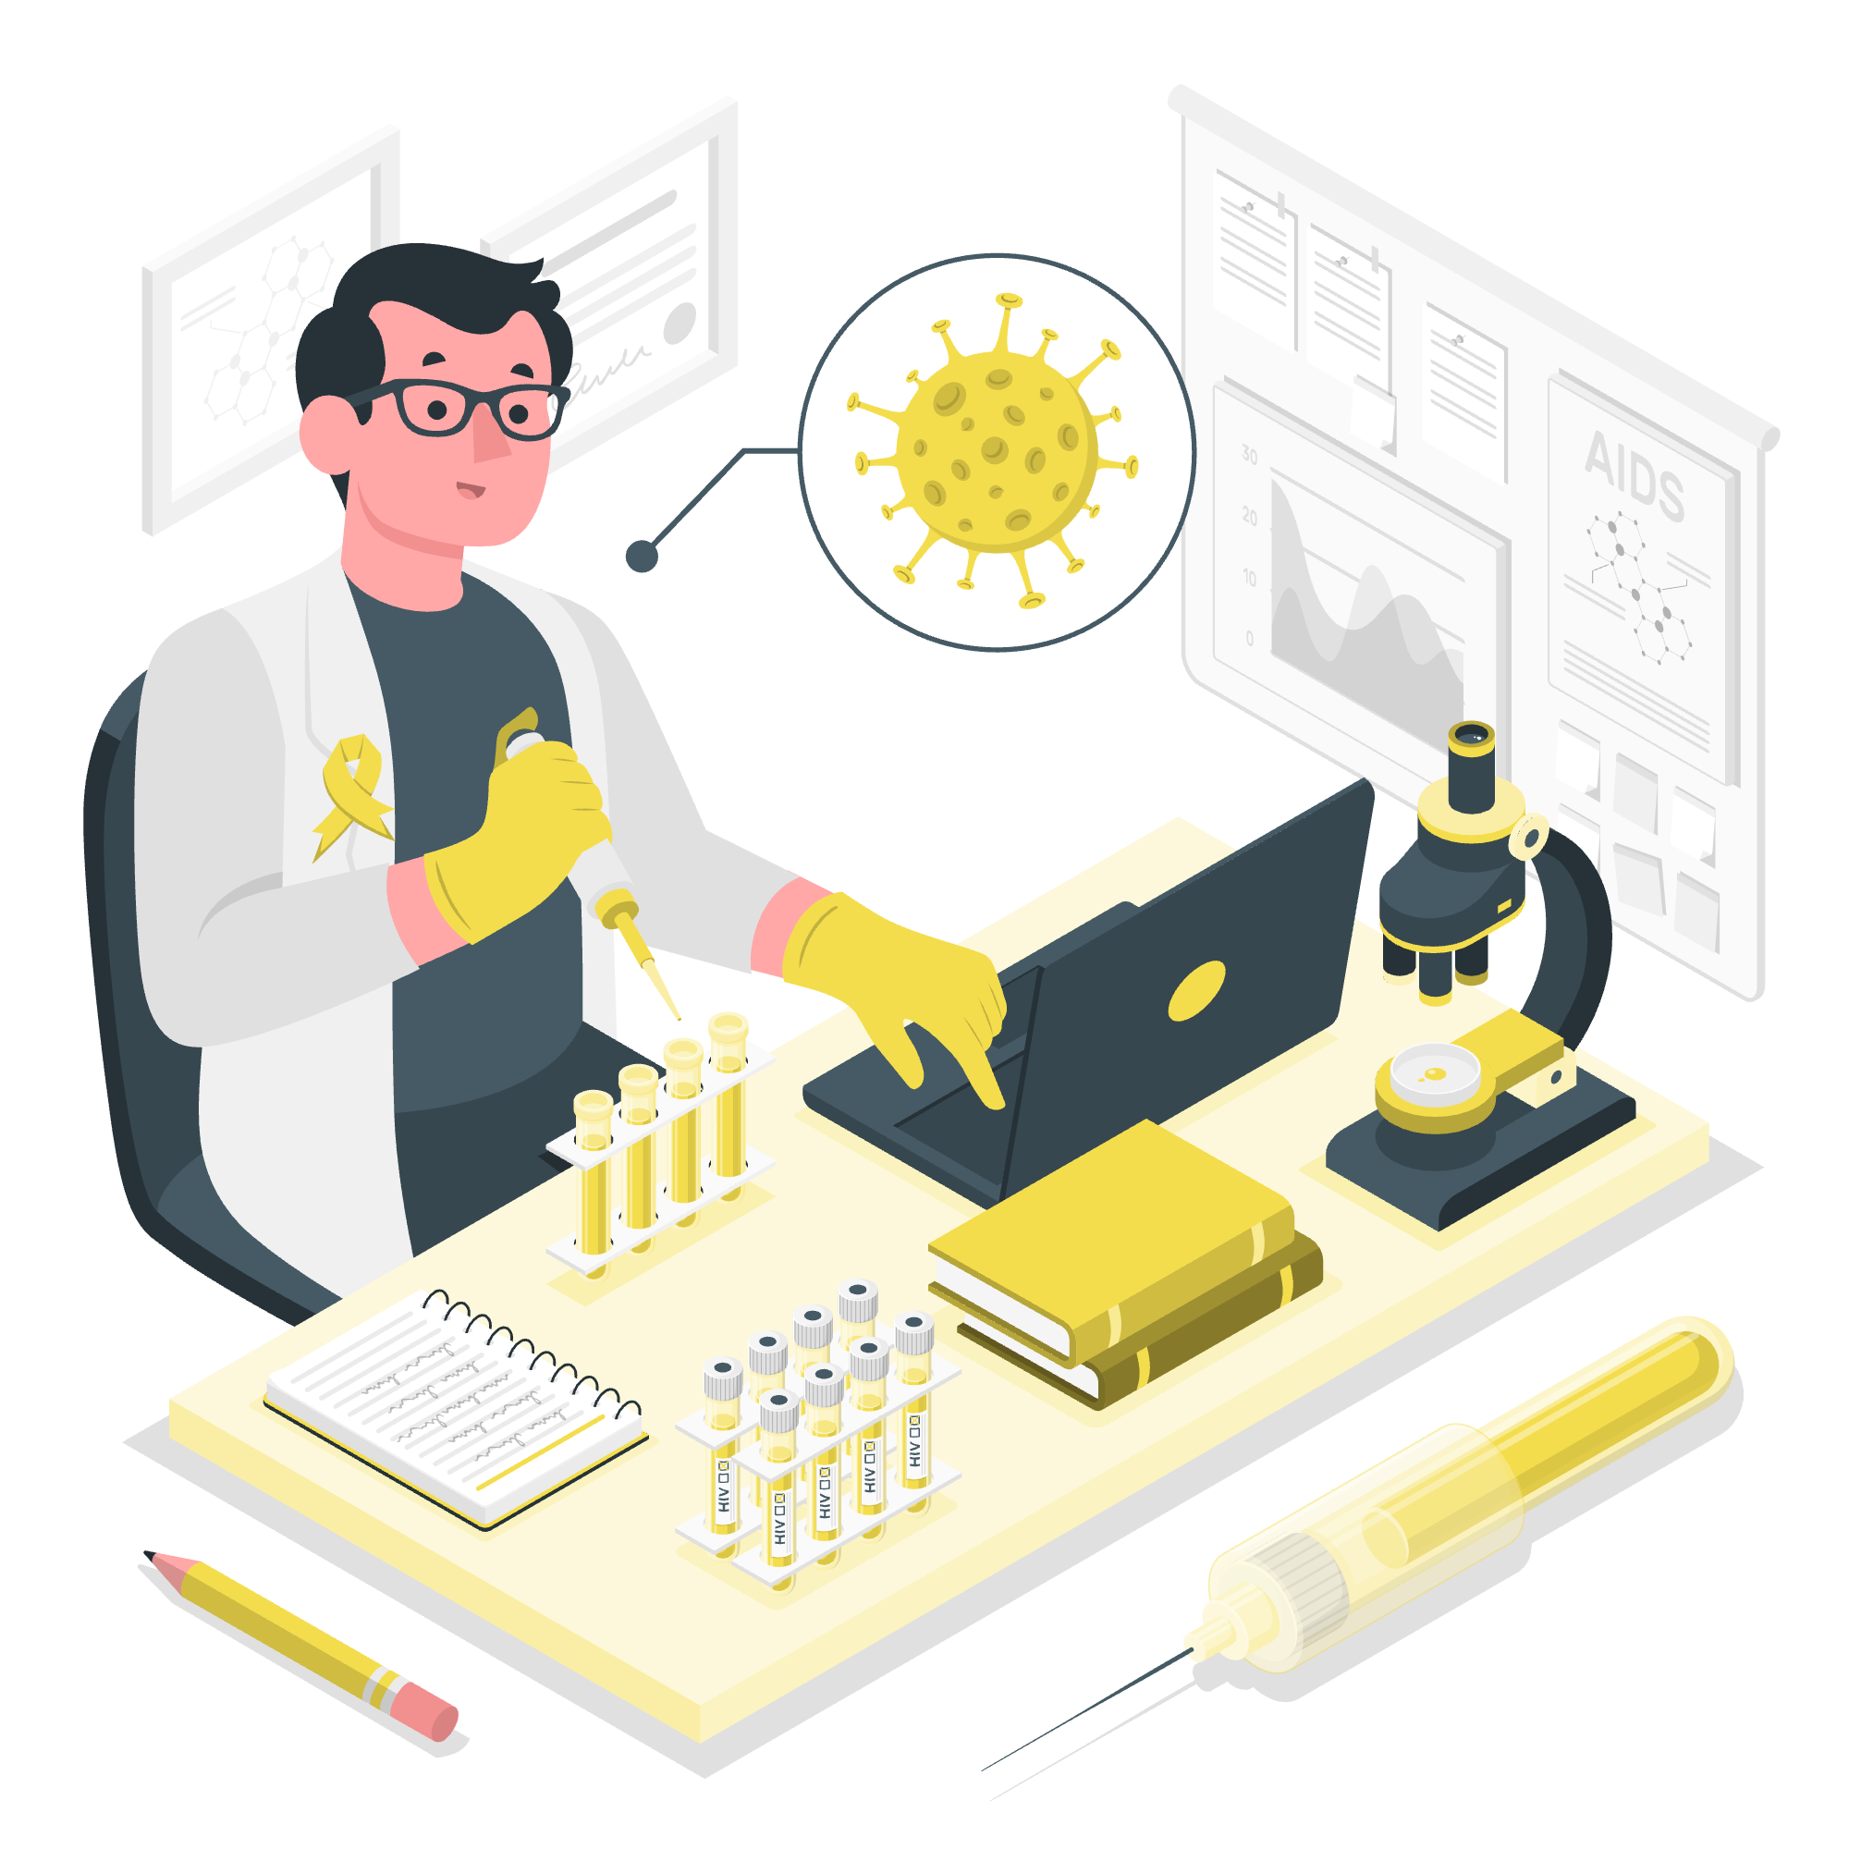
Some Causes for Algorithm Appreciation
When people are facing an objective decision
When the algorithm has a certain level of anthropomorphization
When the decision-maker can understand properly the calculations beyond
Notes:
﻿Some of the cited reasons for the cause of algorithm aversion include: the desire for perfect forecasts (Dawes, 1979;
2 ﻿Einhorn, 1986; Highhouse, 2008), the inability of algorithms to learn (Dawes, 1979), the presumed ability of human forecasters to improve through experience (Highhouse, 2008), the notion that algorithms are dehumanizing (Dawes, 1979; Grove & Meehl, 1996), the notion that algorithms cannot properly consider individual targets (Grove & Meehl, 1996), concerns about the ethicality of relying on algorithms to make important decisions (Dawes, 1979), and the presumed inability of algorithms to incorporate qualitative data (Grove & Meehl, 1996). On the one hand, these writings offer thoughtful and potentially viable hypotheses about why algorithm aversion occurs. On the other hand, the absence of empirical evidence means that we lack real insight into which of these (or other) reasons actually drive algorithm aversion.
﻿Imagine that you are driving to work via your normal route. You run into traffic and
you predict that a different route will be faster. You get to work 20 minutes later than usual, and you learn from a co-worker that your decision to abandon your route was costly; the traffic was not as bad as it seemed. Many of us have made mistakes like this one, and most would shrug it off. Very few people would decide to never again trust their own judgment in such situations. Now imagine the same scenario, but instead of you having wrongly decided to
abandon your route, your traffic-sensitive GPS made the error. ﻿Upon learning that the GPS made a mistake, many of us would lose confidence in the machine, becoming ﻿reluctant to use it again in a similar situation. It seems that the errors that we tolerate in humans become less tolerable when machines make them

Slide 90
Theory of Machine
﻿Theory of Machine: users’ lay theories about how algorithmic judgment works.
It defines the importance of how people expect algorithms and humans to differ, it will allow examination of how algorithmic advisors compare to human advisors.
«Theory of machine, like theory of mind, requires people to consider the internal processes of another agent.»
Jenn Logg
Notes:
Alfred Korzybski, father of general semantics
The map is not the territory

Slide 91
Trust Calibration and XAI
AI Aversion
AI Overreliance
Lee, J. D., & See, K. A. (2004). Trust in automation: Designing for appropriate reliance. In Human Factors (Vol. 46, Issue 1, pp. 50–80).
Notes:
In recent years, has become the focus of the research community developing methods to explain AI models AI (XAI). Many XAI methods have been developed for the most varied type of data and algorithm, however the studies of the impact of such explanations on real users are few and mostly focused on laypeople. In our work we study the relationship between trust and AI explanations with a user study involving healthcare professionals.
Trust plays a central role in the adoption of new technologies, and explanations are often considered as the solution to trust issues. Ideally, explaining a DSS recommendations should help clinicianc with trust calibration.
We can see the trust calibration with technologies as a continuum between the algorithm aversion, or the discounting of algorithm suggestion often because of their complex reasoning.
On the other extreme, we can find the overreliance, also know as Automation Bias, due to the thought that AI is always correct

Slide 92
How to improve decision-making?
+
AI
Dynamic Trust C.

Slide 93
To sum up
1
People erroneously avoid algorithms after seeing them err
2
﻿People are less likely to use the best possible algorithm in decision domains that are more likely to be unpredictable
3
﻿People are more prone to use imperfect algorithms if they can slightly modify them, this can be related to their perceived control

Slide 94
7
Human-Centered AI

Slide 95
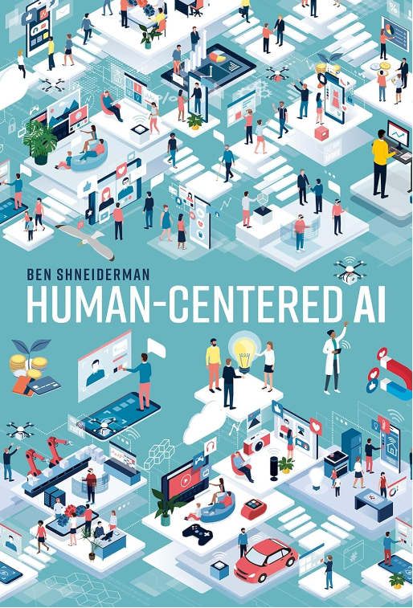
Human-Centered AI
HCAI framework guides designers to give users appropriate control while providing high levels of automation. When successful, these technologies amplify, augment, enhance, and empower users, increasing their performance.

Slide 96
HCAI: Six Grand Challenges
1
2
3
User Well-being
Responsible
Privacy
AI should prioritize human well-being and societal benefits.
AI systems should be created with ethical considerations and responsible design practices.
AI should maintain and protect individuals’ privacy rights.

Slide 97
HCAI: Six Grand Challenges
4
5
6
Human-Centered
Oversight
Human Cognition
AI should be developed with a focus on human needs and usability
AI should have frameworks for governance that align with human values and goals
AI should interact with humans in a way that respects their cognitive abilities and does not overwhelm or mislead them.

Slide 98
Reliable, Safe and Trustworthy AI
Reliability
Safety
Trustworthiness
Systems that produce expected responses when needed. Reliability comes from appropriate technical practices for engineering teams
it ensures that partnerships between people and automation are beneficial and do not lead to catastrophic outcomes.
Trustworthiness goes beyond mere trust; it indicates that an HCAI system deserves the trust of stakeholders

Slide 99
8 golden rules for HCAI
1 | Strive for consistency
2 | Seek universal usability
3 | Offer informative feedback
4 | Design dialogs to yield disclosure
5 | Prevent errors
6 | Permit easy reversal of actions
7 | Keep users in control
8 | Reduce short-term memory load

Slide 100
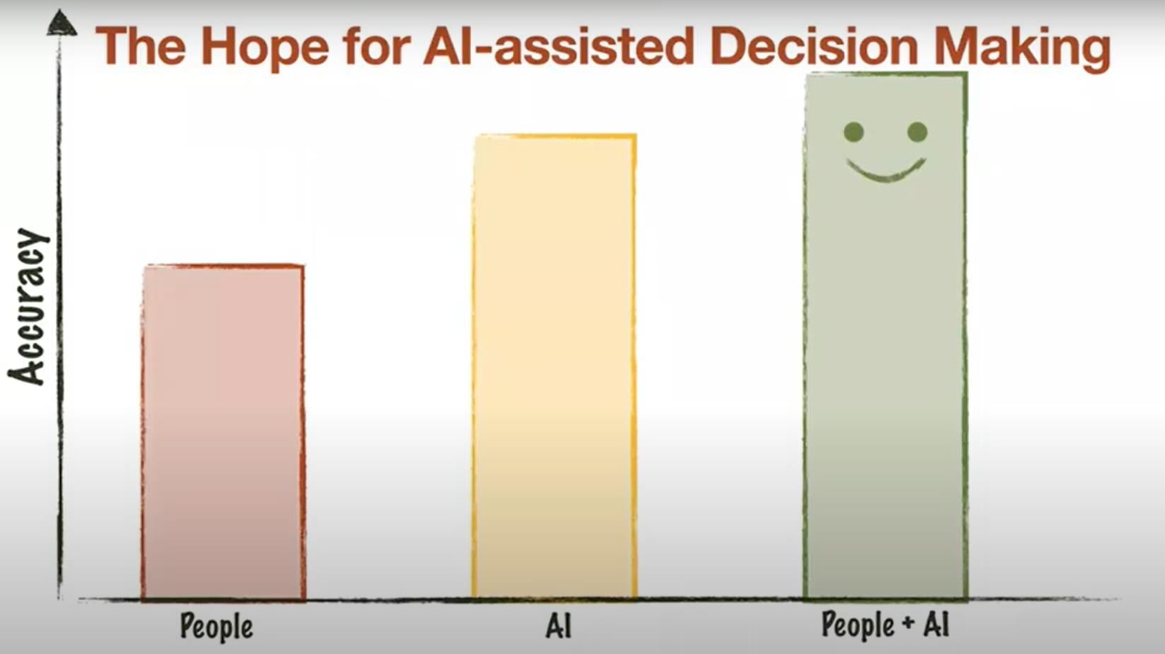
Gajos, K. Z., & Mamykina, L. (2022, March). Do people engage cognitively with AI? Impact of AI assistance on incidental learning. In Proceedings of the 27th International Conference on Intelligent User Interfaces (pp. 794-806).

Slide 101
1
HCAI framework shows the issue of human control on automation
2
Well-designed automation preserves human control where appropriate, thereby increasing performance and enabling creative improvements.
To Sum up
3
Human responsibility for mistakes push for design advancements such consistent informative feedback about machine state, and strategies to collect errors
Notes:
A human-centered system will be made better because of (1) improved reliability from sound software engineering practices, (2) safety culture through business management strategies, (3) trustworthy certification by independent oversight, and (4) regulation by government agencies
“The HCAI framework guides designers to give users appropriate control while providing high levels of automation. When successful, these technologies amplify, augment, enhance, and empower users, dramatically increasing their performance.” (Shneiderman, 2022, p. 81)
The HCAI framework separates the issue of human control from computer automation, making it clear that

Slide 102
Take aways
1
Understanding human decision making can give suggestion to design human centered algorithms
2
AI systems should be designed to support dynamic trust
3
AI systems should guarantee human control and an oversight on the decisional process
Notes:
The participants in our study, relied more on the suggestion when it is presented with an explanation.
From the open-ended questions, we got that participants were not satisfied with the information AI provided to them.
Thus, we conclude that there’s a really compelling evidence that even if people were not satisfied with the AI explanation presented, they implicitly moved towards it
Surprisingly, The use of explanation can be detrimental in terms of reliance even if it is considered as not pleasant.
Another interesting results from the collection of participants opinions is that participants think the AI as a replacement of human activity in medical field more than a companion. This aspect has a relevance in the acceptance of such systems.
Nevertheless, we tested the only scenario in which the suggestion was always correct. So we still do not kow how robust these results are in situations when AI makes incorrect recommendations and we are planning to run such experiments in the next future.

Slide 103
Thank you!
andrea.beretta@isti.cnr.it
Notes:
This project was developed inside the ERC Project XAI for decision making.
Thanks for the attention.

