Slide 1
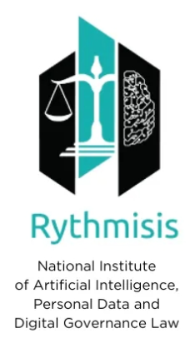
AI GOVERNANCE IN EUROPE: NAVIGATING THE AI ACT AND AI OFFICES, AND UPHOLDING EUROPEAN PRINCIPLES
CLASS 4
By Dr. Maria – Oraiozili Koutsoupia
AI Legal Expert, Qualified Lawyer
President of Rythmisis

Slide 2

INTRODUCTION – 4TH CLASS
AI ETHICS & EXPLAINABILITY
What are we discussing about today?

Slide 3

INTRODUCTION TO THE AI ETHICS – THE PROBLEMS
Source: https://www.techtarget.com/whatis/definition/AI-code-of-ethics

Slide 4

INTRODUCTION TO THE AI ETHICS
- AI HLEG: Ethics Guidance for Trustworthy AI
-Background: Published by the EU High-Level Expert Group on Artificial Intelligence (AI HLEG) on April 8, 2019. Follow-up to the draft from December 2018.Creates a conceptual framework for ethical AI.
-Piloting Phase: Starts in June 2019 to gather feedback. Evaluation by end of 2019.Update in 2020 after feedback.

Slide 5
KEY COMPONENTS OF TRUSTWORTHY AI
Trustworthy AI Defined:
Lawful: Compliance with applicable laws and regulations.
Ethical: Adherence to ethical principles and values.
Robust: Technically and socially resilient.
Key Change:
Introduction of "lawfulness" as a core component.
Recognition of AI's operation within existing legal frameworks (e.g., GDPR, consumer law).
Note: Each component is considered “necessary but not sufficient for the achievement of Trustworthy AI,” and as such all three should “work in harmony and overlap.”

Slide 6
KEY COMPONENTS OF TRUSTWORTHY AI
4 ethical principles that should apply to AI systems:
(1) respect for human autonomy;
(2) prevention of harm;
(3) fairness; and
(4) explicability.
The guidance states these principles might contradict each other. For instance, there may be a situation where prevention of harm (such as terrorism) may conflict with respect for human autonomy (such as privacy). As such, the guidance notes that while the four ethical principles offer some guidance towards solutions, they remain abstract prescriptions, and AI practitioners should approach ethical dilemmas “via reasoned, evidence-based reflection rather than intuition or random discretion”

Slide 7
AI ACT AND ETHICS (RECITAL 27)
While the risk-based approach is the basis for a proportionate and effective set of binding rules, it is important to recall the 2019 Ethics guidelines for trustworthy AI developed by the independent AI HLEG appointed by the Commission. In those guidelines, the AI HLEG developed seven non-binding ethical principles for AI which are intended to help ensure that AI is trustworthy and ethically sound.
The seven principles include human agency and oversight; technical robustness and safety; privacy and data governance; transparency; diversity, non-discrimination and fairness; societal and environmental well-being and accountability. Without prejudice to the legally binding requirements of this Regulation and any other applicable Union law, those guidelines contribute to the design of coherent, trustworthy and human-centric AI, in line with the Charter and with the values on which the Union is founded. According to the guidelines of the AI HLEG:
Human agency and oversight means that AI systems are developed and used as a tool that serves people, respects human dignity and personal autonomy, and that is functioning in a way that can be appropriately controlled and overseen by humans.
Technical robustness and safety means that AI systems are developed and used in a way that allows robustness in the case of problems and resilience against attempts to alter the use or performance of the AI system so as to allow unlawful use by third parties, and minimise unintended harm.
Privacy and data governance means that AI systems are developed and used in accordance with privacy and data protection rules, while processing data that meets high standards in terms of quality and integrity.

Slide 8
AI ACT AND ETHICS (RECITAL 27)
Transparency means that AI systems are developed and used in a way that allows appropriate traceability and explainability, while making humans aware that they communicate or interact with an AI system, as well as duly informing deployers of the capabilities and limitations of that AI system and affected persons about their rights.
Diversity, non-discrimination and fairness means that AI systems are developed and used in a way that includes diverse actors and promotes equal access, gender equality and cultural diversity, while avoiding discriminatory impacts and unfair biases that are prohibited by Union or national law.
Social and environmental well-being means that AI systems are developed and used in a sustainable and environmentally friendly manner as well as in a way to benefit all human beings, while monitoring and assessing the long-term impacts on the individual, society and democracy.
The application of those principles should be translated, when possible, in the design and use of AI models. They should in any case serve as a basis for the drafting of codes of conduct under this Regulation. All stakeholders, including industry, academia, civil society and standardisation organisations, are encouraged to take into account, as appropriate, the ethical principles for the development of voluntary best practices and standards.

Slide 9
EXAMPLES OF “ETHICAL” AI APPLICATIONS & REGULATIONS IN MEMBER STATES
-For instance, the Slovenian Ministry of Finance uses a machine-learning system to detect tax evasion and tax fraud. In Belgium, the police are using a predictive algorithm to predict car robberies. In Poland, this technology is used to profile unemployed people and decide upon the, type of assistance appropriate for them.
-France: from March 2018, the French AI strategy sets out as one of its core principles the requirement that AI technologies must be explainable to be socially acceptable. To that end, the government is required to: put in place several policies in order to develop algorithm transparency and audits; include ethics in training for AI engineers and researchers; carry out a discrimination impact assessment (to encourage AI designers to consider the social implications of the algorithms they produce); and ensure that the principle of human responsibility is applied (e.g. by setting boundaries for the use of predictive algorithms in the law enforcement context). Furthermore, it is proposed that a consultative ethics committee for digital technologies and AI be set up for the purpose of organising a public debate in this field.
-Germany: the ethics-related debate was initially driven by sector-specific industry interests, and resulted in the adoption in June 2017 of a set of ethical rules for automated and connected vehicular traffic by the Transport Ministry's Ethics Commission. In November 2018, the national AI strategy was launched, setting out a range of measures on ethics. For instance, the document advocates using an 'ethics by, in and for design' approach for all development stages and uses of AI. It pledges to promote research into novel ways for pseudonymising and anonymising data and for differential privacy. Furthermore, the federal government will review whether the German AI related legal framework covers all aspects related to algorithm-based and AI-based decisions, services and products and, if necessary, adapt it in order to make it possible to verify whether there is any undue discrimination or bias.
Source: EPRS_BRI(2019)640163_EN

Slide 10
AI ETHICS & STANDARDIZATION
The joint technical committee of the International Organization for Standardization (ISO) and the International Electrotechnical Commission (IEC) is working on developing standards to ensure trustworthiness in AI technology from the outset. Expert working groups are considering how to technically achieve AI systems' robustness, resiliency, reliability, accuracy, safety, security and privacy.
Another leading standardisation organisation, the Institute of Electrical and Electronics Engineers (IEEE) published in 2019 an ethical framework setting out more than 100 ethical issues and recommendations to serve as a reference for policy-makers, engineers, developers and companies deploying, selling and using AI systems. In practice, the IEEE seeks to develop specific industry standards and processes – related to transparency, accountability, and algorithmic bias – for the certification of AI systems.
Source: EPRS_BRI(2019)640163_EN

Slide 11

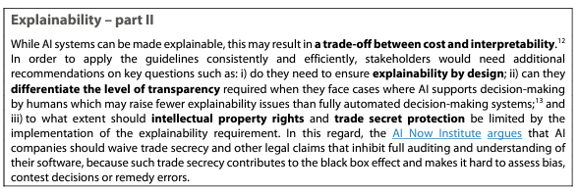
EXPLAINABILITY & ETHICS
Source: EPRS_BRI(2019)640163_EN

Slide 12
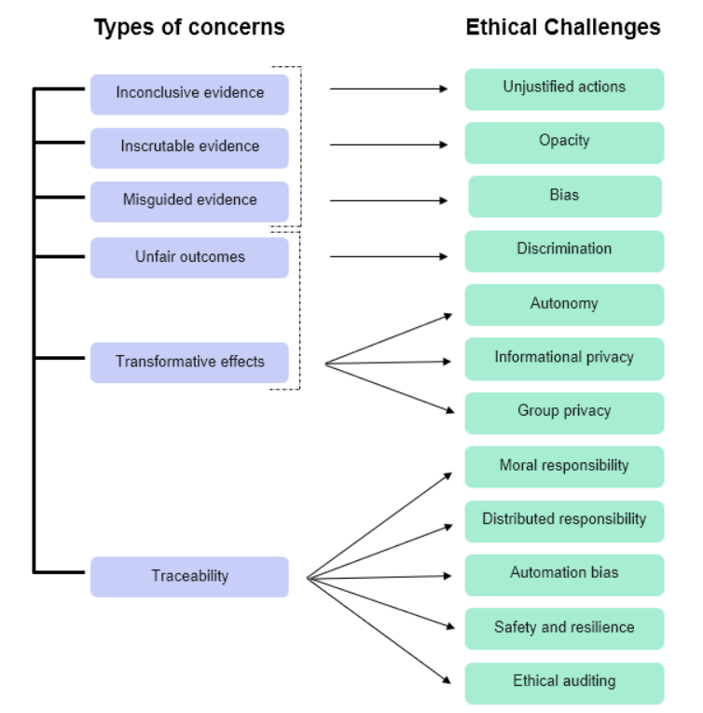

ASIMOV LAWS AS AN AI ETHICS BASIS – USUAL CONCERNS
Source: https://www.yatesweb.com/chatgpt-and-the-ethics-of-ai/ and https://www.coe.int/en/web/bioethics/common-ethical-challenges-in-ai

Slide 13

ETHICAL DILEMMAS – SCENARIOS (1)
Autonomous Vehicles and Decision-Making
Scenario:
Imagine a situation where an autonomous vehicle (AV) must make a decision in an unavoidable accident scenario. The AV can either:
Continue on its path, hitting a group of pedestrians crossing the road.
Swerve to the side, hitting a single pedestrian on the sidewalk.
Discussion Points:
Ethical Principles Involved:
  Prevention of Harm: Which action minimizes overall harm?
  Fairness: Is it fair to sacrifice one life to save many?
  Respect for Human Autonomy: Should the AV have the right to make life-and-death decisions?
  Image Source: https://www.alamy.com/

Slide 14
ETHICAL DILEMMAS – SCENARIOS – SOLUTION (1)
Potential Solutions:
Utilitarian Approach: Choose the action that results in the least overall harm (swerve to hit one pedestrian).
Deontological Approach: Adhere to a rule that does not permit intentionally causing harm to any individual (continue straight, as swerving would be an intentional action to harm the single pedestrian).
Consensus and Regulation: Develop and follow strict ethical guidelines and regulatory frameworks that dictate the AV’s actions in such scenarios.
Image Source: https://www.alamy.com/

Slide 15

ETHICAL DILEMMAS – SCENARIOS (2)
AI in Hiring Practices
Scenario:
TechCorp, a large technology company, has implemented an AI-driven hiring system to screen job applicants for software engineering positions. The AI system analyzes resumes, cover letters, and online assessments to identify the most suitable candidates for interviews. However, after several months of using the system, the HR department notices that the AI disproportionately rejects candidates with ethnic-sounding names and those from historically black colleges and universities (HBCUs). An internal review reveals that the AI was trained on historical hiring data from TechCorp, which had inherent biases favoring candidates from certain demographics and educational backgrounds.
Image source:https://oorwin.com/blog/the-role-of-ai-in-recruitment.html

Slide 16
ETHICAL DILEMMAS – SCENARIOS (2)
Facts:
TechCorp's Historical Data: The training data included resumes and hiring outcomes from the past decade, during which there was an unintentional bias against certain ethnic groups and educational institutions.
Disproportionate Rejection: Candidates with ethnic-sounding names and from HBCUs are being rejected at higher rates compared to other candidates.
Legal and Ethical Implications: The company faces potential discrimination claims and ethical concerns regarding fairness and equality in hiring practices.
Discussion Points:
Fairness: Is the AI system treating all candidates equally, or is it perpetuating historical biases?
Transparency: Can TechCorp explain how the AI makes its decisions? Is the decision-making process of the AI transparent and understandable?
Accountability: Who is responsible for the biases in the AI system—the developers, the HR department, or the company as a whole?

Slide 17
ETHICAL DILEMMAS – SCENARIOS - SOLUTION (2)
Potential Solutions:
Bias Mitigation:
  Data Auditing: Regularly audit the training data and AI decisions to identify and correct biases.
  Bias Correction Algorithms: Implement algorithms specifically designed to counteract bias in the training data.
Human Oversight:
  Review Process: Introduce a human review process where HR professionals can review and override AI decisions, especially for candidates from underrepresented groups.
  Ethics Committee: Establish an ethics committee to oversee the AI’s performance and ensure it aligns with the company's values and diversity goals.
Diverse Training Data:
  Inclusive Data Collection: Use a more diverse set of training data, ensuring it includes resumes and hiring outcomes from a broad range of demographic groups and educational institutions.
  Continuous Improvement: Continuously update the training data to reflect current hiring practices and societal changes.
Regular Audits and Updates:
  Periodic Audits: Conduct regular audits of the AI system’s decisions to ensure fairness and transparency.
  Ongoing Training: Continuously train the AI system with new data to adapt to changing societal norms and reduce biases.

Slide 18
EXPLAINABILITY: AI ACT
Article 13 par.3. The instructions for use shall contain at least the following information:
a)the identity and the contact details of the provider and, where applicable, of its authorised representative;
b)the characteristics, capabilities and limitations of performance of the high-risk AI system, including:
(i)ts intended purpose;
(iv)where applicable, the technical capabilities and characteristics of the high-risk AI system to provide information that is relevant to explain its output; [..]

Slide 19

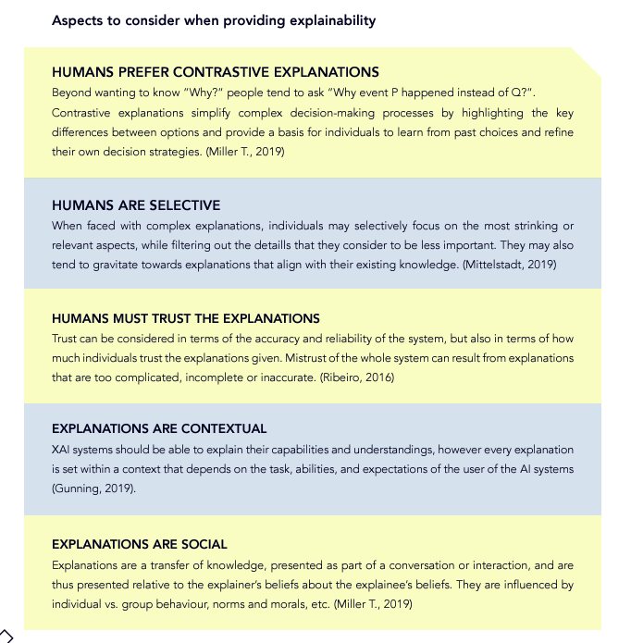
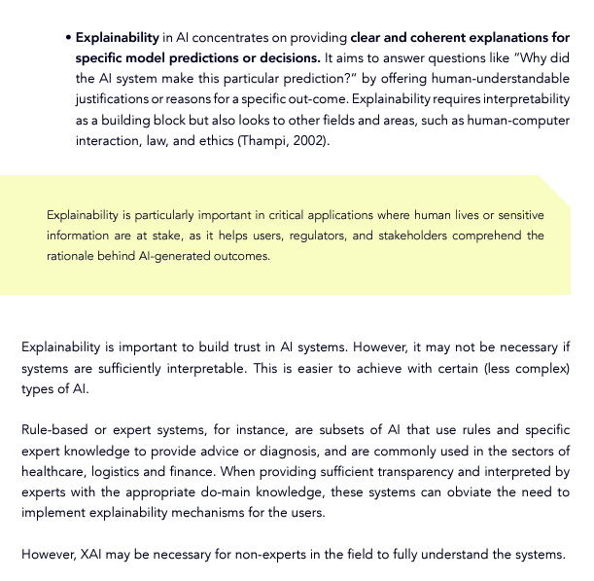
EXPLAINABILITY: THE EU TAKE

Slide 20
EXPLAINABILITY: THE EU TAKE
“To be trustworthy, AI should be, amongst others, transparent, accountable and ethical, and explainable AI can play an important role in meeting these specific requirements.
From the perspective of the EDPS, the concept of XAI embodies the commitment to develop ‘human-centred’ AI. By explaining the “why” behind AI decisions, it enables individuals to participate in the digital landscape in a meaningful way, for example by filing complaints if their rights are violated by AI-driven decisions. XAI empowers individuals with understandable insights into how their personal data is being handled by revealing the rationale behind AI decisions. The transparency provided by XAI not only strengthens trust between organisations and users, but is also in line with core data protection principles. In addition, XAI would enable data subjects to identify and challenge unfair decisions, thereby enhancing fairness in decision-making, promoting equal treatment and the principle of nondiscrimination. But, XAI is not just a step towards transparency, it is a leap towards bridging the gap between machine-driven processes and the human search for justification, trust, and fairness. The role of XAI goes beyond mere explanation; it embodies the recognition that human understanding, ethical judgement and empathetic consideration are integral facets in the use of AI technologies. The human dimension remains essential. As we embrace the transformative potential of artificial intelligence, it is crucial to remember that the use of AI systems can have profound consequences on individuals as well as on society as a whole. In this context, AI goes beyond technology to combine AI’s potential with human need for understanding, responsibility and ethical oversight. The adoption of XAI contributes to a future where AI should be defined not only by its technical capabilities, but also by humanity’s collective responsibility to uphold human rights, ethics, and accountability.”

Slide 21

ANY QUESTIONS?
Thank you!
Dr. Maria – Oraiozili Koutsoupia

