Slide 1
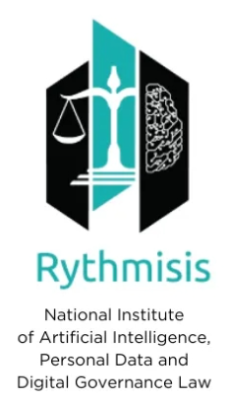
AI GOVERNANCE IN EUROPE: NAVIGATING THE AI ACT AND AI OFFICES, AND UPHOLDING EUROPEAN PRINCIPLES
CLASS 2
By Dr. Maria – Oraiozili Koutsoupia
AI Legal Expert, Qualified Lawyer
President of Rythmisis

Slide 2

INTRODUCTION – 2ND CLASS
HIGH-RISK AI SYSTEMS AND COMPLIANCE
What are we discussing about today?

Slide 3
INTRODUCTION TO HIGH-RISK AI SYSTEMS
High-risk AI systems are those that pose significant risks to the health, safety, and fundamental rights of individuals or society.
Examples include autonomous vehicles, medical diagnostic tools, and biometric identification systems.

Slide 4
IMPORTANCE OF COMPLIANCE
Compliance ensures the safe and ethical use of AI, protecting users and developers.
Non-compliance can lead to severe penalties, legal actions, and damage to reputation.

Slide 5
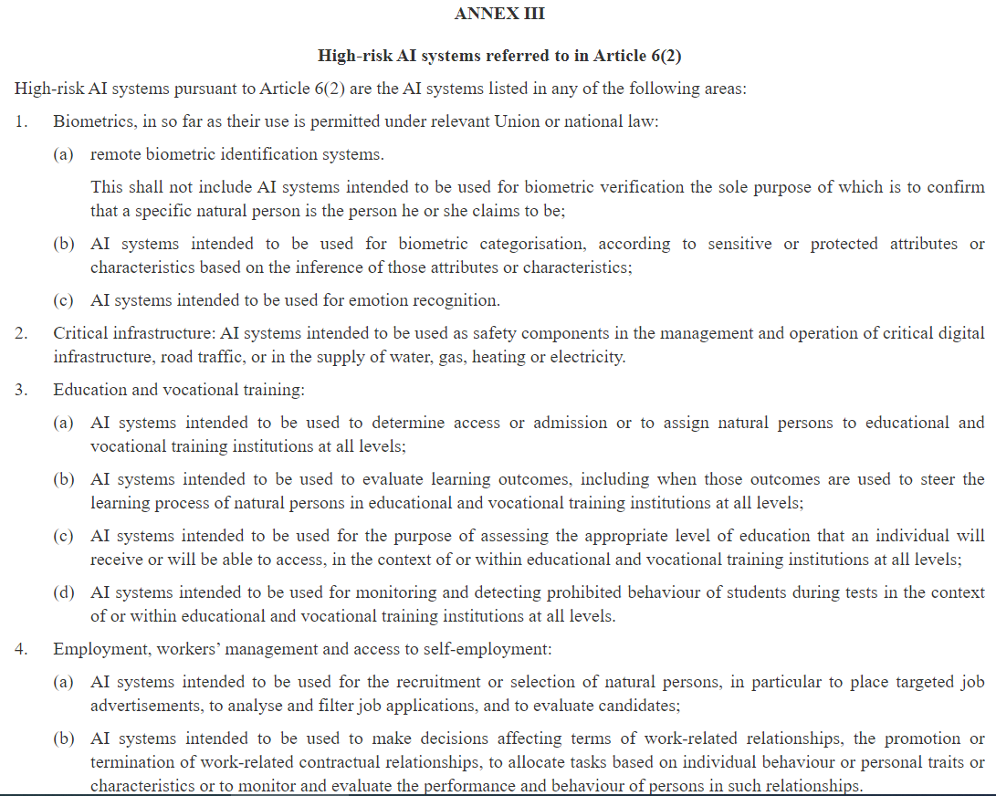
HIGH-RISK AI SYSTEMS -CRITERIA
Condition 1: AI as a Safety Component or Product
AI systems intended as integral safety components of products or standalone products covered by Union harmonization legislation listed in Annex I are classified as high-risk.
Condition 2: Requirement for Third-Party Conformity Assessment:
AI systems must undergo a third-party conformity assessment as mandated by Union harmonization legislation in Annex I. Ensures they meet stringent safety and ethical standards before market introduction.
Additional Criteria under Annex III: Annex III provides supplementary criteria for identifying high-risk AI systems. Criteria include specific use-cases and risk mitigation factors.

Slide 6
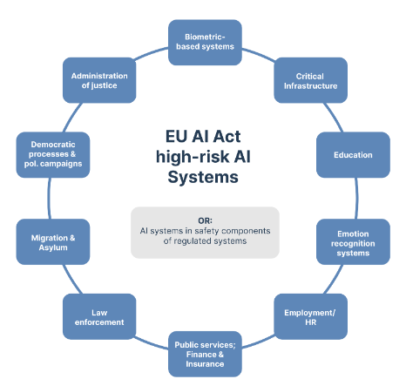
AI ACT: HIGH-RISK AI SYSTEMS
CRITERIA OF CLASSIFICATION
-Article 6 of the EU AI Act sets criteria for classifying AI systems as high-risk.
-Criteria are based on their role as safety components or products and the requirement for third-party conformity assessments.
Source: https://www.trail-ml.com/blog/eu-ai-act-how-risk-is-classified

Slide 7
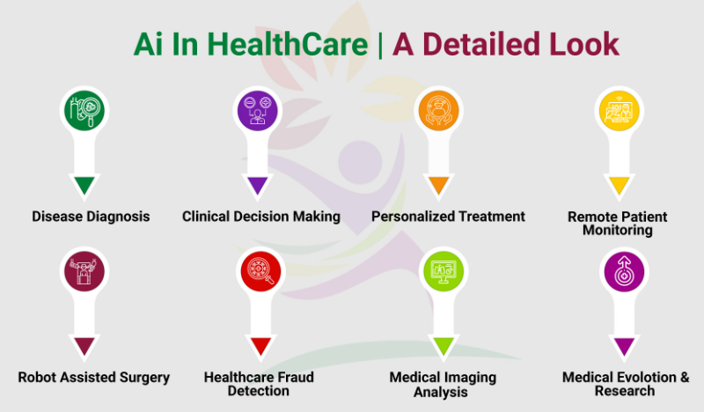

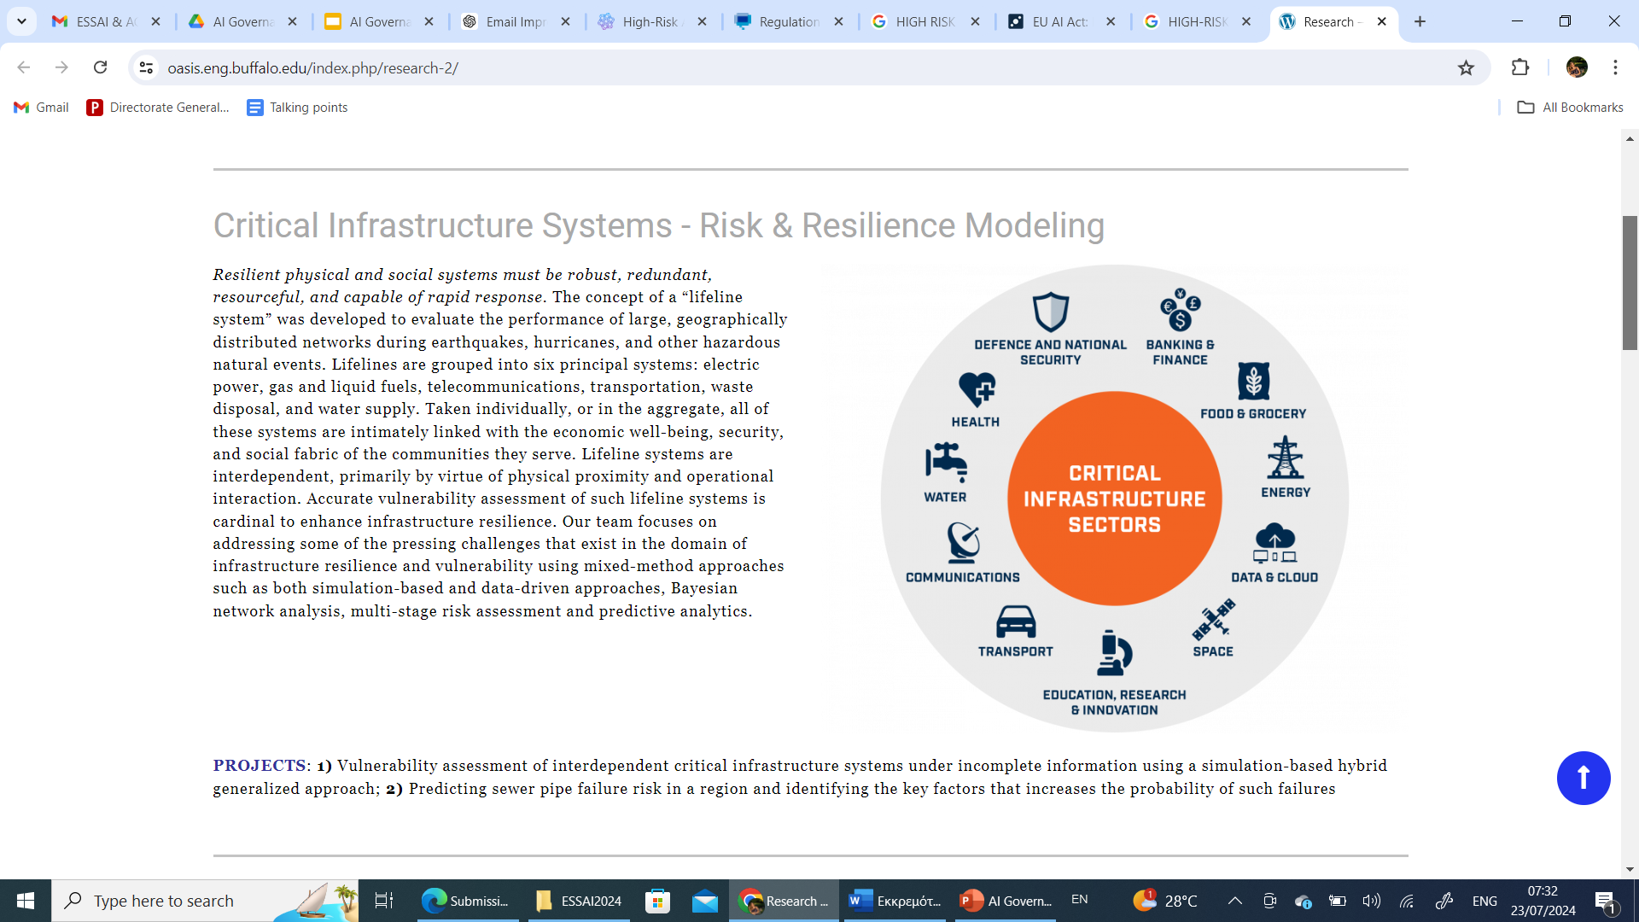
HIGH-RISK AI SYSTEMS
- EXAMPLES
Healthcare Systems: AI used in medical diagnosis, treatment recommendations, and patient care monitoring.
Transportation Systems: Autonomous vehicles and AI-driven traffic management systems.
Critical Infrastructure: AI systems controlling energy distribution, water supply, and telecommunications networks.
Sources: https://oasis.eng.buffalo.edu/index.php/research-2/
https://fitwellhub.pk/uses-of-ai-in-healthcare/

Slide 8
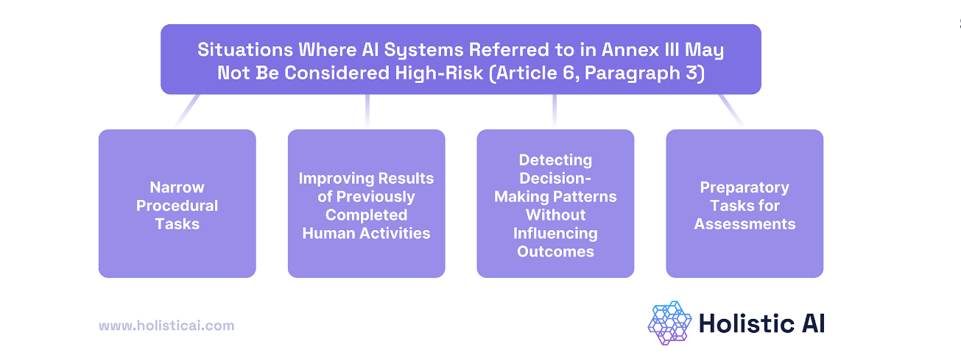
EXCEPTIONS FROM HIGH-RISK AI SYSTEMS
Risk Mitigation Factors in Annex III
  AI systems may be exempt from high-risk classification if they do not pose significant risks.
  Factors include the nature of tasks, autonomy levels, and impact on decision-making. (Article 6, Paragraph 3)

Slide 9

EXCEPTIONS FROM HIGH-RISK AI SYSTEMS - DOCUMENTATION
🡪 The provider who considers that an AI system is not high-risk on the basis of the conditions referred to above should draw up documentation of the assessment before that system is placed on the market or put into service and should provide that documentation to national competent authorities upon request.
🡪 Such a provider should be obliged to register the AI system in the EAU database established under this Regulation. With a view to providing further guidance for the practical implementation of the conditions under which the AI systems listed in an annex to this Regulation are, on an exceptional basis, non-high-risk, the Commission should, after consulting the Board, provide guidelines specifying that practical implementation, completed by a comprehensive list of practical examples of use cases of AI systems that are high-risk and use cases that are not.

Slide 10
OBLIGATIONS FOR HIGH-RISK AI PROVIDERS – RISK MANAGEMENT SYSTEM (ARTICLE 9)
The risk management system shall be understood as a continuous iterative process planned and run throughout the entire lifecycle of a high-risk AI system, requiring regular systematic review and updating. It shall comprise the following steps:
the identification and analysis of the known and the reasonably foreseeable risks that the high-risk AI system can pose to health, safety or fundamental rights when the high-risk AI system is used in accordance with its intended purpose;
the estimation and evaluation of the risks that may emerge when the high-risk AI system is used in accordance with its intended purpose, and under conditions of reasonably foreseeable misuse;
the evaluation of other risks possibly arising, based on the analysis of data gathered from the post-market monitoring system referred to in Article 72;
the adoption of appropriate and targeted risk management measures designed to address the risks identified pursuant to point (a).

Slide 11
OBLIGATIONS FOR HIGH-RISK AI PROVIDERS – TESTING (ARTICLE 9)
High-risk AI systems shall be tested for the purpose of identifying the most appropriate and targeted risk management measures. Testing shall ensure that high-risk AI systems perform consistently for their intended purpose and that they are in compliance with the requirements set out in this Section.
Testing procedures may include testing in real-world conditions in accordance with Article 60.
The testing of high-risk AI systems shall be performed, as appropriate, at any time throughout the development process, and, in any event, prior to their being placed on the market or put into service. Testing shall be carried out against prior defined metrics and probabilistic thresholds that are appropriate to the intended purpose of the high-risk AI system.

Slide 12
OBLIGATIONS FOR HIGH-RISK AI PROVIDERS
🡪 Ensure regulatory compliance, transparency, and mitigation of adverse impacts.
Documentation and Assessment Requirements: Providers must conduct thorough risk assessments and document system functionalities, data processing methods, and potential risks.
Providers must register their high-risk AI systems with competent authorities before deployment. Submit detailed documentation and assessment reports to facilitate transparency and regulatory oversight.
Providers must comply with EU AI Act guidelines, ensuring ethical and legal conformity of their AI systems.

Slide 13
OBLIGATIONS FOR HIGH-RISK AI PROVIDERS
🡪 Ensure regulatory compliance, transparency, and mitigation of adverse impacts.
Documentation and Assessment Requirements: Providers must conduct thorough risk assessments and document system functionalities, data processing methods, and potential risks.
Providers must register their high-risk AI systems with competent authorities before deployment. Submit detailed documentation and assessment reports to facilitate transparency and regulatory oversight.
Providers must comply with EU AI Act guidelines, ensuring ethical and legal conformity of their AI systems.

Slide 14
OBLIGATIONS FOR HIGH-RISK AI PROVIDERS - DATA
Data and Data Governance Requirements for High-Risk AI Systems
General Requirement: High-risk AI systems must use training, validation, and testing data sets that meet specified quality criteria (paragraphs 2 to 5).
Data Governance and Management Practices: Data governance and management practices must be appropriate for the high-risk AI system's intended purpose, covering: Design choices, Data collection processes and origin, especially the original purpose for personal data, Data-preparation processes: annotation, labelling, cleaning, updating, enrichment, aggregation Formulation of assumptions about what data measures and represents, Assessment of data availability, quantity, and suitability, Bias examination and potential impacts on health, safety, and rights, Measures to detect, prevent, and mitigate biases, Identification of data gaps and shortcomings and how to address them
Data Quality: Data sets must be:
Relevant and representative, Free of errors and complete, Possess appropriate statistical properties for the intended purpose. These criteria can apply to individual data sets or a combination thereof.

Slide 15
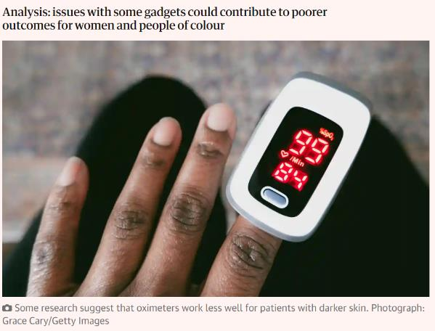
OBLIGATIONS FOR HIGH-RISK AI PROVIDERS - DATA
Data and Data Governance Requirements for High-Risk AI Systems
Contextual Relevance
Data sets must consider specific characteristics of the geographical,
contextual, behavioural, or functional settings for their intended use.
Processing of Special Categories of Personal Data
Special categories of personal data may be processed to detect and correct biases if:
  No alternative data can achieve the bias detection and correction
  Data is subject to strict technical limitations, security measures, and confidentiality
  Data is not shared with other parties and is deleted after use
  Records of processing activities justify the necessity of using special categories of data

Slide 16
DATA QUALITY & MANAGEMENT
High-quality data is essential for training, validating, and testing AI systems. Ensures AI systems perform as intended and safely, avoiding discrimination and biases.
High-quality data sets should be relevant, representative, free of errors, and complete, with appropriate statistical properties to mitigate biases.
Providers should use third parties offering certified compliance services. These services verify data governance, integrity, and data training, validation, and testing practices.

Slide 17
DATA QUALITY & MANAGEMENT (PERSONAL DATA)
-The right to privacy and data protection (next class) must be guaranteed throughout the AI system's lifecycle, adhering to principles of data minimisation and data protection by design and by default.
-Data governance and management practices should include transparency about the original purpose of data collection, especially for personal data.
-Measures may include anonymisation, encryption, and technology that allows algorithms to be brought to the data.

Slide 18
DATA QUALITY & MANAGEMENT (PERSONAL DATA)
-The right to privacy and data protection (next class) must be guaranteed throughout the AI system's lifecycle, adhering to principles of data minimisation and data protection by design and by default.
-Data governance and management practices should include transparency about the original purpose of data collection, especially for personal data.
-Measures may include anonymisation, encryption, and technology that allows algorithms to be brought to the data.

Slide 19
ROBUSTNESS & HUMAN OVERSIGHT
Human Oversight (Article 14)
Systems must allow effective human oversight to prevent or minimize risks.
Oversight measures should:
  Enable understanding of system capabilities and limitations
  Address automation bias
  Facilitate proper interpretation and intervention
  Include a 'stop' button or similar emergency procedures
Accuracy, Robustness, and Cybersecurity (Article 15)
Systems must maintain high levels of accuracy, robustness, and cybersecurity throughout their lifecycle.
Accuracy metrics and performance must be declared in the instructions for use.
Systems must be resilient to errors and secure against unauthorized alterations.
Continuous learning systems must avoid feedback loops that introduce bias.

Slide 20
THE ROLE OF THE EUROPEAN COMMISSION
The European Commission updates high-risk AI classifications in Annex III by defining criteria for adding or modifying high-risk AI classifications.
Ensures alignment with technological advancements and accurate regulatory oversight through criteria-based assessments and transparent delegated acts.
The Commission evaluates AI system purpose, data processing capabilities, and potential impacts.
Criteria for Removing AI Systems from the High-Risk List: AI systems are removed from the high-risk list if they no longer pose significant risks. Based on comprehensive impact assessments and regulatory criteria to balance safety with innovation.

Slide 21
THE ROLE OF THE EUROPEAN COMMISSION
The European Commission updates high-risk AI classifications in Annex III by defining criteria for adding or modifying high-risk AI classifications.
Ensures alignment with technological advancements and accurate regulatory oversight through criteria-based assessments and transparent delegated acts.
The Commission evaluates AI system purpose, data processing capabilities, and potential impacts.
Criteria for Removing AI Systems from the High-Risk List: AI systems are removed from the high-risk list if they no longer pose significant risks. Based on comprehensive impact assessments and regulatory criteria to balance safety with innovation. Delegated Acts can be used for this purpose.
Delegated acts allow the Commission to update regulatory frameworks swiftly. Involve transparent procedures, including public consultations and expert input, to respond to technological developments and emerging risks.

Slide 22

REGULATORY SANDBOXES
Establishment and Operation:
National AI Regulatory Sandboxes:
  Each Member State must establish at least one by August 2, 2026.
  Can be established jointly with other Member States.
  Participation in existing sandboxes is allowed if they provide equivalent national coverage.
Additional Sandboxes:
  Can be regional, local, or established jointly with other Member States.
EU-Level Sandboxes:
  European Data Protection Supervisor can establish sandboxes for EU institutions.

Slide 23
REGULATORY SANDBOXES
Resources and Cooperation:
Allocation of Resources:
  Sufficient resources must be allocated for effective and timely operation.
Cooperation:
  Authorities should cooperate and may involve other actors in the AI ecosystem.
Controlled Environment:
Innovation and Testing:
  Provide a controlled environment for developing, testing, and validating AI systems.
Guidance and Support:
  Authorities provide guidance, supervision, and support to identify and mitigate risks.

Slide 24
AI REGULATORY SANDBOXES - KEY FEATURES AND OBJECTIVES
Key Features:
Guidance and Exit Reports:
  Authorities offer guidance on regulatory expectations.
  Providers receive written proof and exit reports detailing sandbox activities and results.
Access and Transparency:
  Sandboxes should ensure broad and equal access, especially for SMEs and start-ups.
  Procedures for application and participation must be simple and transparent.
Objectives:
Legal Certainty:
  Improve legal certainty to achieve regulatory compliance.
Best Practices:
  Support sharing of best practices through cooperation.
Innovation and Competitiveness:
  Foster innovation and competitiveness, developing an AI ecosystem.

Slide 25
AI REGULATORY SANDBOXES - KEY FEATURES AND OBJECTIVES
Regulatory Learning:
  Contribute to evidence-based regulatory learning.
Market Access:
  Facilitate and accelerate access to the Union market, especially for SMEs.
Data Protection and Ethics:
Personal Data Processing:
  Conditions for processing personal data for public interest AI systems.
Real-World Testing:
  High-risk AI systems can be tested under strict conditions and approvals.
Coordination and Reporting:
Coordination:
  National authorities coordinate activities and cooperate within the Board framework.
Annual Reports:
  Authorities submit annual reports on sandbox progress, including best practices and recommendations.

Slide 26
AI ACT & RESEARCH
Key Points:
Support for Innovation:
  Regulation supports innovation and respects scientific freedom.
  AI ACT excludes AI systems developed solely for scientific research and development from its scope.
Scope Exclusions:
  Scientific Research: AI systems developed for research and development are excluded until they are placed on the market or put into service.
  Product-Oriented Development: Regulations do not apply to AI systems/models in testing and development stages until market-ready.
Obligations:
  Compliance: General-purpose AI model providers must comply proportionately based on the model type. Non-professional or scientific researchers are encouraged to voluntarily comply but are not required to.
  Market Readiness: AI systems must comply with the regulation once marketed or put into service.
  Testing: Testing in real-world conditions is not covered by exclusions.

Slide 27

AI ACT & RESEARCH
Key Points:
AI Regulatory Sandboxes:
  Facilitation: Involve various actors (e.g., notified bodies, SMEs, start-ups, research labs, European Digital Innovation Hubs) to foster cooperation across public and private sectors.
General Requirements:
  All research and development activities must follow recognized ethical standards and applicable Union law.

Slide 28

SANCTIONS IN CASE OF NON - COMPLIANCE

Slide 29
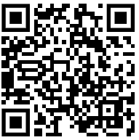
ANY QUESTIONS?
Thank you!
Dr. Maria – Oraiozili Koutsoupia

